Slide 1
Fireside Talk
John Hathaway & Ronald Stoeferle
Precious Metals Summit Beaver Creek, 2024
“The greatest danger in times of turbulence is not the turbulence.
It is to act with yesterday’s logic.”
Peter Drucker
Notes:
Good afternoon, ladies and gentlemen.
Small changes can have a big impact.
Did you know that until the 15th century, The queen, was imited to only moving one square diagonally. But then a major rule change transformed the game of chess.
In the new rulebook, the queen was granted the ability to move any number of squares diagonally, vertically, or horizontally, making her the most powerful piece on the chess board.
This shift forced players to rethink their strategies and adapt to a new playbook.
Similarly, significant changes are happening in the gold market. The rules are evolving, and in the next minutes, we’ll explore these fundamental shifts and introduce the new gold playbook.

Slide 2
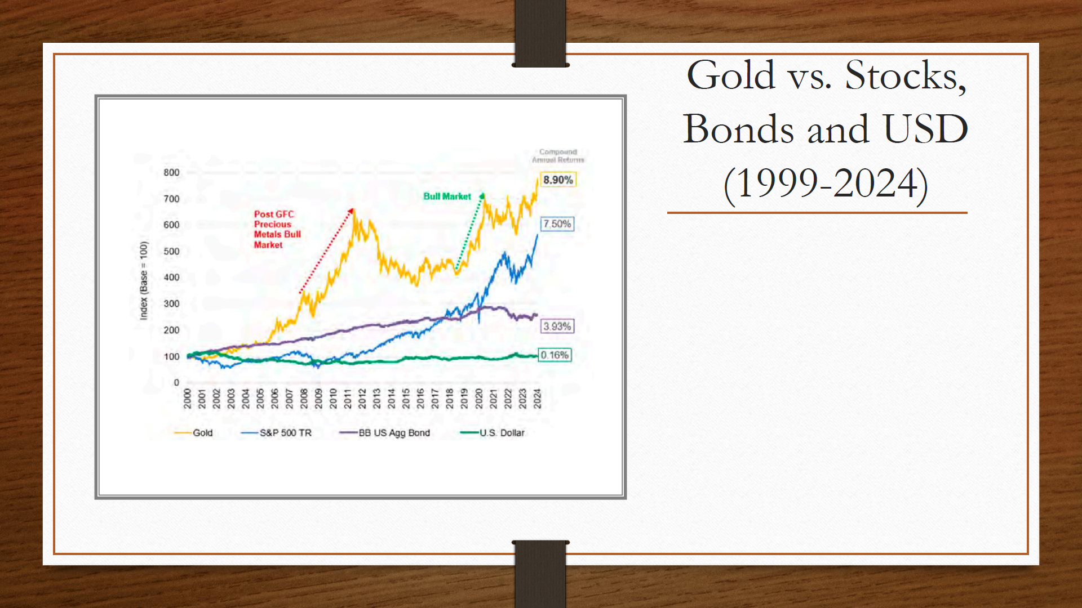

Slide 3
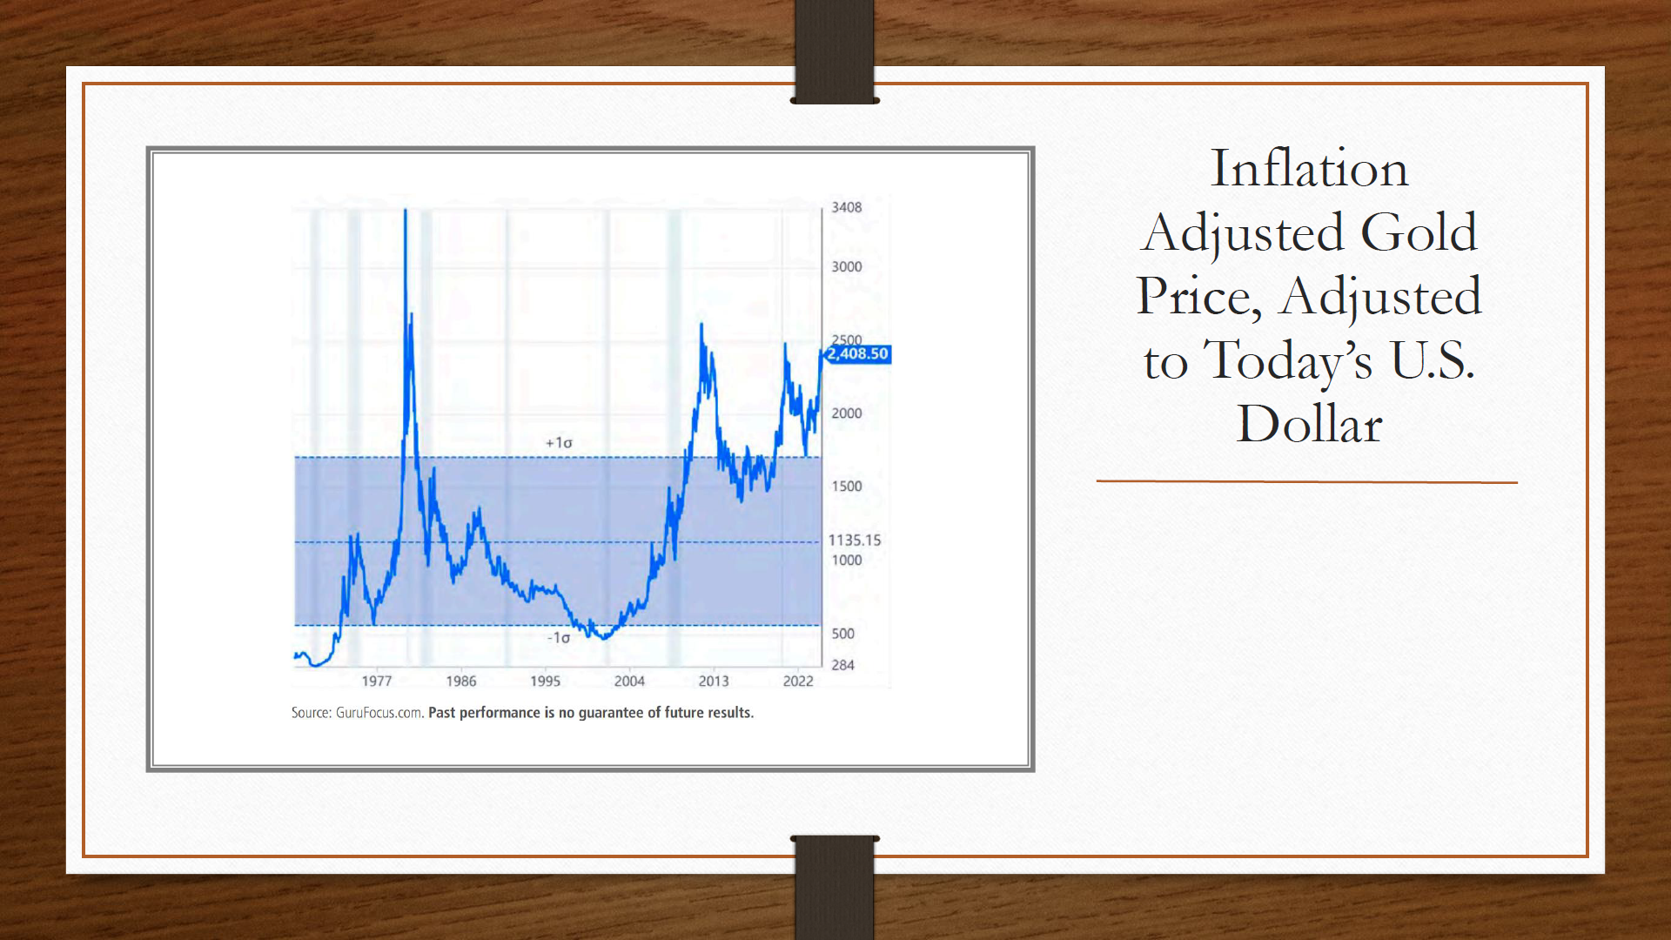

Slide 4
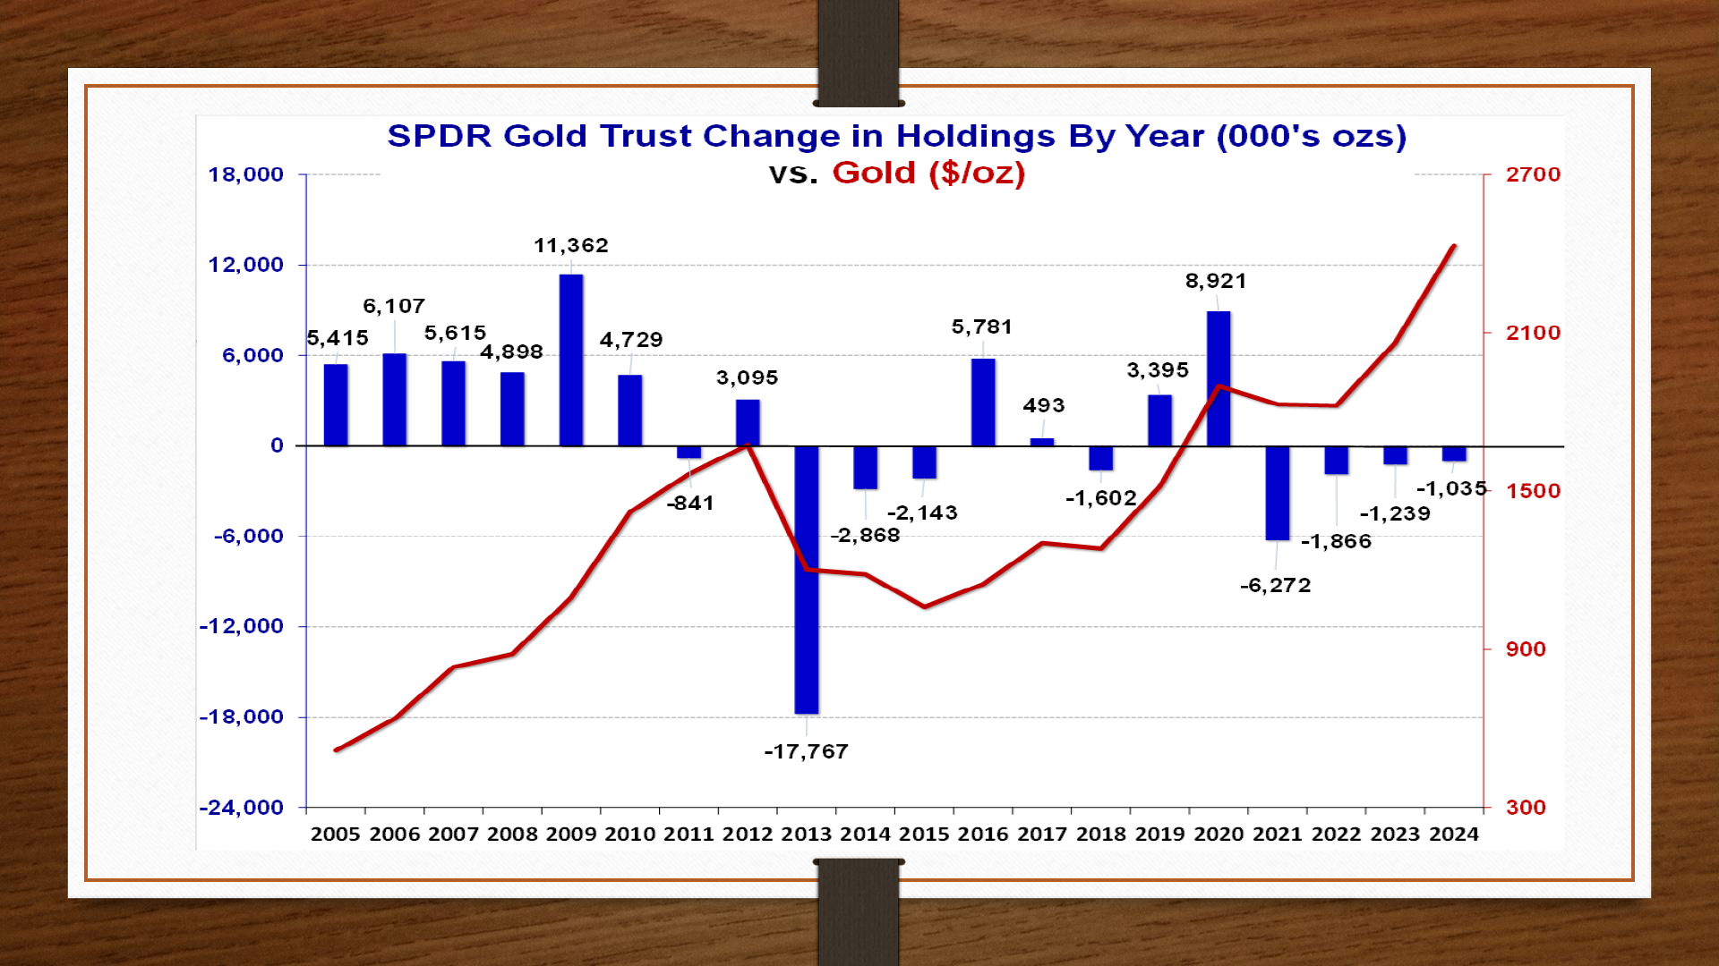

Slide 5
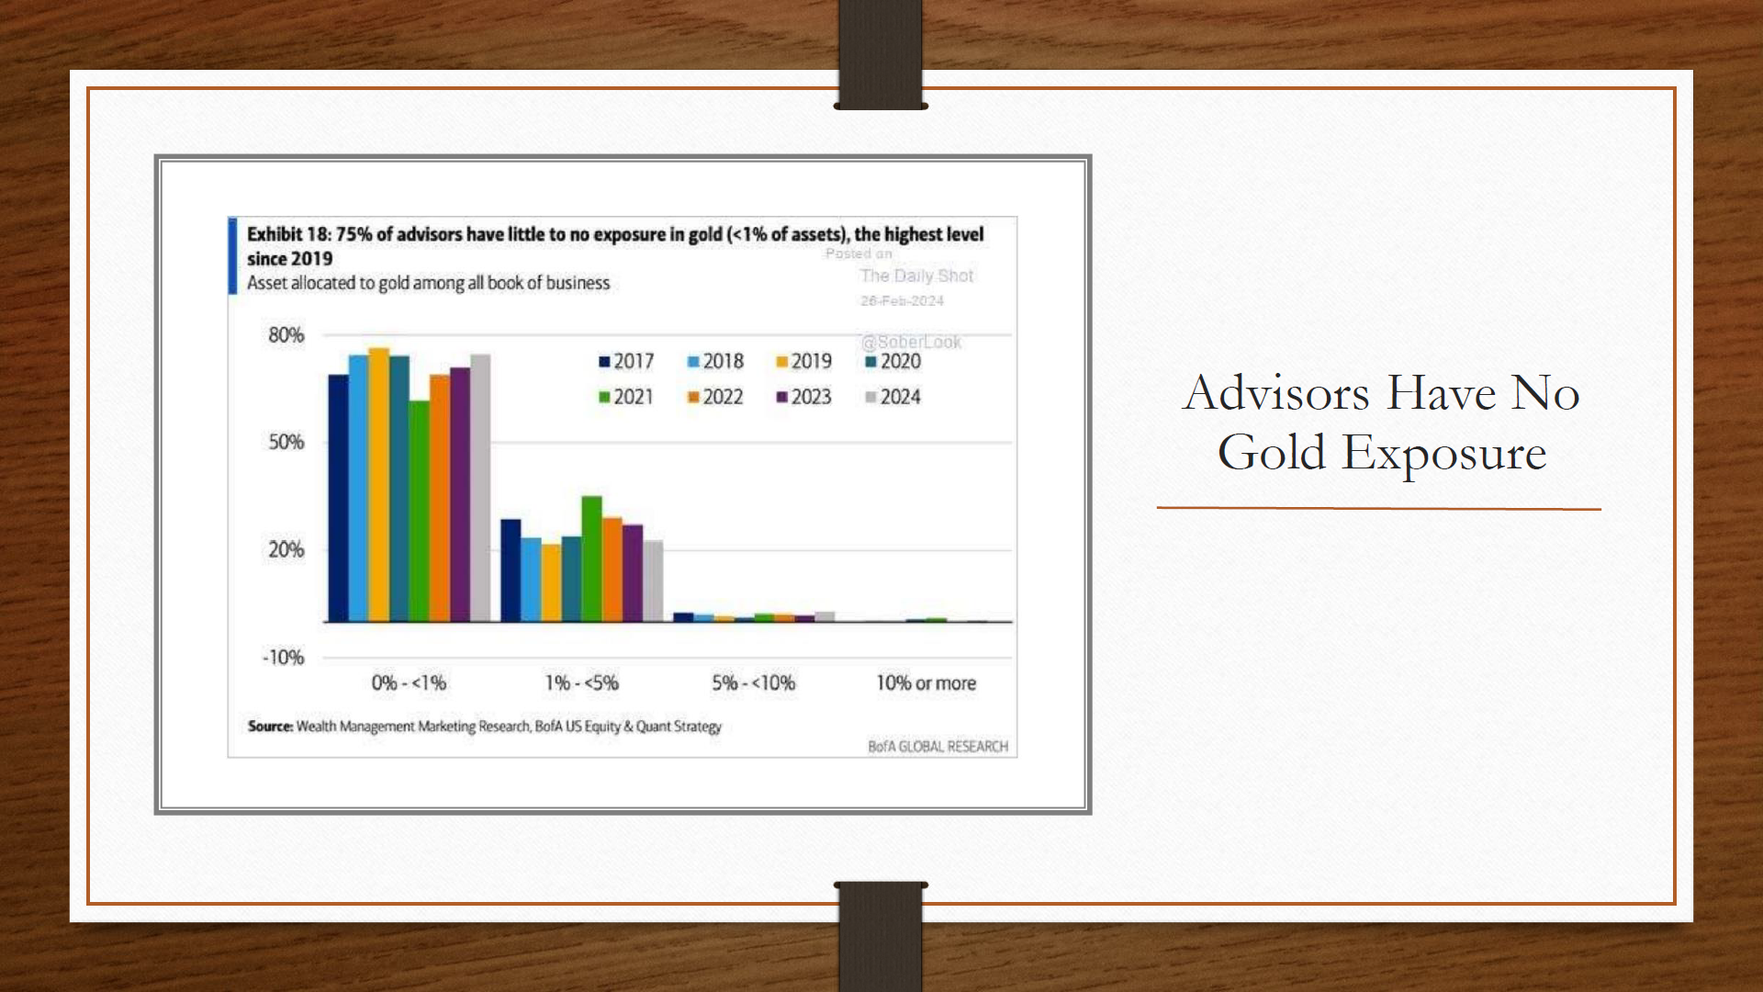

Slide 6
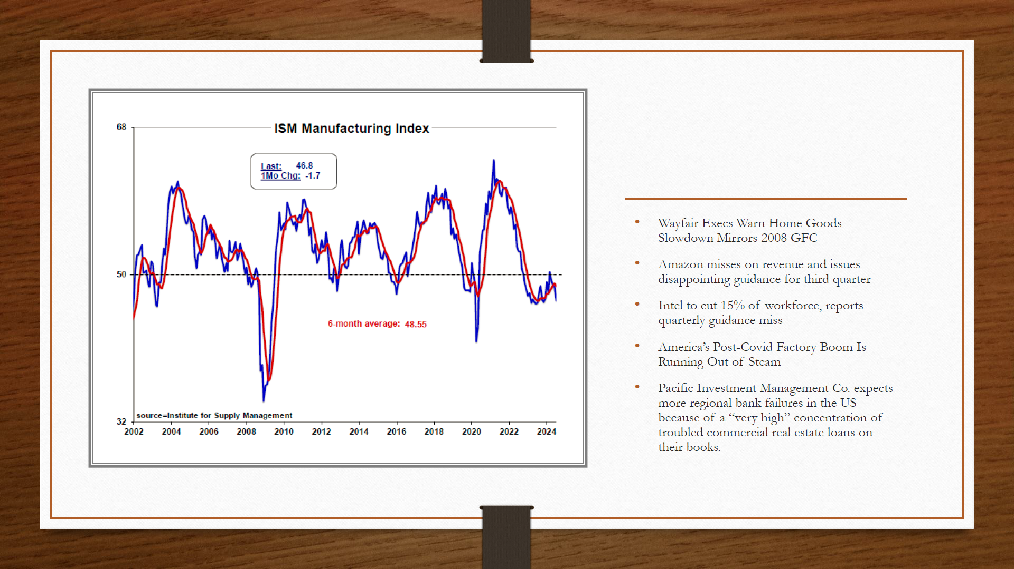

Slide 7
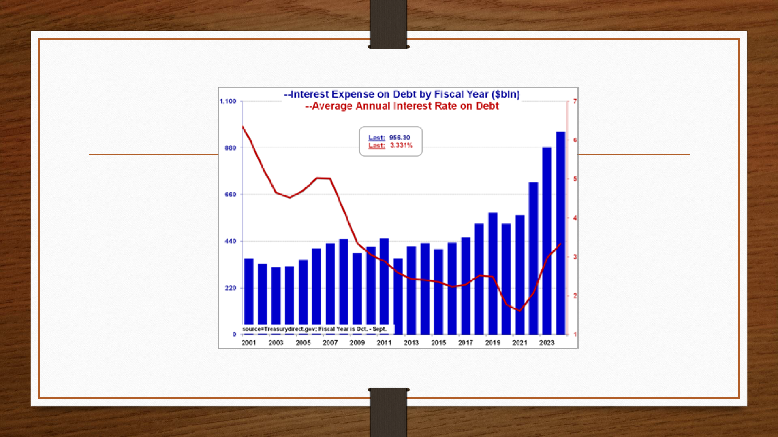

Slide 8
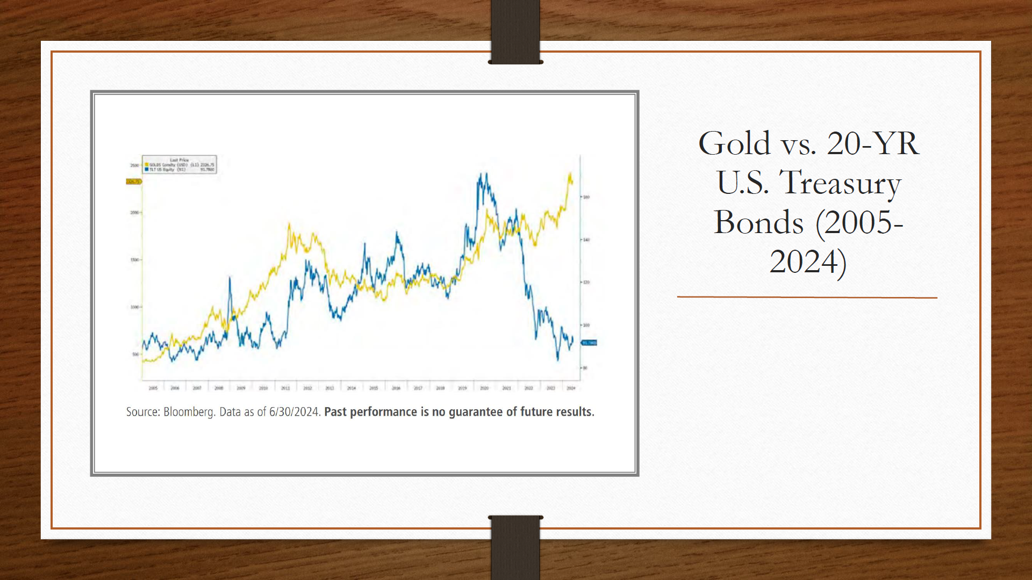

Slide 9
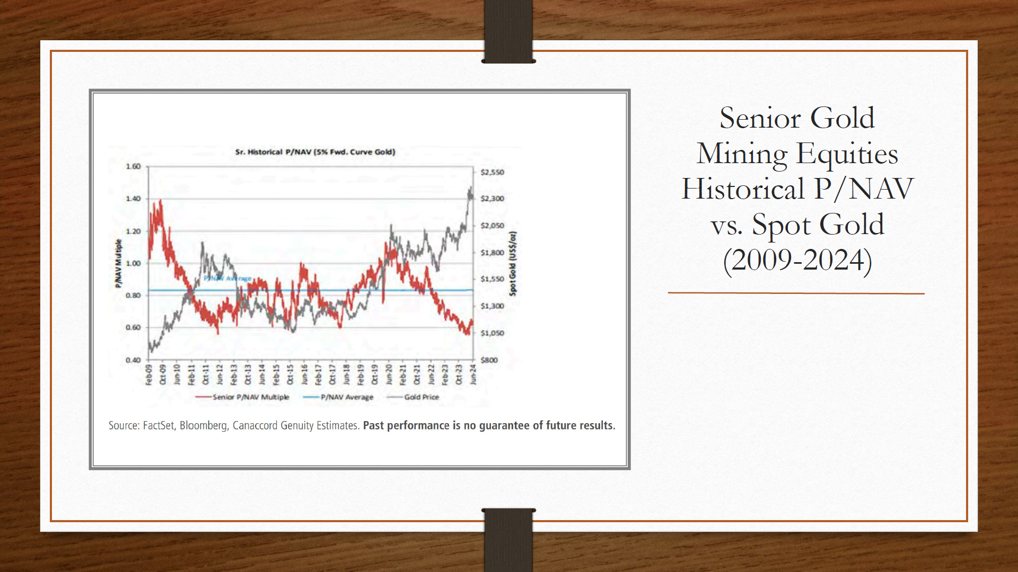

Slide 10
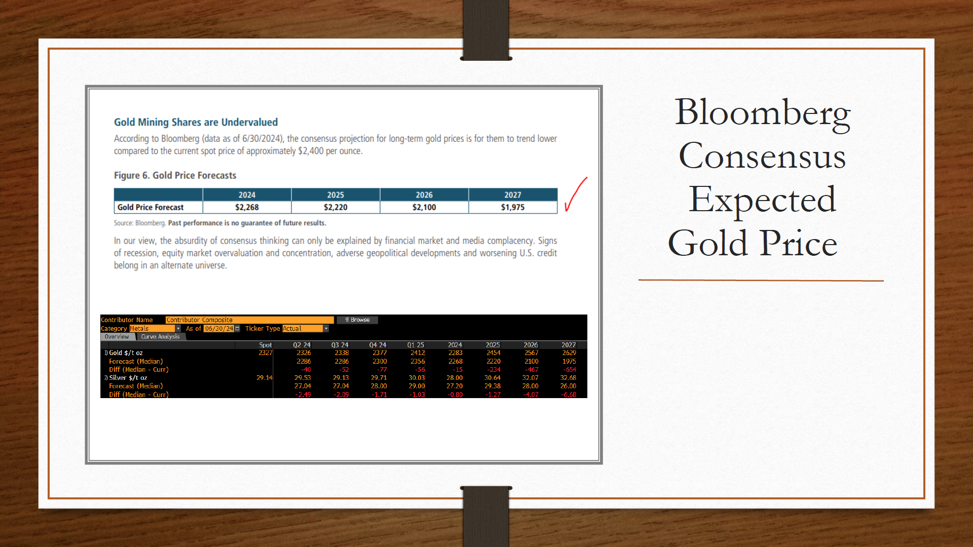

Slide 11
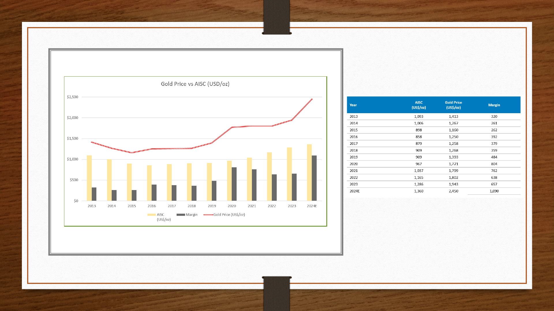

Slide 12
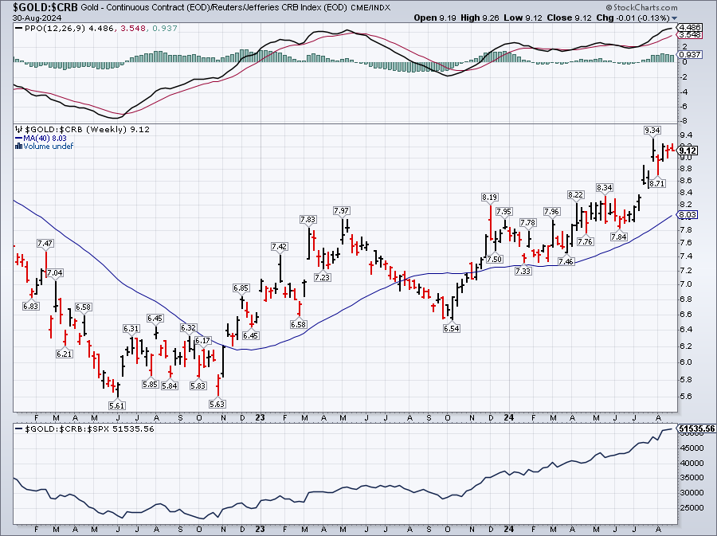

Slide 13
Fireside Talk
John Hathaway & Ronald Stoeferle
Precious Metals Summit Beaver Creek, 2024
“The greatest danger in times of turbulence is not the turbulence.
It is to act with yesterday’s logic.”
Peter Drucker
Notes:
Good afternoon, ladies and gentlemen.
Small changes can have a big impact.
Did you know that until the 15th century, The queen, was imited to only moving one square diagonally. But then a major rule change transformed the game of chess.
In the new rulebook, the queen was granted the ability to move any number of squares diagonally, vertically, or horizontally, making her the most powerful piece on the chess board.
This shift forced players to rethink their strategies and adapt to a new playbook.
Similarly, significant changes are happening in the gold market. The rules are evolving, and in the next minutes, we’ll explore these fundamental shifts and introduce the new gold playbook.

Slide 14
New Gold Playbook: Central Bank Demand One of the Main Drivers!
Global Central Bank Gold Purchases, in % of Mine Production, 1995–2023
Post Russian invasion of Ukraine
Post GFC Environment
Great Britain (395 Tonnes) and Switzerland (1,300 Tonnes) selling Gold Reserves
Source: Reuters Eikon, Incrementum AG

Slide 15


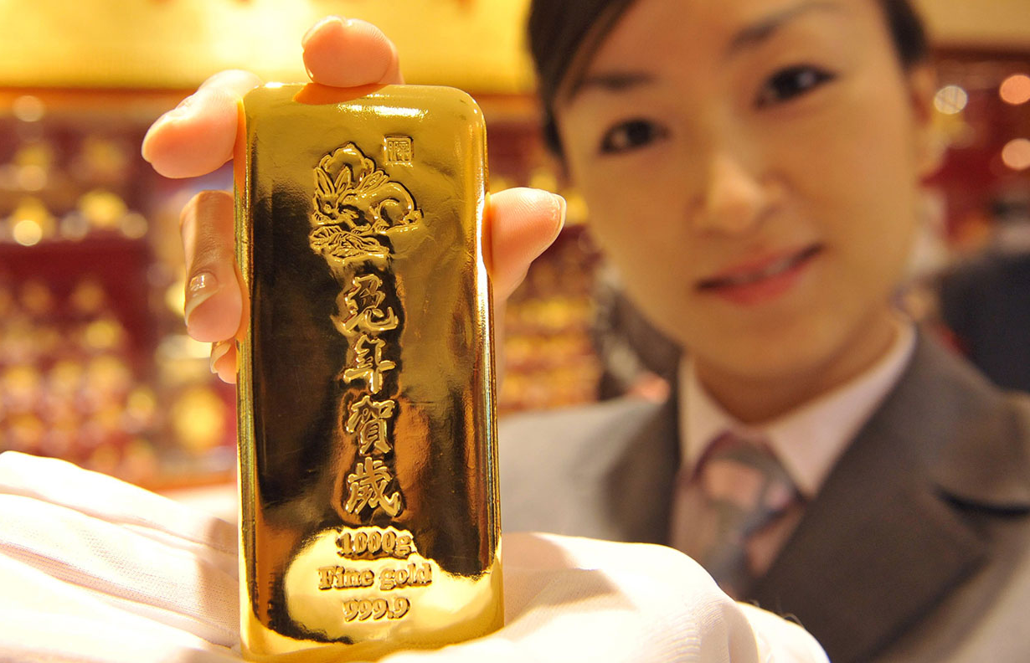
Private Gold Demand is Dominated by Emerging Markets
Consumer Demand for Gold, Grams per Capita, 2023
Source: worldometers.info, World Gold Council, Incrementum AG, FRAGOLD, Wolfgang Wrzesniok-Roßbach
Notes:
- 65% of global jewellry demand from China, India and Mideast
- Gold bar and gold coin demand: 50% from China, India and Mideast alone!
Louis Vincent Gave: Gold is a LOW BETA EMERGING MARKET PROXY

Slide 16
Growing Purchasing Power And Population Are The Breeding Ground For An Increasing Demand For Gold In The East.
10-Year-CAGR of GDP per capita, and Population in Developed and Emerging Markets, 2013–2023
Source: worldeconomics.com, Incrementum AG
Notes:
Louis Vincent Gave: Gold as a Low-Beta Emerging Market Proxy
Gold demand is shifting East!
Emerging markets, which have a strong cultural affinity for gold, are seeing rising demand driven by growing populations and increasing GDP per capita, which averaged 5.4% annually from 2013 to 2023.
With emerging markets expected to account for around 50% of global GDP in 2024, gold demand and prices are projected to rise in the long term.

Slide 17

Western Financial Investors Are Skipping the Gold Rush - For Now
Accumulated Gold ETF Holdings by Region (lhs), in Tonnes, and Gold (rhs), in USD, 01/2004–07/2024
Source: World Gold Council, Incrementum AG
Notes:
1000= tons of outflows from Gold ETFs since the peak.
A key element of the new gold playbook is that the Western financial investor is no longer the marginal buyer or seller of
Gold!
The significant demand from central banks and private Asian and Mideast buyers is the main reason why the price of gold has been able to thrive in an environment of rising real interest rates.
It seems that Western investors initially turned down the invitation to the gold party. Now that the party is gaining momentum, they do not want to admit they were party poopers. It could therefore happen that they will only come late to this party when it is
already in full swing, and then at a much higher “price of admission”.

Slide 18
Gold Is On Everyone's Lips, But Not In All Portfolios: 71% Of All Investment Advisors In The USA Hold Less Than 1% Gold!
Gold Allocation of Investment Advisors, 2023
Source: BofA Global Research, Crescat Capital, Incrementum AG
Notes:
While gold is widely discussed, it’s far from being a major portfolio component.
A Bank of America study showed that 71% of US advisors have less than 1% of their portfolios in gold.
There’s also a lack of interest in gold mining stocks, as they’ve lost investor trust due to poor past performance.
What could change that lack of interest? What could Western investors back to into the gold camp?

Slide 19
Recession Ahead? Inversion Is a Warning, but Un-Inversion = Signal!
US 10Y-2Y Spread, 01/1978–08/2024
Global Financial Crisis
1990-1991
Recession
Dot-com Bubble
COVID-19
Recession
???
Source: Reuters Eikon, Incrementum AG

Slide 20
The Longer the Base the Higher the Space
Gold, in USD, 01/2000–01/2012
+89%
Resistance at
USD 1,000
+248%
Source: Reuters Eikon, Incrementum AG

Slide 21
The Longer the Base the Higher the Space
Gold, in USD, 01/2016–01/2030
USD 4,800
+100%
Resistance at USD 2,000
+89%
Source: Reuters Eikon, Incrementum AG

Slide 22
How Does Gold Perform After the First Rate Cut?
Gold, in USD (lhs), and Federal Funds Rate (rhs), 01/2000–08/2024
+31%
+39%
+25%
Source: Reuters Eikon, Incrementum AG

Slide 23
How Do Mining Stocks Perform After the First Rate Cut?
HUI, in USD (lhs), and Federal Funds Rate (rhs), 01/2000–08/2024
+26%
+267%
+29%
Source: Reuters Eikon, Incrementum AG

