Slide 1
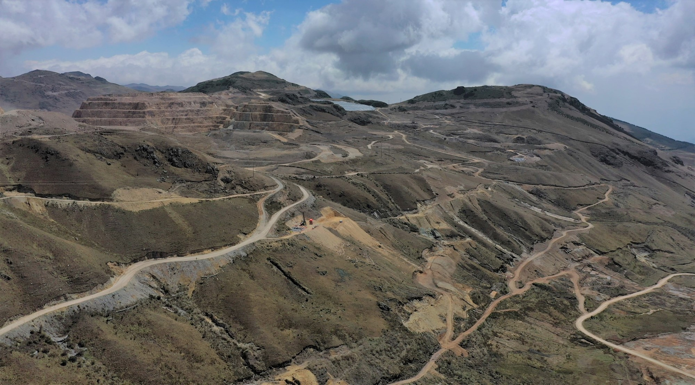
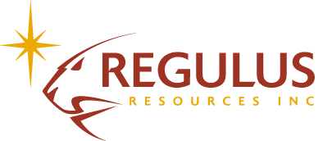
The AntaKori Copper-Gold Project
A World-Class Brownfield Opportunity
Energy Transition Metals Summit 2024
TSX.V: REG
OTCQX: RGLSF

Slide 2
DISCLAIMER
Forward Looking Information
Forward‐Looking Information. Certain statements regarding Regulus, including management's assessment of future plans and operations, may constitute forward-looking statements under applicable securities laws and necessarily involve known and unknown risks and uncertainties, most of which are beyond Regulus' control. Often, but not always, forward-looking statements or information can be identified by the use of words such as "plans", "expects" or "does not expect", "is expected", "budget", "scheduled", "estimates", "forecasts", "intends", "anticipates" or "does not anticipate" or "believes" or variations of such words and phrases or statements that certain actions, events or results "may", "could", "would", "might" or "will" be taken, occur or be achieved.
Specifically, and without limitation, all statements included in this presentation that address activities, events or developments that Regulus expects or anticipates will or may occur in the future, including the proposed exploration and development of the AntaKori project described herein, the completion of the anticipated drilling program, the completion of an updated NI 43-101 Resource Estimate, the impact of the COVID-19 pandemic on the Canadian and worldwide economy, the Company’s workforce, worldwide demand for commodities and the Company’s business generally and management's assessment of future plans and operations and statements with respect to the completion of the anticipated exploration and development programs, may constitute forward-looking statements under applicable securities laws and necessarily involve known and unknown risks and uncertainties, most of which are beyond Regulus' control. These risks may cause actual financial and operating results, performance, levels of activity and achievements to differ materially from those expressed in, or implied by, such forward-looking statements. Although Regulus believes that the expectations represented in such forward-looking statements are reasonable, there can be no assurance that such expectations will prove to be correct. The forward-looking statements contained in this presentation are made as of the date hereof and Regulus does not undertake any obligation to publicly update or revise any forward-looking statements or information, whether as a result of new information, future events or otherwise, unless so required by applicable securities law.
Presentation of Resource Estimates. This presentation uses the terms "indicated" and "inferred" in connection with its resource presentations, as defined in accordance with National Instrument 43‐101 Standards of Disclosure for Mineral Projects ("NI 43‐101") under guidelines set out in the Canadian Institute of Mining, Metallurgy and Petroleum (the "CIM") Standards on Mineral Resources and Mineral Reserves adopted by the CIM Council on May 10, 2014. An Inferred Mineral Resource is that part of a Mineral Resource for which quantity and grade or quality are estimated on the basis of limited geological evidence and sampling. Geological evidence is sufficient to imply but not verify geological and grade or quality continuity. An Inferred Mineral Resource has a lower level of confidence than that applying to an Indicated Mineral Resource and must not be converted to a Mineral Reserve. It is reasonably expected that the majority of Inferred Mineral Resources could be upgraded to Indicated Mineral Resources with continued exploration. An Indicated Mineral Resource is that part of a Mineral Resource for which quantity, grade or quality, densities, shape and physical characteristics are estimated with sufficient confidence to allow the application of Modifying Factors in sufficient detail to support mine planning and evaluation of the economic viability of the deposit. Geological evidence is derived from adequately detailed and reliable exploration, sampling and testing and is sufficient to assume geological and grade or quality continuity between points of observation. An Indicated Mineral Resource has a lower level of confidence than that applying to a Measured Mineral Resource and may only be converted to a Probable Mineral Reserve. All of Regulus' exploration programs and the related disclosure of information of technical or scientific nature are prepared by or prepared under the direct supervision of Dr. Kevin B. Heather, FAusIMM, Regulus' Chief Geological Officer, who is a "qualified person" as defined in NI 43‐101.
TSX.V: REG | OTCQX: RGLSF
2

Slide 3
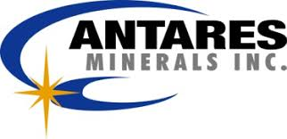
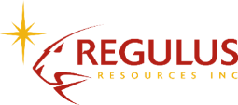
OUR STRATEGY
Management With A Clear Business Model And Successful Track Record
1
2
3
Monetize By
Selling to a
Major Mining Co.
Acquire Mineral Resources with Overlooked Potential
Add Value by Expanding Resource &
Project De-Risking
The Team’s Companies & Key Projects
Antares Minerals
Haquira Cu-Mo Project
2005
Acquired for US$15 from Phelps Dodge
2005-2010
C$45 M spent on exploration through
to PEA
2010
Sold to First Quantum
Minerals for
C$650+ M
Regulus Resources AntaKori Cu-Au Project
2014
Acquired via merger with Southern Legacy
2014 – Present
Land agreements established + extensive drilling + strategic partnerships
Watch Here
Aldebaran Resources Altar Cu-Au Project
2018
Spin out of REG’s Argentina assets and JV earn-in on
the Altar Cu-Au Project
2019 – Present
Large resource in hand, being expanded through exploration
Watch Here
TSX.V: REG | OTCQX: RGLSF
3

Slide 4
WHY REGULUS RESOURCES?
INVESTMENT HIGHLIGHTS
AntaKori Is A High-Grade, Low Strip Project In An Established Mining District
One of the highest-grade undeveloped copper deposits with growth potential
M&I Res: 2.6 B lbs Cu, 2.3 M Oz Au*
Inf Res: 2.4 B lbs Cu, 2.2 M Oz Au*
Low strip ratio
Brownfield project near two existing mines and infrastructure
Copper projects needed for Green Energy Transition
PROVEN STRATEGY
Same team previously sold Antares Minerals for C$650 MM
QUALITY PARTNERS
Experienced management team
Support of strategic stakeholders
Rio Tinto
Route One Investment Co. LP
Osisko Gold Royalties Ltd.
Management owns ~11%
Company actively involved in local community projects
Company working collaboratively with neighbouring mines
DELIVERING A COPPER PROJECT AT THE RIGHT TIME
Identify Underexplored Asset
Grow Resource Through Exploration
De-Risk Asset
Monetize
TSX.V: REG | OTCQX: RGLSF
*see details of resource estimate on website
4

Slide 5
CAPITAL STRUCTURE
A Tightly-Held Junior With Strong And Strategic Partners
CAPITAL STRUCTURE
Ticker (TSX.V) | REG
Ticker (BVL) | REG
Ticker (OTCQX) | RGLSF
Shares issued | 124,658,818
Fully diluted | 135,933,818
Share price (Apr 22, 2024) | C$1.60
Market capitalization | C$199.2 M
Current cash position (as of Mar 31) | ~C$16.5 M
ANALYST COVERAGE
David Davidson
TSX.V: REG | OTCQX: RGLSF
5

Slide 6
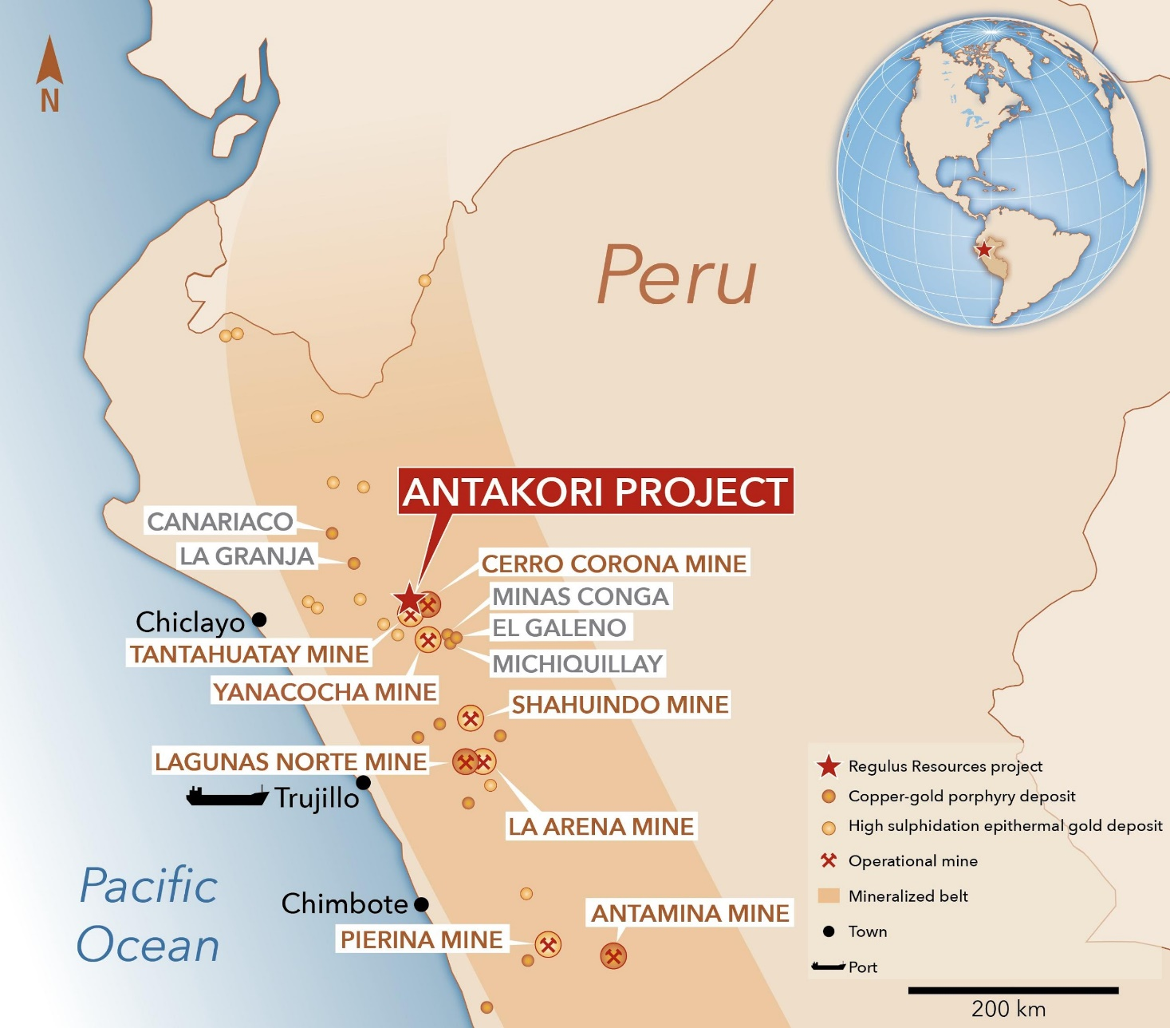
WHERE IS THE ANTAKORI PROJECT?
Located In A Well-Established Mining District In A Major Copper Producing Country
TOP GLOBAL COPPER-GOLD PRODUCER
Peru is the second largest copper producing country in the world and largest gold producer in South America.
GEOLOGICALLY WELL-ENDOWED
The region is geologically well endowed with large copper and gold projects and operations including Yanacocha, Michiquillay, La Granja, Antamina, Cerro Corona, and Tantahuatay.
EXCELLENT INFRASTRUCTURE
There is existing infrastructure in the region from current mining operations including ports, power and water.
TSX.V: REG | OTCQX: RGLSF
6

Slide 7
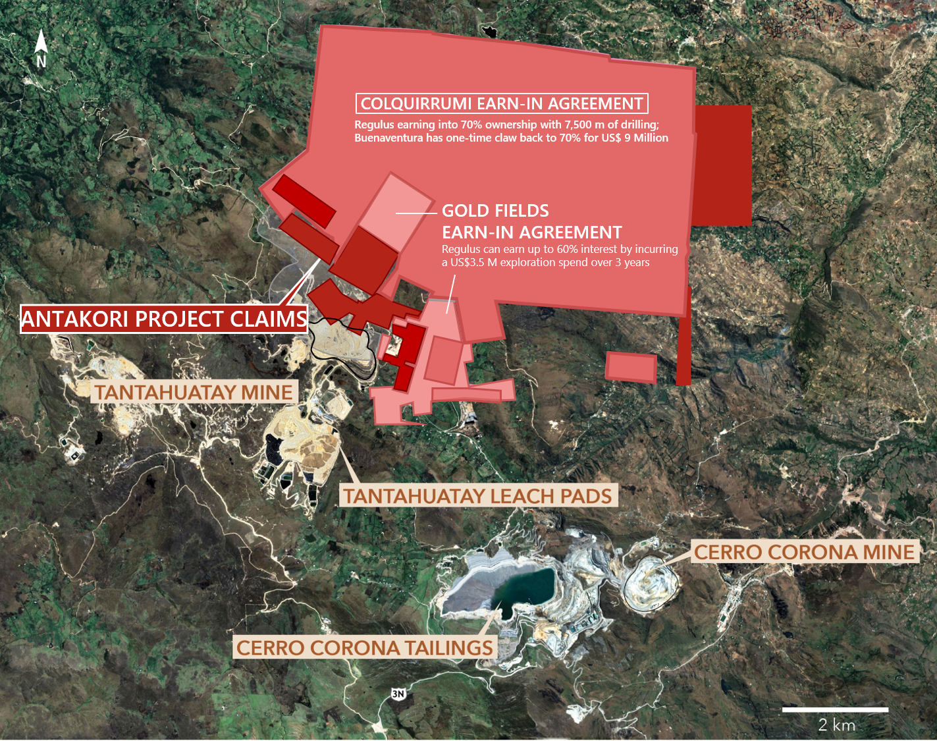
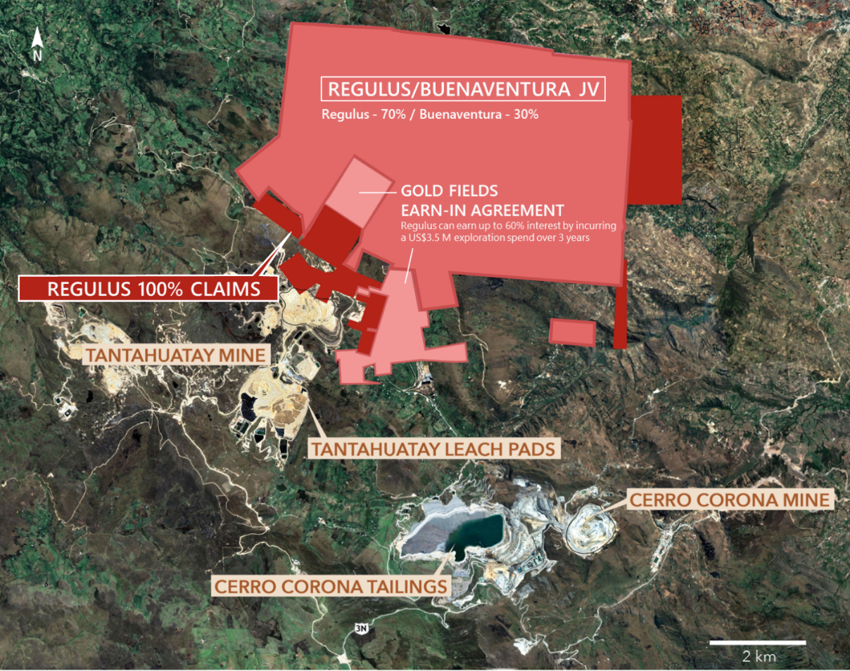
WHAT IS THE DISTRICT SETTING?
AntaKori Is Strategically Located Adjacent To Two Operating Mines
TANTAHUATAY MINE
Oxide, heap leach gold mine operated by Coimolache (JV between Buenaventura, Southern Copper and ESPRO)
Mine projected to stop mining oxides in 2027¹
Beneath oxide mineralization is a significant copper-gold sulphide deposit of which a portion fall on Tantahuatay’s property, and a portion falls on Regulus’ property
Transition to a sulphide mine needs to occur for Tantahuatay to avoid complete closure of the mine
A properly scaled sulphide project would involve both Tantahuatay and AntaKori (“TantaKori”)
CERRO CORONA MINE
Sulphide mine with 20,000 tpd concentrator operated by Gold Fields, produces copper and gold
Running out of tailings space in 2025 and will start milling low grade stockpile which will last until 2030²
Need to find or acquire more ore to avoid closure
Per SEC Technical Report Summary Pre-Feasibility Study Coimolache Department of Cajamarca, Peru
Per SNL Financial
TSX.V: REG | OTCQX: RGLSF
7

Slide 8
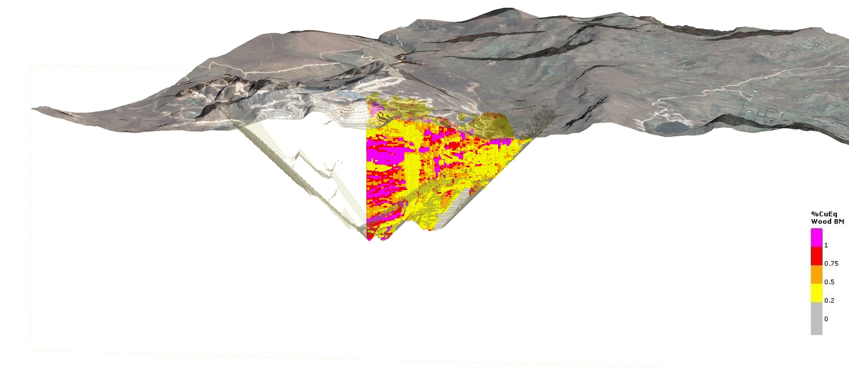
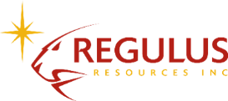
WHAT IS THE ANTAKORI PROJECT?
AntaKori Represents A Portion Of A World-Class Copper-Gold Deposit
3D map looking to northwest
AntaKori
Sulphides Exploration
AntaKori – Brownfield Exploration
Tantahuatay Oxide Mine
100% owned by Regulus
Significant resource calculated in 2019
High-grade near surface
Regulus and Coimolache utilized a data sharing agreement where Regulus was able to lay back onto Coimolache ground with a conceptual pit for resource purposes
Tantahuatay Sulphides
Tantahuatay Sulphides
Owner, Coimolache¹, currently mining the oxide cap as a heap leach gold operation
⁽²⁾
2019 Regulus Conceptual Pit
Coimolache (Southern Copper 44%; Buenaventura 40%; ESPRO 16%)
Assumed metallurgical recoveries for CuEq are copper 85%, gold 55% and silver 50%, according to the 2019 Mineral Resource Estimate compiled by Wood.
2019 “In-Pit” Resource Blocks (Reported)
AntaKori and Tantahuatay Sulphides are adjacent to one another and together form the Tantakori Deposit.
TSX.V: REG | OTCQX: RGLSF
8

Slide 9
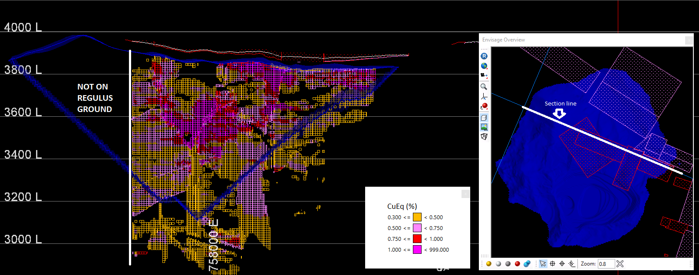
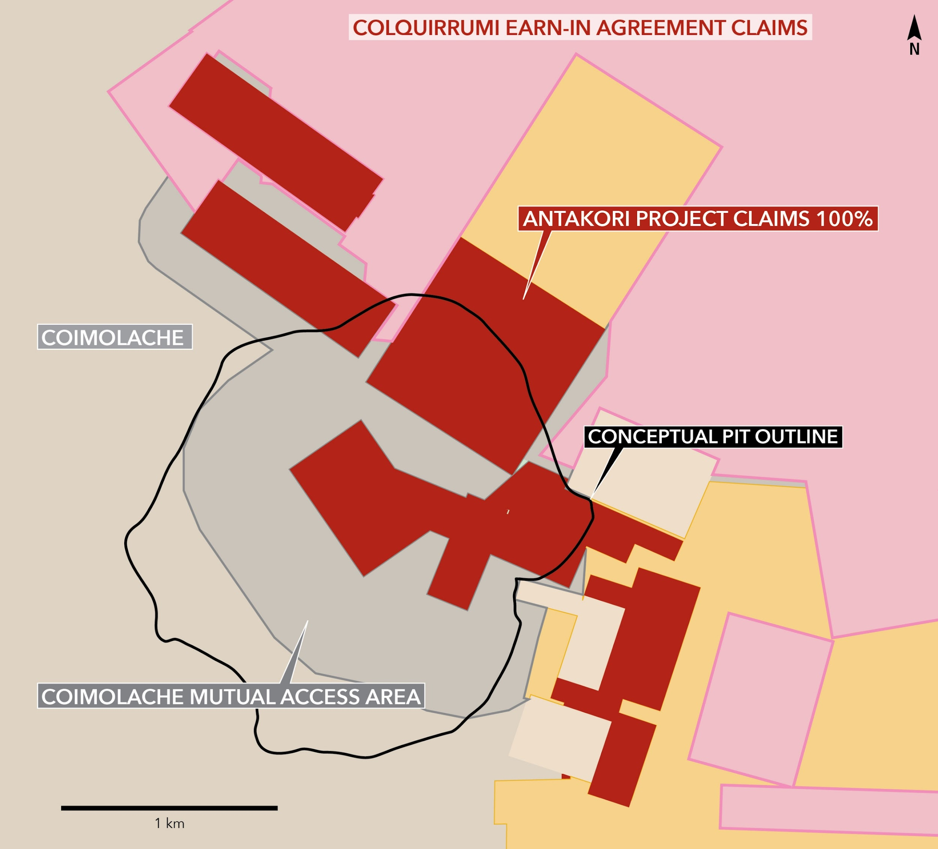
WHAT IS ON THE ANTAKORI SIDE?
A Significant Resource With High-Grade Mineralization At Surface And Low Strip Ratio (0.85/1)
Regulus (70%) / Buenaventura (30%) JV
GOLD FIELDS EARN-IN CLAIMS
High Grade Near Surface
Section line
Mineralization Outside Pit
COIMOLACHE AREA OF INTEREST
AntaKori Resource Highlights
Utilizes both Regulus and Tantahuatay sulphides data (within area of interest) to model a portion of the TantaKori deposit (only AntaKori reported). Large areas of mineralization outside of conceptual pit not currently classified as resources.
2019 RESOURCE ESTIMATE (AntaKori Only)
Resource Category | Tonnes (millions) | Cu (%) | Au (g/t) | Ag (g/t) | Cu (B lbs) | Au (M oz) | Ag (M oz)
Indicated | 250 | 0.48 | 0.29 | 7.5 | 2.6 | 2.3 | 61
Inferred | 267 | 0.41 | 0.26 | 7.8 | 2.4 | 2.2 | 67
Note: Resource completed using 0.3% CuEq cut-off and
constrained utilizing a 60,000 tpd conceptual open pit.
Resource estimate and CuEq values were calculated using
the following metal prices: Cu = US$3/lb, Au = US$1400/oz,
Ag = US$18/oz. Assumed metallurgical recoveries for CuEq
are copper 85%, gold 55% and silver 50%, according to the
2019 Mineral Resource Estimate compiled by Wood. The
formula utilized to calculate copper equivalent values is
CuEq(%) = Cu% + (Au g/t*0.7130) + (Ag g/t*0.0091)
TSX.V: REG | OTCQX: RGLSF
9

Slide 10
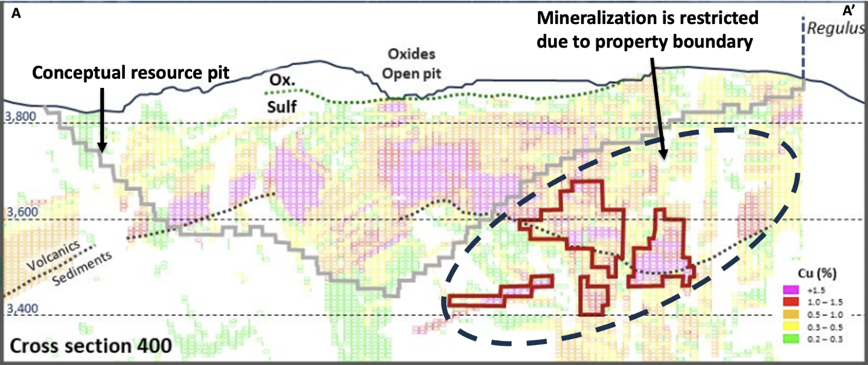
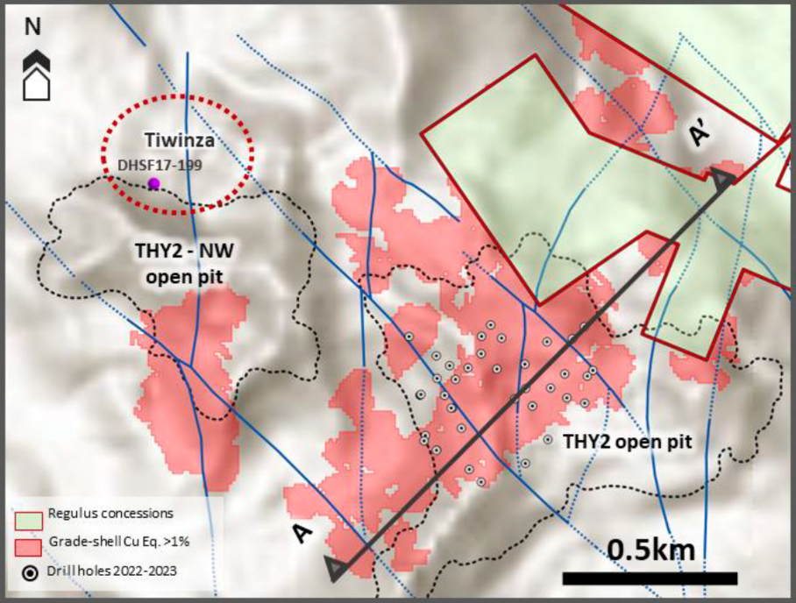
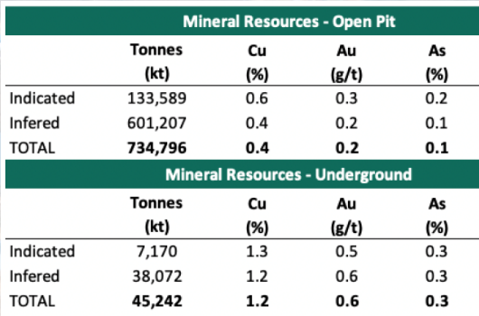
WHAT IS ON THE TANTAHUATAY SIDE?
A Large Copper-Gold Sulphide Resource Beneath The Oxide Mine
AntaKori Project
Tantahuatay Sulphides
Significant portions of >1%CuEq mineralization near AntaKori claims, which would likely not be accessible in an open-pit without integrating the two properties
Forced to evaluate underground resources instead
Results in underreporting of potential resources
Tantahuatay currently shows a mix of open pit and underground resources in their latest resource estimate as a result
Notes: Images and Resources published in Buenaventura 2023 Investor Day Report.
Parameters for calculation of resource not publicly released.
Resources not necessarily inside Regulus conceptual pit.
Interim Resource
TSX.V: REG | OTCQX: RGLSF
10

Slide 11
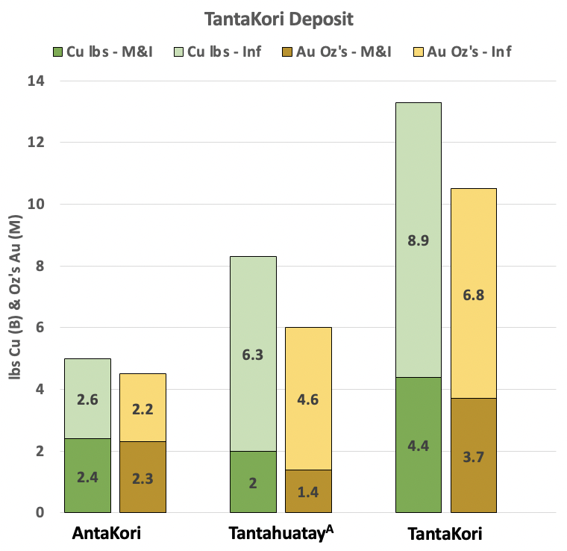
WHY IS THE ‘TANTAKORI’ DEPOSIT SO ATTRACTIVE?
Size, Grade And Brownfield Nature Make The TantaKori Deposit Stand Out
HIGHLIGHTS
Large tonnage with attractive grades, and high-grade near surface
Low strip ratio of 0.85^{B} with potential to go lower
Oxide mine effectively pre-stripping large portions of the deposit
Near power lines, highways and infrastructure
Easier to permit due to presence of operating mine
Significant opportunities to grow resources through:
Data integration
Completing an unconstrained unified resource estimate
Capturing defined mineralization that currently falls outside conceptual pit
Growth through exploration
REGULUS’ STRATEGY
Seek opportunities to work with Tantahuatay to maximize value for all stakeholders
Grow portion of resource that falls on Regulus’ ground
Evaluate optimal processing methods including application of Rio Tinto - Nuton’s primary copper sulphide leach technologies
Maintain good standing in region on social, political and environmental fronts
Complete drilling and spending commitments on earn-in ground to maximize land position
Seek opportunities for consolidation or sale
*See slide 22 for AntaKori resource estimate
A - Buenaventura 2023 December Investor Day report. Regulus has not reviewed the Tantahuatay Sulphides resource estimate and cannot confirm it utilizes the same estimation techniques as the AntaKori estimate
B – Strip ratio reported in Regulus conceptual pit
Interim Resource
TSX.V: REG | OTCQX: RGLSF
11

Slide 12
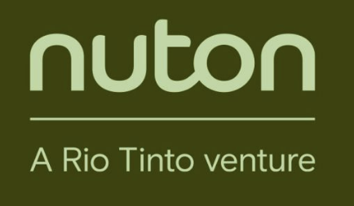
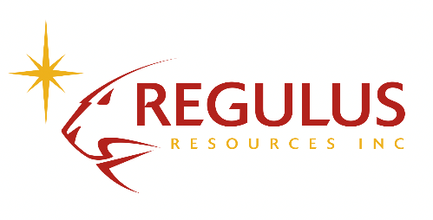
RIO TINTO NUTON STRATEGIC INVESTMENT & PARTNERSHIP
Collaborating To Unlock Copper Resources In A District With Substantial Scale Potential
NutonTM Overview & Strategic Investment Details
Benefits of Nuton’s Sulphide Leaching Technology
Sizeable investment (C$20.5 M) by one of the largest diversified miners in the world, at an attractive valuation of C$1.02 per share
Technical endorsement of the AntaKori project and the long-term vision of Regulus management
Nuton is focused on commercializing its proprietary suite of copper leach technologies, with potential to unlock copper from hard-to-leach ore and low-grade material, with industry-leading recoveries
Phase One Nuton testing revealed strong copper extraction rates up from samples of different mineralization styles. Regulus has delivered samples to Nuton for the phase two program which entails column tests on larger-scale samples. Results expected by end of 2024
Smaller Production Footprint and Reduced Impacts: eliminating the need for a concentrator and generating no tailings, Nuton has less need for water and land than traditional copper production methods
Generating Greater Value From Resources: Industry-leading copper recoveries mean more copper can be extracted from each unit of ore. The technology also offers the possibility to reevaluate legacy sites, including tailings and low-grade stockpiles, uncovering what others see as waste or liability into valuable resources
Producing Copper From Mine To Metal In One Place: Ore can be processed on site yielding pure copper cathode ready for downstream uses. This shortens and optimizes the supply chain from mine to cathode
TSX.V: REG | OTCQX: RGLSF
For more information about NutonTM please visit https://nuton.tech/
12

Slide 13
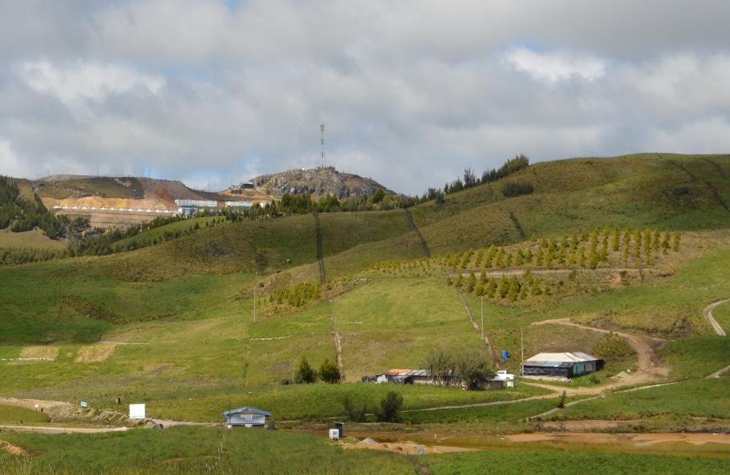
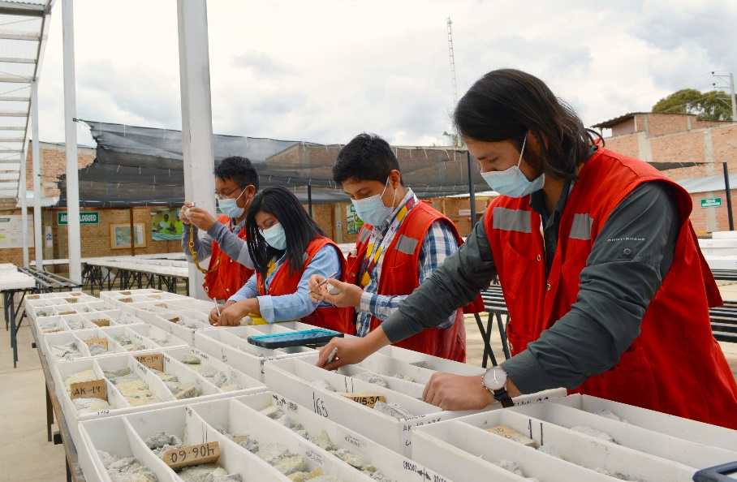
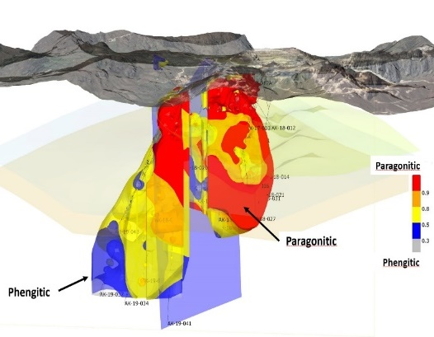
CREATING SUSTAINABLE VALUE FOR ALL STAKEHOLDERS
Regulus’ Approach To Sustainably Develop The AntaKori Project
ACTIVELY INVOLVED IN LONG-TERM COMMUNITY AND ENVIRONMENTAL PROJECTS
LARGE DEPOSIT WITH POTENTIAL FOR MULTI-GENERATIONAL MINE LIFE
A TECHNICAL APPROACH THAT WILL FACILITATE MINING ANTAKORI
Regulus has a collaborative approach on the ground to work on long-term projects with local communities to increase agricultural production, support improved health and education, and carry out environmental remediation work such as the Tres Mosqueteros remediation project (above).
Regulus is advancing AntaKori as a world-class copper-gold deposit that has the potential to have a long mine life which would continue local employment and support for the regional economy for generations to come.
Unlike many juniors, Regulus extensively collects data sets, e.g. petrographic and hyperspectral data (Core Scan), which will facilitate the mining of AntaKori and adds considerable value to the project in the eyes of a major looking to acquire Regulus.
TSX.V: REG | OTCQX: RGLSF
13

Slide 14
UNLOCKING VALUE AT THE ANTAKORI PROJECT
Perceived Issues At The Project vs Regulus’ Solutions
Complex claim position: can exploration occur?
Reached agreements with CMC, Buenaventura and Gold Fields to allow exploration
Can we deal with arsenic?
Multiple pathways to deal with arsenic including Nuton primary copper sulphide leaching
Can we obtain permission to drill?
Utilized CMC drill permits and acquired drill permits for northern claims
Can we expand and report the resource?
Grew resource substantially by completing new holes and integrating CMC/Regulus datasets
Can we obtain social license?
Worked closely with communities to establish sustainable social license
Can we finance without significant dilution while funding the project?
Multiple non-dilutive financings with Osisko and above market financing with Rio Tinto
TSX.V: REG | OTCQX: RGLSF
14

Slide 15
MAJORS ACTIVELY ACQUIRING COPPER ASSETS
Mining producers looking for growth in copper with limited opportunities
TSX.V: REG | OTCQX: RGLSF
15

Slide 16
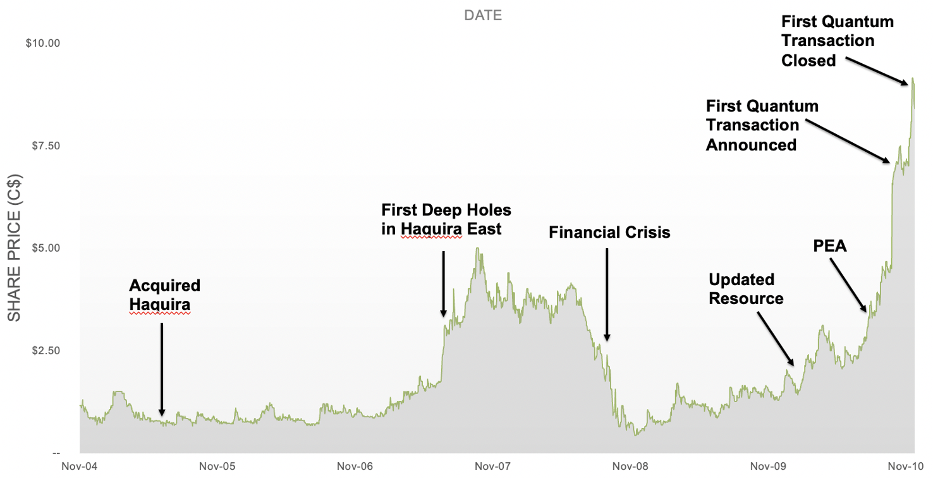
WHAT DID THE TEAM DO WITH ANTARES?
Generated Significant Value For Shareholders
TSX.V: REG | OTCQX: RGLSF
Predecessor company delivered significant return on investment for shareholders
16

Slide 17
INVESTMENT RECAP: THE ANTAKORI PROJECT
A Brownfield Copper-Gold Deposit with District-Scale Potential
REGIONALDEVELOPMENT
PROJECT POTENTIAL
GROWING MINERAL RESOURCE
250 Mt @ 0.48% Cu, 0.29 g/t Au, 7.5 g/t Ag (Indicated)
267 Mt @ 0.41% Cu, 0.26 g/t Au, 7.8 g/t Ag (Inferred)
Mineralization remains open
Low strip ratio
Nearby mines’ ore is depleting Potential for multi-generational mine
Significant infrastructure already in place
Recent investments by Rio Tinto, Antofagasta and First Quantum
STRATEGIC PARTNERS
COMPELLING VALUATION
AND FULLY FUNDED
Well placed to create sustainable, long-term
value for shareholders and local communities
in the years ahead.
Contact: Ben Cherrington, Investor Relations Manager, ben.cherrington@regulusresources.com
+1 347-394-2728 (N. America) | +44 7538 244 208 (Europe), www.regulusresources.com

