Slide 1
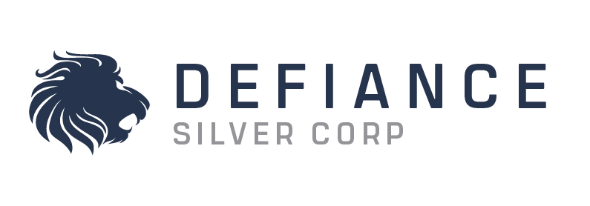
CORPORATE PRESENTATION
FEBRUARY 2022
SEPTEMBER 2022
TSXV:DEF OTCQX:DNCVF WKN: A1JQW5

Slide 2
Disclaimer
FORWARD-LOOKING INFORMATION AND STATEMENTS
This presentation contains “forward-looking information” and “forward-looking statements” within the meaning of applicable securities laws. This information and statements address future activities, events, plans, developments and projections. All statements, other than statements of historical fact, constitute forward looking statements or forward-looking information. Such forward-looking information and statements are frequently identified by words such as “may”, “will”, “should”, “anticipate”, “plan”, “expect”, “believe”, “estimate”, “intend” and similar terminology and reflect assumptions, estimates, opinions and analysis made by management of Defiance in light of its experience, current conditions, expectations of future development and other factors which it believes to be reasonable and relevant.
Forward-looking information and statements involve known and unknown risks and uncertainties that may cause Defiance’s actual results, performance and achievements to differ materially from those expressed or implied by the forward-looking information and statements and accordingly, undue reliance should not be placed thereon. Risks and uncertainties that may cause actual results to vary include but are not limited to the speculative nature of mineral exploration and development, including the uncertainty of reserve and resource estimates; operational and technical difficulties; the availability of suitable financing alternatives; fluctuations in gold and other commodity prices; changes to and compliance with applicable laws and regulations, including environmental laws and obtaining requisite permits; political, economic and other risks arising from Defiance’s Mexican activities; fluctuations in foreign exchange rates; as well as other risks and uncertainties which are more fully described in our annual and quarterly Management’s Discussion and Analysis and in other filings made by us with Canadian securities regulatory authorities and available at www.sedar.com. Defiance disclaims any obligation to update or revise any forward-looking information or statements except as may be required by law.
NI43-101 DISCLOSURE:
George Cavey, P. Geo., a Qualified Person under the meaning of Canadian National Instrument 43-101 is responsible for the technical information in this presentation.
2

Slide 3
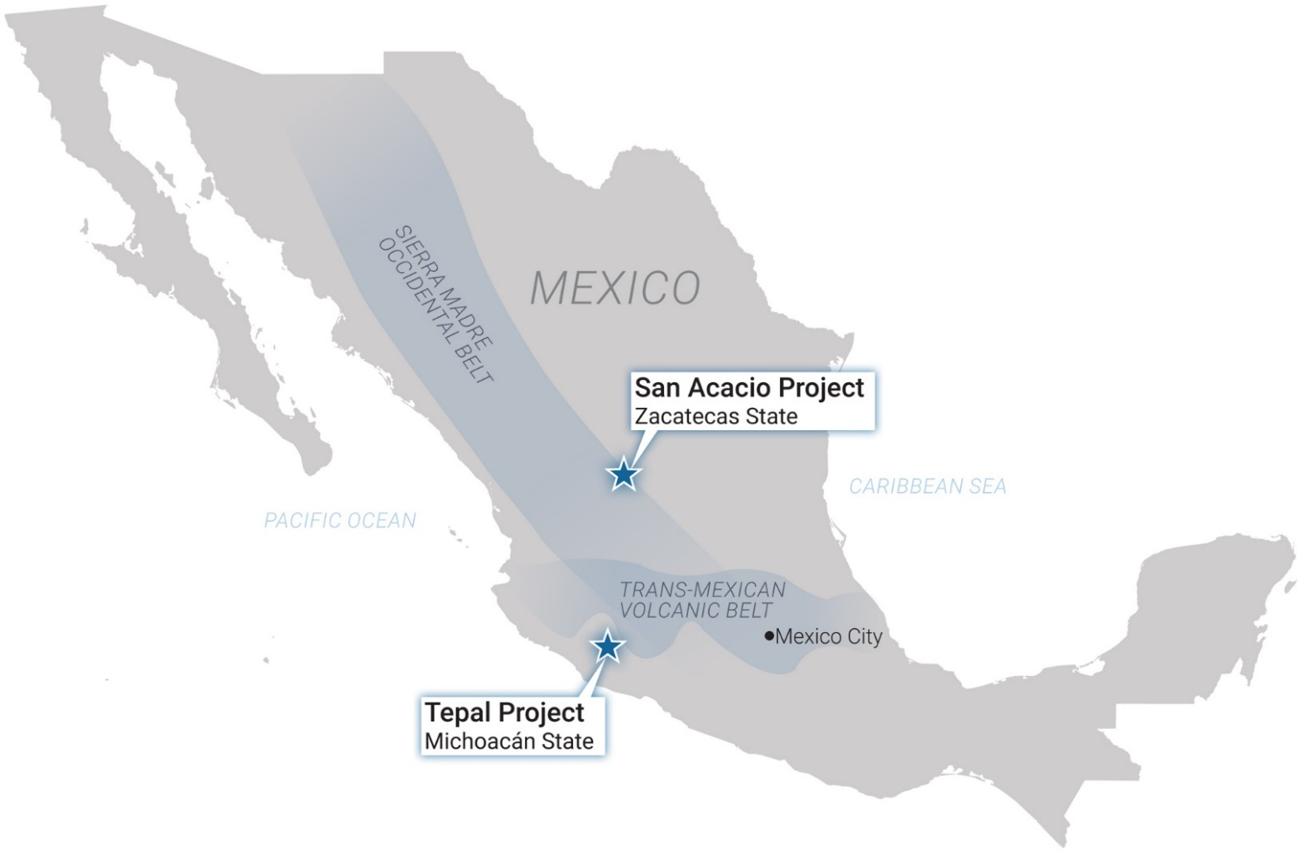
SOLID PROJECT BASE | WITH A FOCUS ON PRECIOUS METALS
 | Zacatecas Projects (San Acacio) | Tepal Project
LOCATION | Zacatecas | Michoacán
PRIMARY COMMODITY | Silver | Gold-Copper
DEPOSIT TYPE | Epithermal Vein | Porphyry-Epithermal
STAGE | Resource | Pre-Feasibility
NI 43-101 RESOURCE | 16.9mm ozs Ag * | 1.8mm ozs Au + 813mm lbs Cu
INFRASTRUCTURE | Excellent; road, power grid, water, and experienced Mexican labor | Excellent; road, seaport, access with low topographical relief
OWNERSHIP | Under Option | 100%
*-Source: NI-43-101 Technical Report and Resource Estimate, San Acacio Silver Deposit, Zacatecas Sate, Mexico, by Giroux and Cuttle; September 2014 (further details in the Appendix of this presentation)
+-Source: NI-43-101 Technical Report Preliminary Economic Assessment on the Tepal Project, Michoacan, Mexico, JDS Energy & Mining Inc; January 2017 (further details in the Appendix of this presentation)
3

Slide 4
Why invest in defiance?
Proven Mine Finders: Experienced Management team with decades of exploration success leading to M&A and Mine Development
Leverage to Precious Metal Prices:
Tepal Au Price Sensitivity
Zacatecas Resource Upside
Robust Resource Base ^{(1,2)} and Significant Exploration Potential
Highly Aligned with Shareholders:
Management and Key Shareholders aligned
Drill-ready exploration targets: Systematic exploration and reinterpretation of historical work has generated highly prospective targets to add ounces and increase grade.
(1) Please see Defiance news release dated January 15, 2015 and Appendix for 43-101 Inferred Mineral Resource Estimate
(2) Please see ValOro news release dated January 19, 2017 and Appendix for PEA Assumptions
4

Slide 5
TIGHT SHARE STRUCTURE
Share Structure
Share Price History
TRADING | Trading Symbols | TSXV:DEF OTC:DNCVF
 | 52 Week Hi-Low | $0.80-$0.235
 | Average Daily Trading Volume | ~222,655
CASH POSITION July 2022 | Cash (CAD $M) | ~$11.7
SHARE STRUCTURE August 26th, 2022 | Share Price | $0.30
 | Market Cap (CAD $M) | ~$68.3M
 | Common Shares | 227,702,437
 | Options | 9.5
 | Warrants | 20.61
 | DSU/PSU/RSU | 0.31
 | Fully Diluted | 260,723,202
OWNERSHIP | Institutional Ownership | ~35%
Price per Share
Volume
Source: Sedar, TMX, LBMA, Yahoo Finance
5

Slide 6
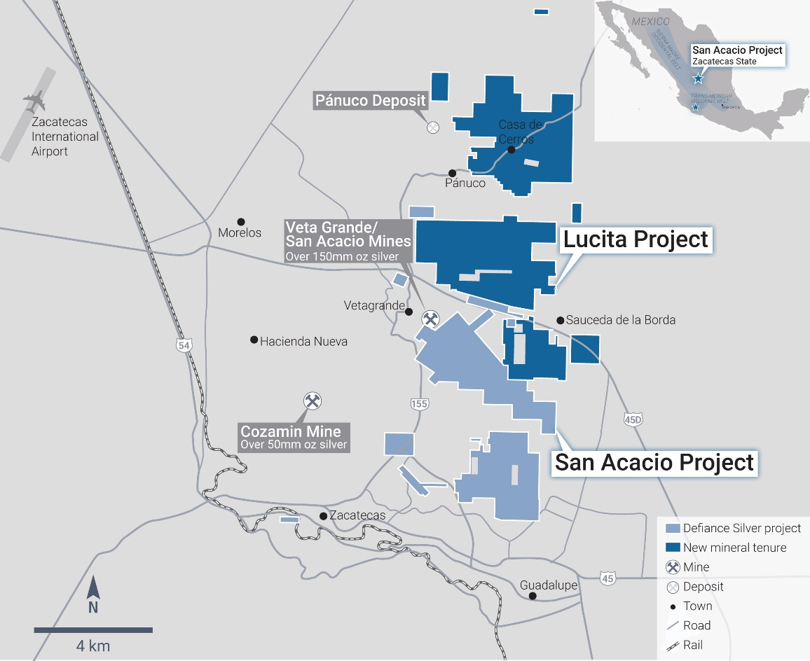
Zacatecas district projects
WITHIN THE BILLION OUNCE ZACATECAS MINING DISTRICT
Located in Zacatecas, Mexico.
Option to acquire 100% ownership.
Current Initial Resource: 16.9 mm Oz. Ag based on 44 holes totalling 10,200m of drilling.
San Acacio and Lagartos projects located on the prolific Veta Grande and Mala Noche Vein Systems.
Significant Intersections outside of current resource; Base Metals never tabled into previous resource estimates.
Excellent infrastructure, topography, and labour.
The Zacatecas Silver district has produced >1B ozs Ag and is still a prolific mining region for silver and base metal deposits.
“Fresnillo from the 1960’s”. Similar crustal position/crustal blocks
Fresnillo out of ore by the mid 1960’s; now the world’s largest primary silver mine
In 1975, as a result of geochemical, geophysical and geological programs, Fresnillo discovered the Santo Nino vein at a depth of approximately 300m; 3m of 1087 g/t Ag, 1.62 g/t Au, 0.4% Pb, 0.7% Zn.*
Discovery-Focused Geoscience Works
**(Ruvalcaba-Ruiz & Thompson, 1988; Gemmel, et al., 1988, Querol & Palacios, 1990
6

Slide 7
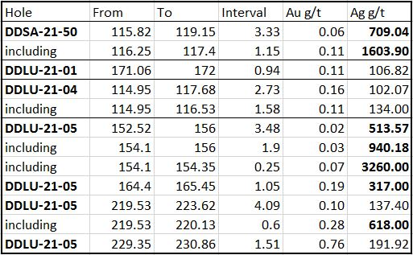
LUCITA EXPLORATION PROJECT
DISCOVERY READY PARTNERSHIP WITH PAN AMERICAN SILVER
Nearly tripled Defiance's land position in historic Zacatecas silver district.
Option to acquire 100% ownership from Pan American Silver
High-grade historical drilling on Northern, Panuco licenses.
Significant, well-mineralized, multi- kilometer target at Lucita Central (Palenque Vein System). Individual drill results* up to 3260 g/t Ag & 1603 g/t Ag
*True thickness unknown
7

Slide 8
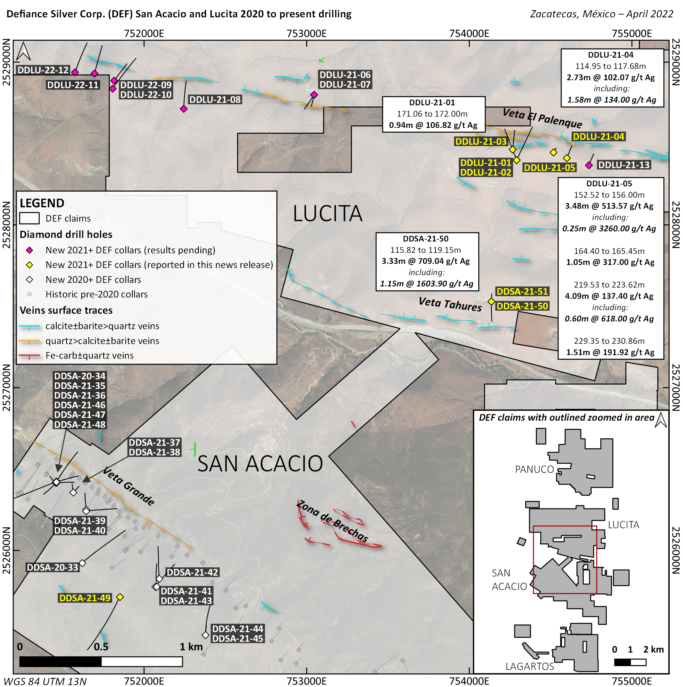
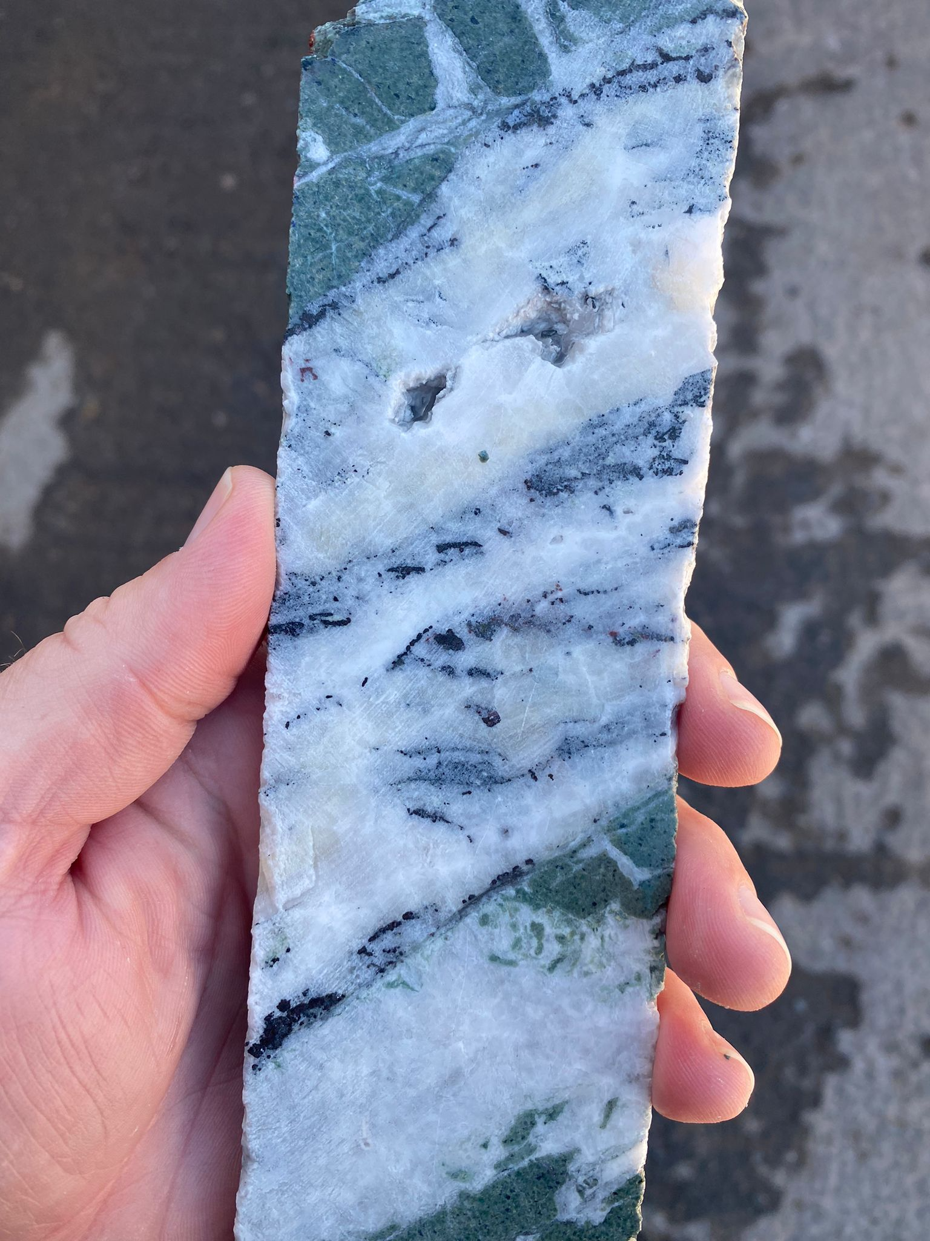
LUCITA CENTRAL
Multi-Kilometre vein system. Surface mapping has identified over 20km strike length of prospective structures.
4,750 metres drilled to date; 13 holes complete, 8 holes pending results from lab.
Shallow vein system, multiple vein, vein-breccia and stockwork style zones have been encountered.
Results to date include*:
3.48m @513.57 g/t Ag (DDLU-21-05)
3.33m @709.04 g/t Ag (DDSA-21-50)
Pyrargyrite-proustite, acanthite and argentite hosted in polyphase quartz and quartz calcite veins
*True thickness unknown

Slide 9
LUCITA NORTH - PANUCO
Multi-Kilometre vein system.
Northern Zacatecas District
3 phases of historical drilling completed, returning high grade silver in a number of different veins.
Neighbouring operators currently reporting high grade results on veins that continue onto the project.
Results to date include*:
1.25m @779 g/t Ag (LU-11-19)
3.35m @325 g/t Ag (LU-11-16)
Expanded follow up exploration planned for 2022.
Detailed surface mapping and sampling
Geophysics and Drilling
*True thickness unknown

Slide 10
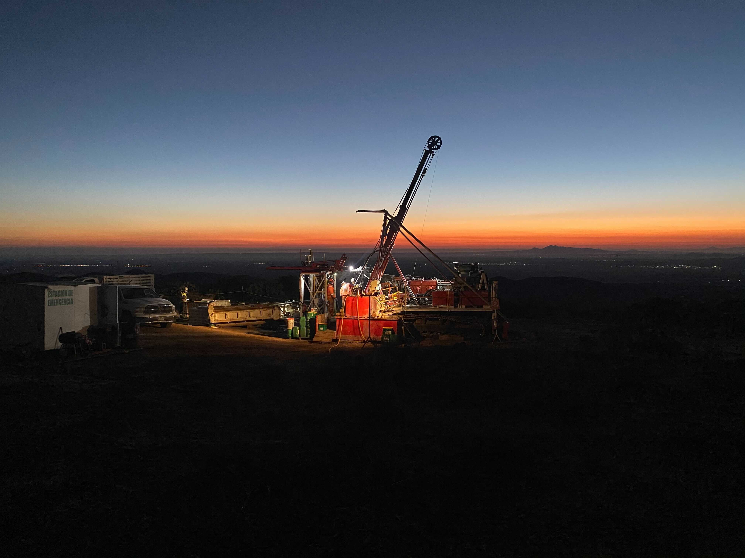
VETA GRANDE
SAN ACACIO RESOURCE PROJECT
Located in Zacatecas, Mexico. One of Mexico’s most well-known mining districts
Excellent infrastructure, topography, and skilled local workforce. 10-minute drive from city centre on paved roads, power on site.
Option to acquire 100% ownership. Lagartos property owned outright
Current Initial Resource: 16.9 mm Oz. Ag based on 44 holes totalling 10,200m of drilling. Over 20,000m drilling completed since last resource update. ~7800m drilling completed last year.
San Acacio and Lagartos projects located on the prolific Veta Grande and Mala Noche Vein Systems. Next door neighbour is the 3800 TPD Cozamin mine (Capstone mining)
Veta Grande vein system has historically produced >150m oz of Ag.
Significant Intersections outside of current resource; Base Metals never tabled into previous resource estimates.
The Zacatecas mining district has produced >1B ozs Ag and is still a prolific mining region for silver and base metal deposits.

Slide 11
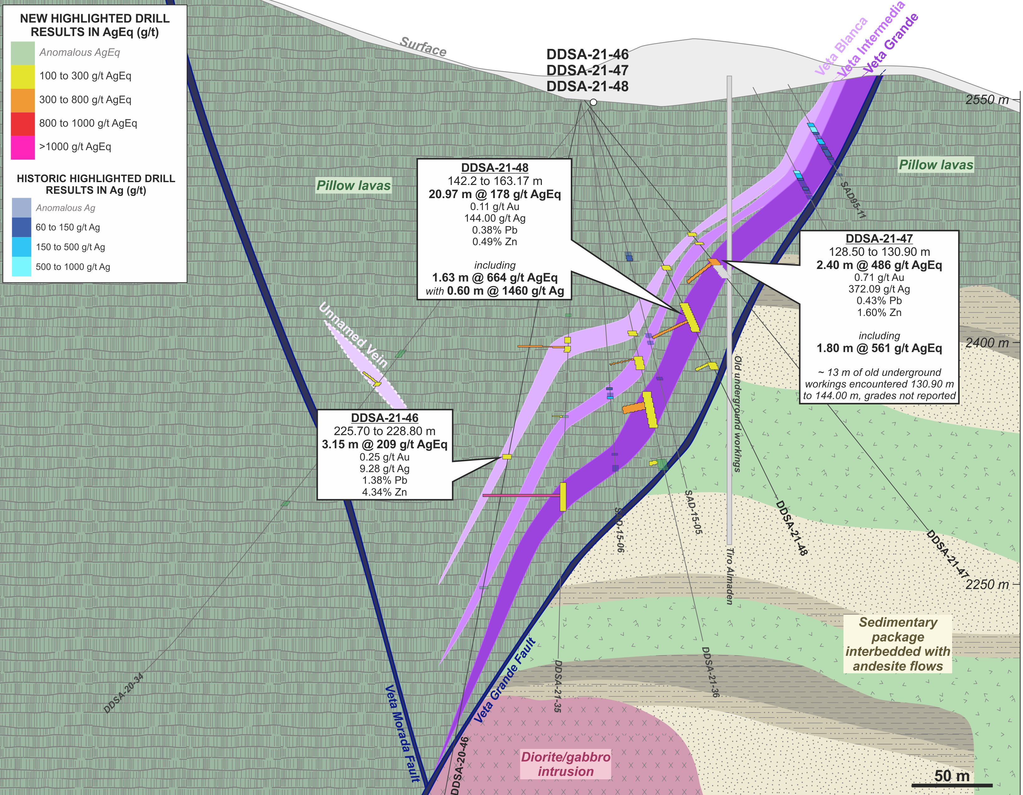
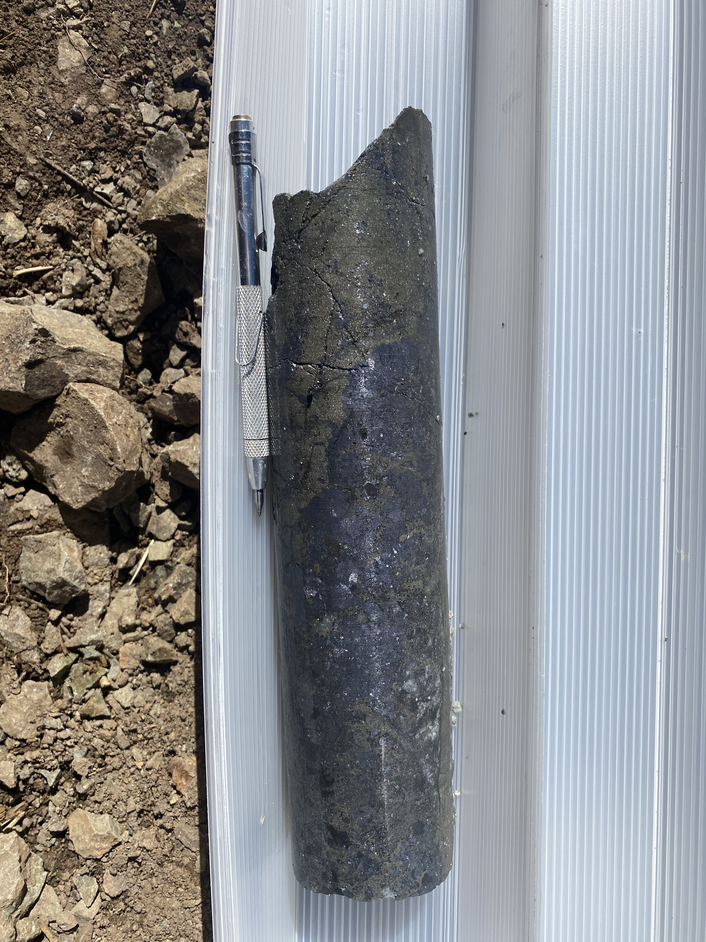
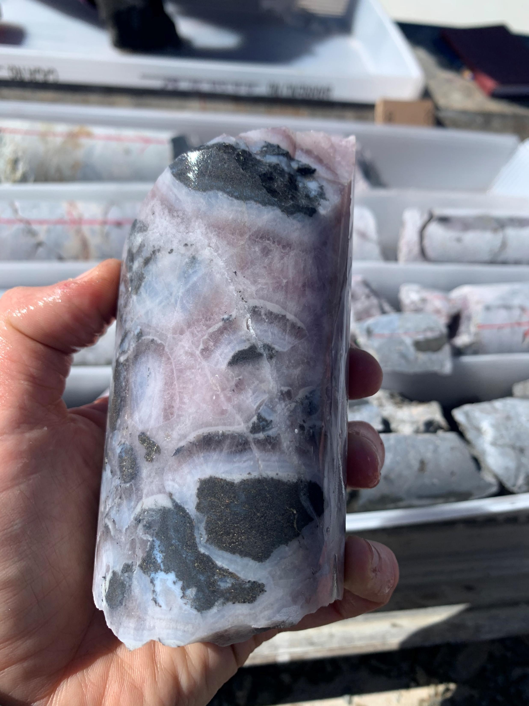
4.73 m of 385 g/t AgEq
Representative Samples
1.85 m of 1102 g/t Ag
11

Slide 12
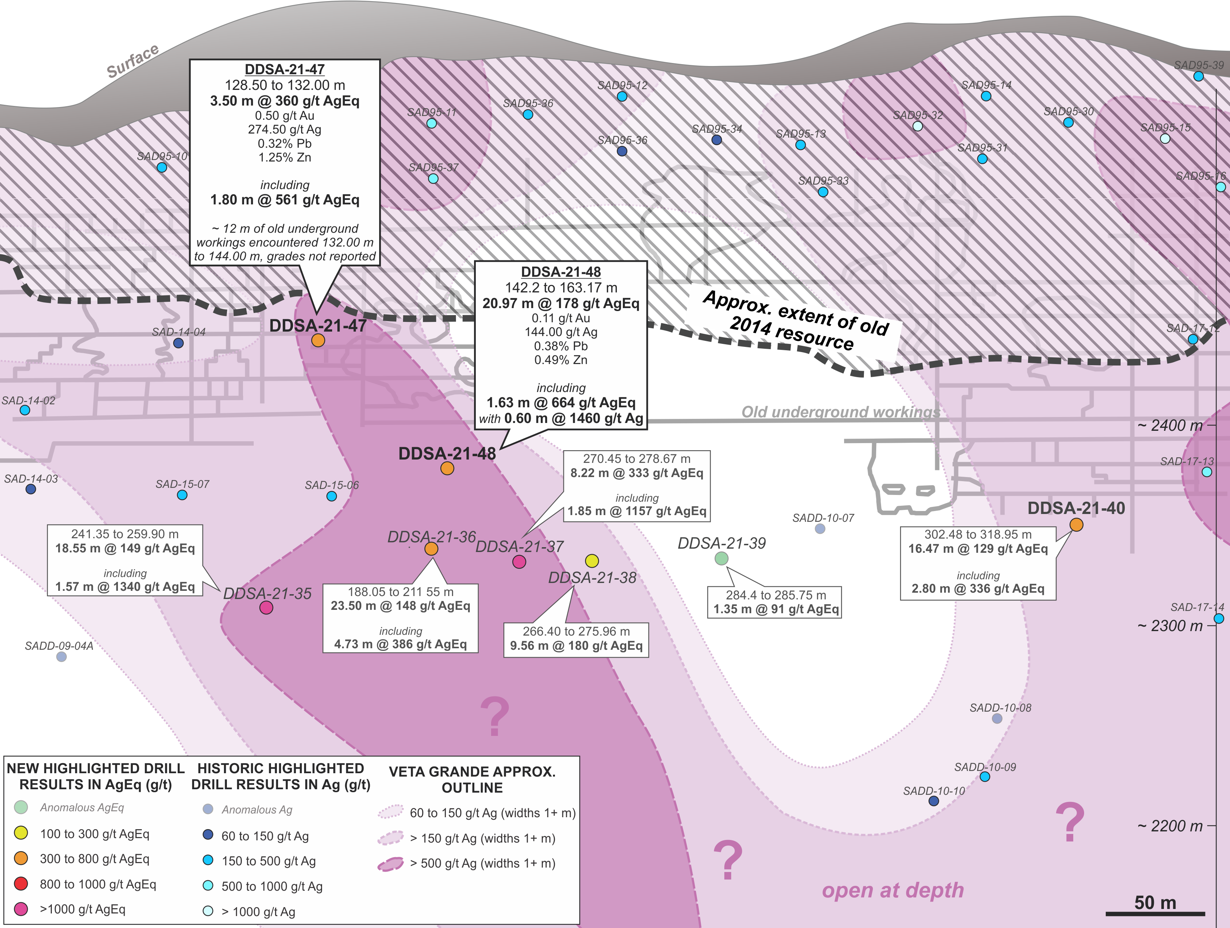
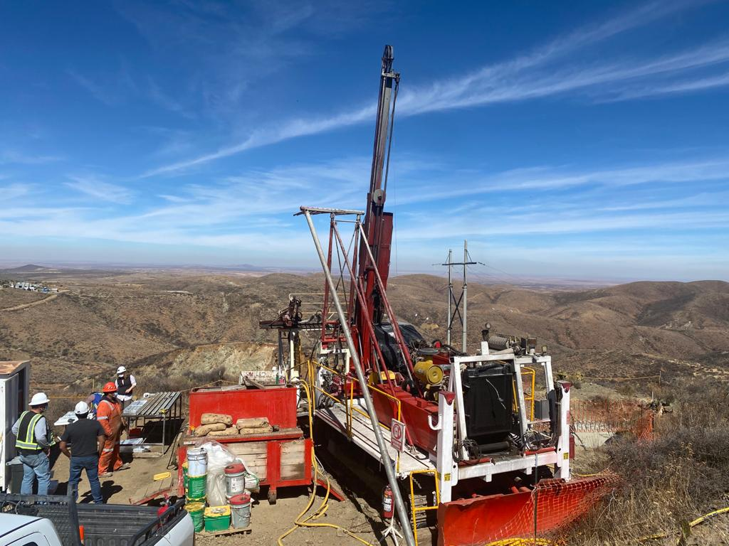
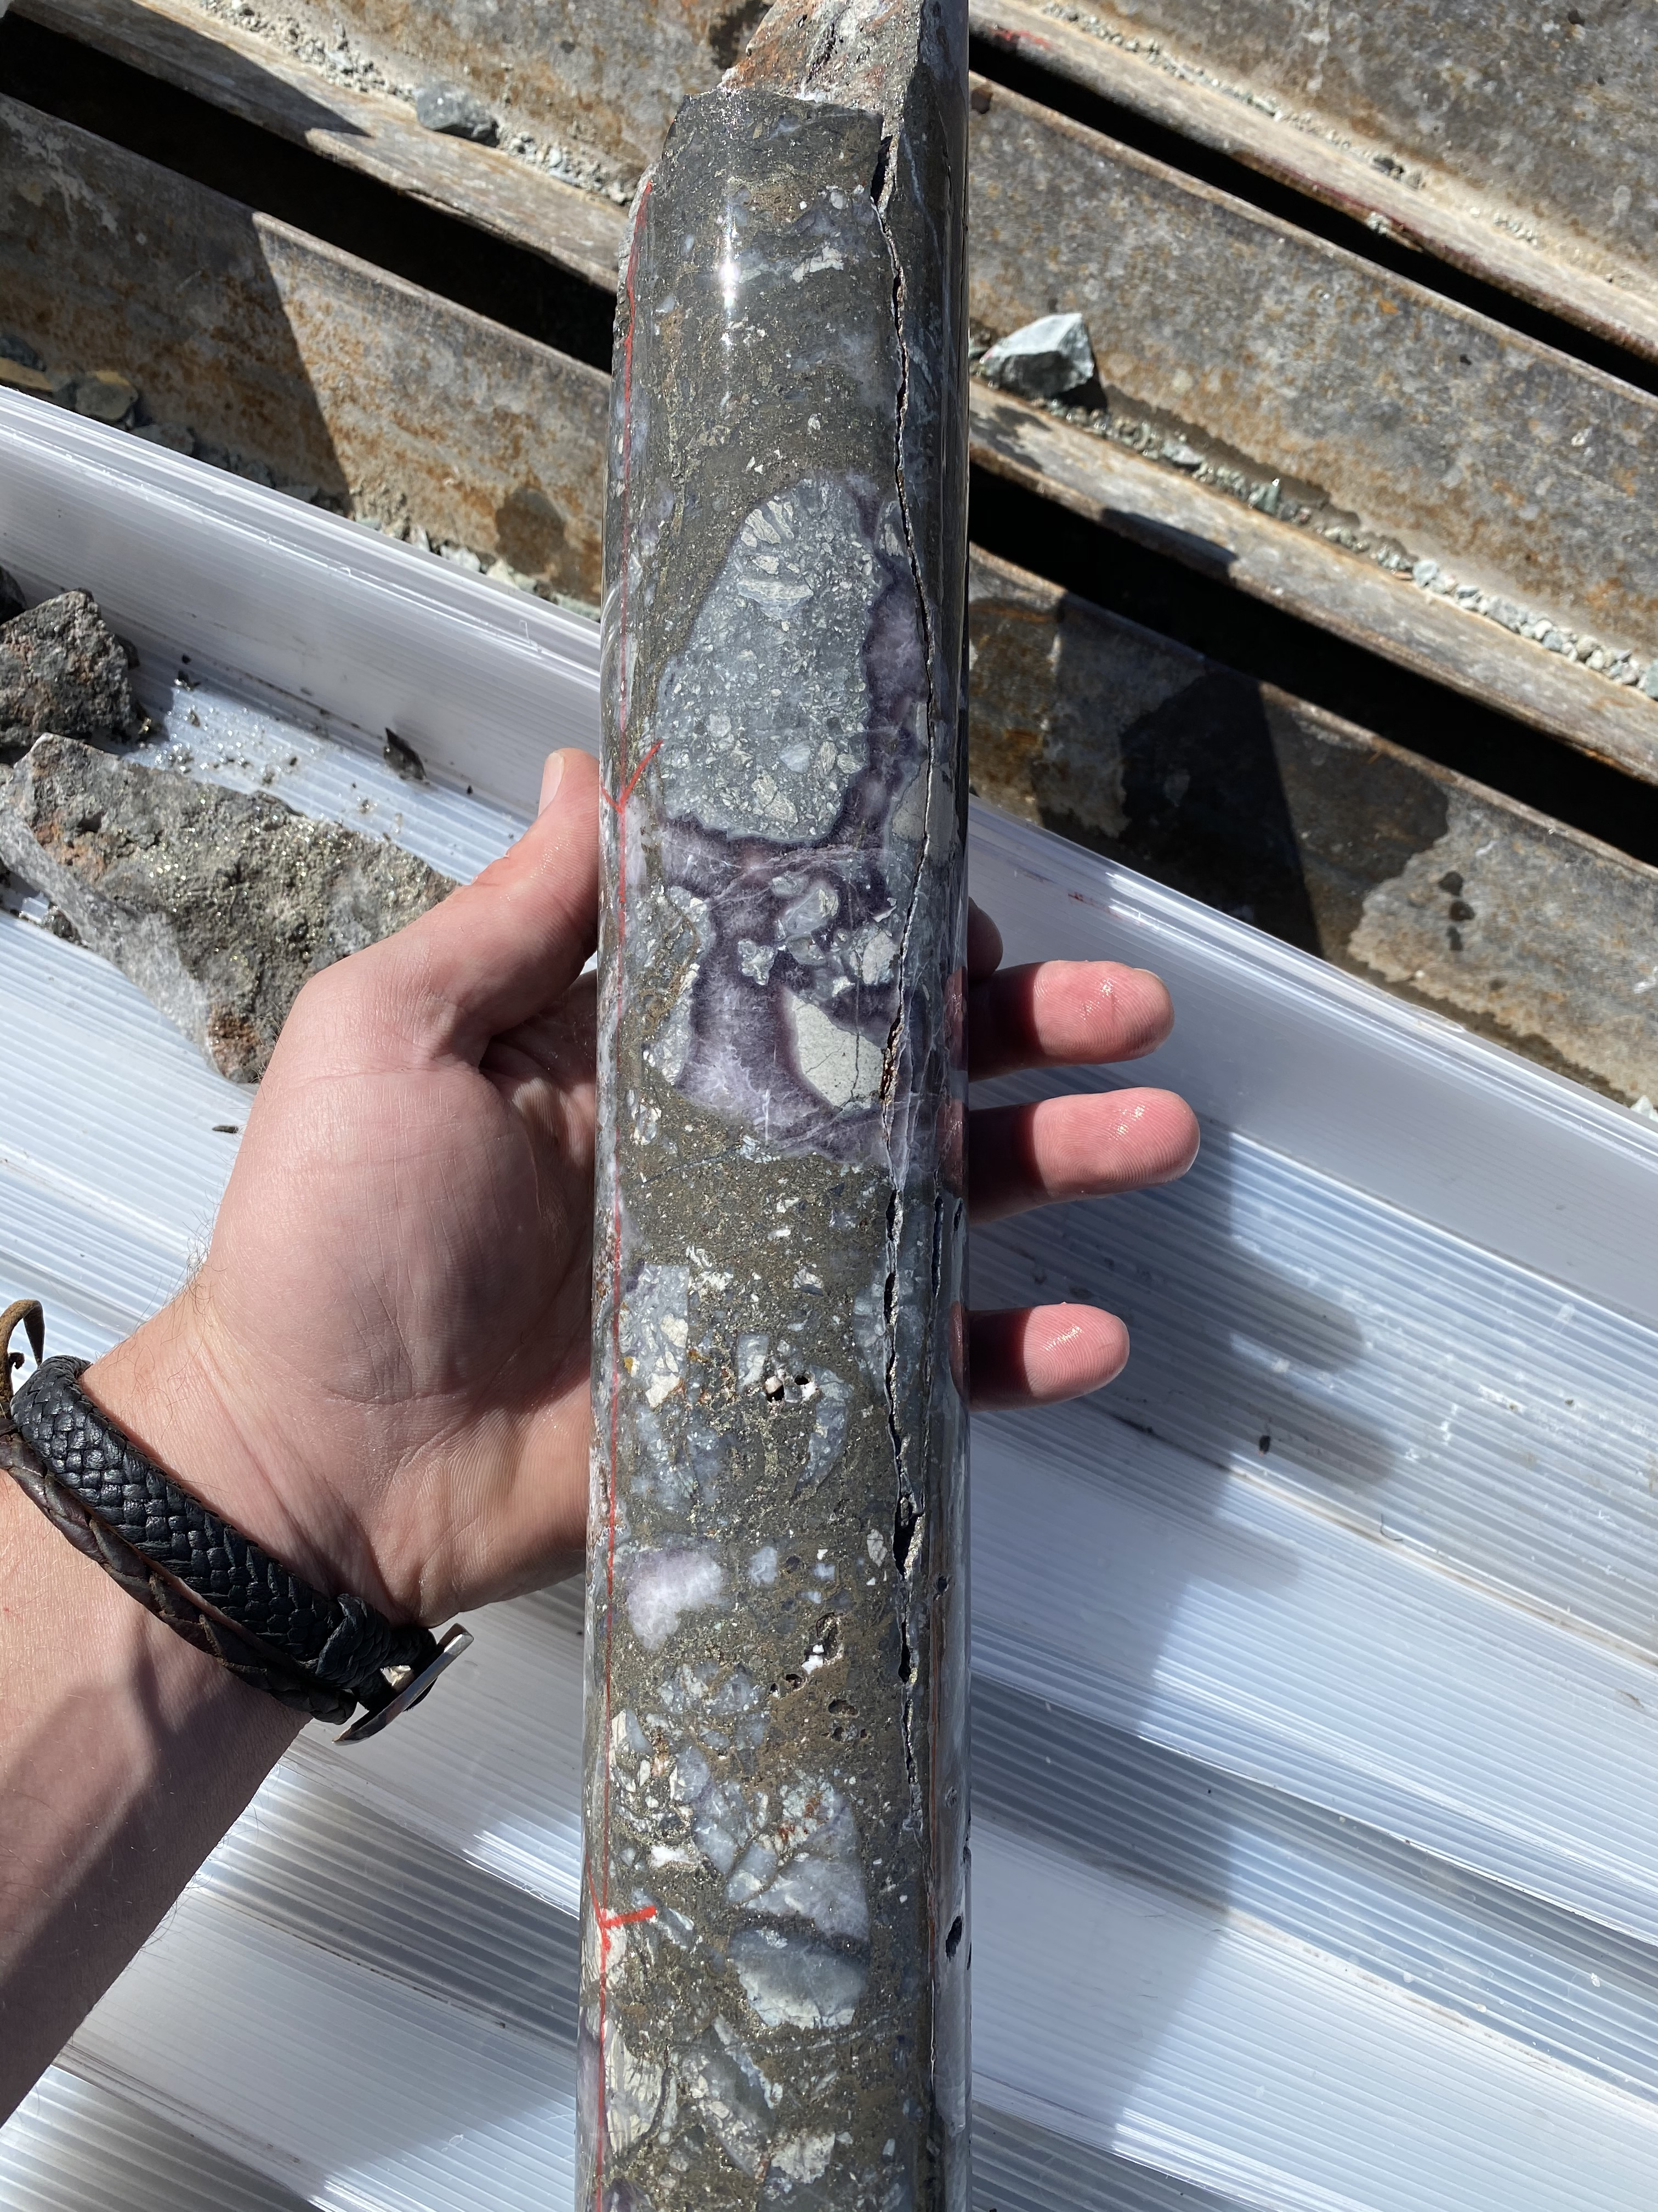
Target Area
Polyphase Vein Breccias

Slide 13
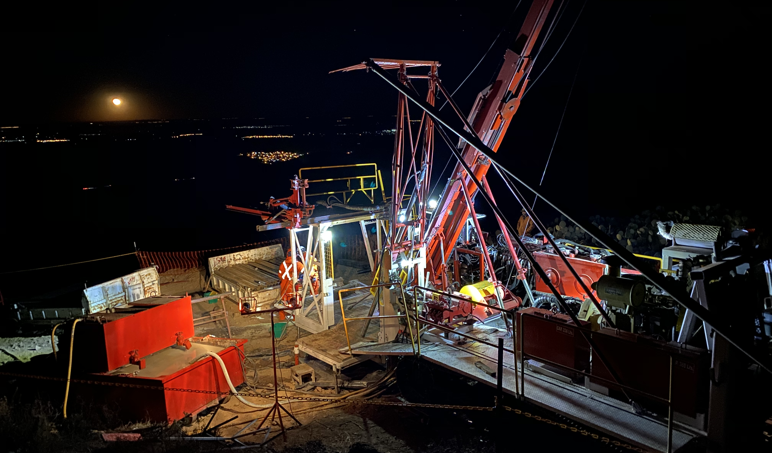
STRATEGY TO ADD VALUE AT ZACATECAS DISTRICT PROJECTS
DISCOVERY-FOCUSED MINERAL SYSTEMS GEOSCIENCE
FULLY-FINANCED EXPLORATION AND RESOURCE DRILLING PROGRAM
ADDING OUNCES TO AN ADVANCED ASSET
PHASE 1 REGIONAL DRILLING COMPLETED . 4750 METRES DRILLED (15 Holes) at LUCITA (13) and TAHURES (2).
HIGH GRADE INITIAL RESULTS FROM MAIDEN DRILLING AT PALENQUE
ONGOING DRILLING TO BE CONTINUED AT VETA GRANDE.
13

Slide 14
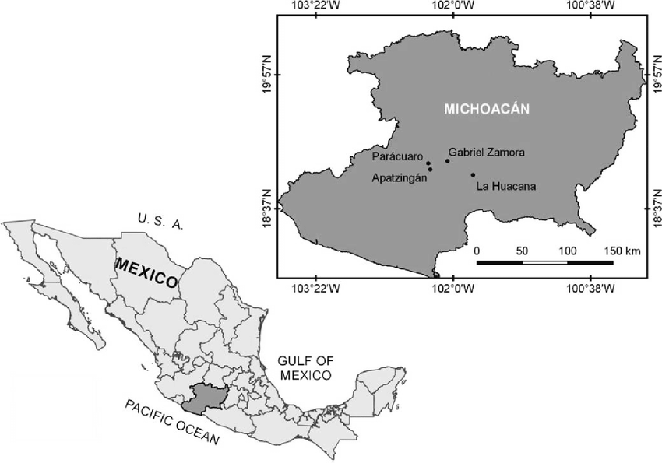
TEPAL GOLD-COPPER PROJECT
TECHNICALLY & FINANCIALLY DE-RISKED
Railway
Highway
Paved Road
Deposit
Located in Michoacán near the border of Jalisco State.
100% ownership. Option to Acquire 2.5% NSR
Current M&I resource: 1.8 mm Oz. Au & 813 mm lbs Cu⁺.
C$27M spent to-date. PEA completed in 2017
Excellent infrastructure: road accessible with power, water, and port facilities.
Surface rights currently held by private landowners.
50 megawatts available today (28 MW required for mine).
Tepal Project
Morelia
Manzanillo Port
Colima
Lázaro Cardenas – Deep Sea Port
Significant Exploration Target: Un-tested, recently discovered High Grade Gold Feeder System
+-Source: NI-43-101 Technical Report Preliminary Economic Assessment on the Tepal Project, Michoacan, Mexico, JDS Energy & Mining Inc; January 2017 (further details in the Appendix of this presentation)
14
Notes:
Put metal amounts and metal grades. If using equiv, NPV equiv.
We need a better project map.

Slide 15
TEPAL GOLD-COPPER PROJECT
ACCRETIVE ACQUISITION IN A DOWN MARKET
$4.2mm
$27.0mm
PRE-TAX
POST-TAX
Acquisition Cost of $1.39 per AuEq. Oz
PRE-TAX NPV 5%
US $299M
POST-TAX NPV 5%
US $169M
Spent by predecessor company to discover 1.8mm ozs Au and 813mm lbs Cu¹, and produce 4 economic studies
Acquired in December 2018 from ValOro for $4.2mm in Defiance Silver shares equal to approximately $1.39 per AuEq. Oz
PRE-TAX IRR
36%
POST-TAX IRR
24%
AT $1,375 GOLD AND $2.75 COPPER, POST-TAX NPV (5%) INCREASES TO
US $257M
PAYBACK
1.6 Yrs
PAYBACK
2.3 Yrs
AT $1,500 GOLD AND $3.00 COPPER, POST-TAX NPV (5%) INCREASES TO
GOLD PRICE of $1,250
AT $1,500 GOLD AND $3.00 COPPER, POST-TAX NPV (5%) INCREASES TO
US $345M
COPPER PRICE of $2.50
Using base case price assumptions of $1,250/oz. gold, $2.50/lb copper and $18.00/oz. silver, Tepal has an estimated $169 million after-tax NPV at a 5% discount rate, an attractive 24% after-tax IRR, and an after-tax payback period of 2.3 years. Base case LOM revenue split is 54% gold/43% copper/3% silver. The base case economic evaluation used metals prices that are close to current spot prices and near the median of current medium to long term analyst forecasts. After-tax economics were prepared using the following assumptions: a 2.5% Net Smelter Return (NSR) royalty, 0.5% Mexican royalty based on precious metals revenue, 7.5% Mexican royalty based on EBITDA, 12% annual depreciation rate, accumulated tax loss carry forward of US$22.4 million, and a 30% Mexican income tax rate. Please see Valoro News Release dated January 29, 2017
1- Source: NI-43-101 Technical Report Preliminary Economic Assessment on the Tepal Project, Michoacan, Mexico, JDS Energy & Mining Inc; January 2017
15
Notes:
Check all these details against the resource and further drilling. Hypothesis on resource development. Target synthesis. Within permitted area.

Slide 16
TEPAL GOLD-COPPER PROJECT
2017 PEA HIGHLIGHTS (USD)
LOM Production & Cash Costs
Production Summary
LOM
10 Years
INITIAL CAPITAL COST
US$214M
PRODUCTION AVERAGES LOM 10 YEARS
Au: 79,000 oz
Cu: 32Mlbs
LOM 10 YEARS PER OZ AU COST
Avg cash cost $313/oz AISC $396/oz
Using US$1,250/oz. Au price, US$2.50/lb. Cu price and US$18.00/oz. Ag price
Cash cost includes all mining, milling & refining, transport, mine-level G&A, and royalty costs; net of byproduct credits
Using base case price assumptions of $1,250/oz. gold, $2.50/lb copper and $18.00/oz. silver, Tepal has an estimated $169 million after-tax NPV at a 5% discount rate, an attractive 24% after-tax IRR, and an after-tax payback period of 2.3 years. Base case LOM revenue split is 54% gold/43% copper/3% silver. The base case economic evaluation used metals prices that are close to current spot prices and near the median of current medium to long term analyst forecasts. After-tax economics were prepared using the following assumptions: a 2.5% Net Smelter Return (NSR) royalty, 0.5% Mexican royalty based on precious metals revenue, 7.5% Mexican royalty based on EBITDA, 12% annual depreciation rate, accumulated tax loss carry forward of US$22.4 million, and a 30% Mexican income tax rate. Please see Valoro News Release dated January 29, 2017
Source: NI-43-101 Technical Report Preliminary Economic Assessment on the Tepal Project, Michoacan, Mexico, JDS Energy & Mining Inc; January 2017
16
Notes:
Check NSR/NPV from PEA numbers etc. -

Slide 17
exploration upside at Tepal
CentRE Block
South Zone - Strong potential to increase Au and Cu resource through targeted exploration and systematic drilling.
“Central Block” Recent work indicates the presence of high grade Au-Ag epithermal zones that remain largely untested.
Drill targets exist both within and nearby current pit shell in the “North”, “South” and “Tizate” proposed pits.
West Block
South Zone – Strong grades and open at depth.
North Tizate /Off Tizate
follow-up drilling planned.
17

Slide 18
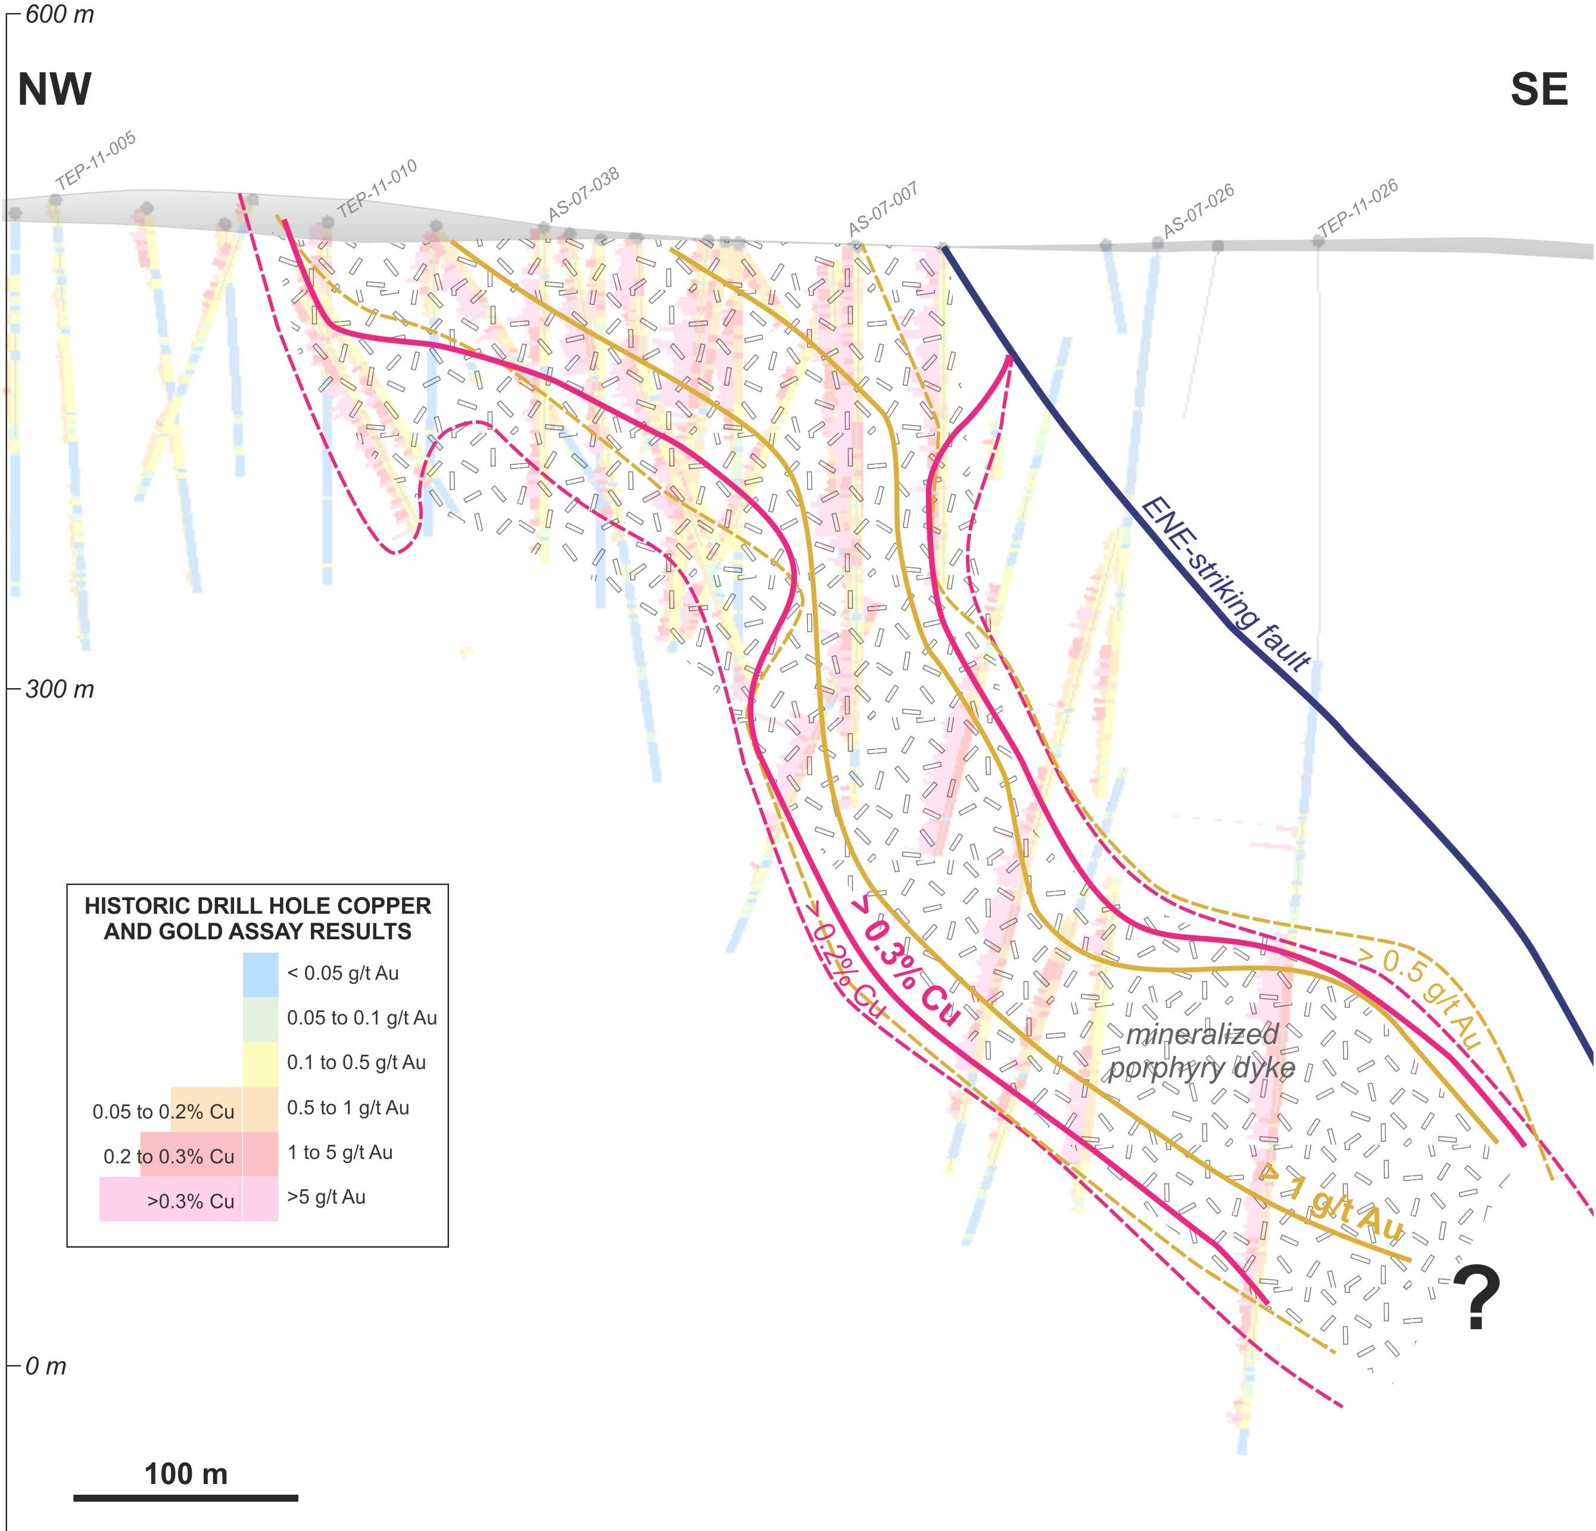
SOUth Zone – Target: increasing resource Base
Re-interpreted Geologic Model indicates porphyry system in south zone open at depth.
Current exploration focused on high-grade Au/Cu mineralization found
At depth in South Pit
TEP-11-026: 309m-496m – 188m - 1.04 g/t Au, 0.38% Cu, 1.2 g/t Ag.
Along Strike of and at depth in North Pit testing Cu-Au bearing porphyry stocks.
Approximate base of current pit shell design
188m -1.04 g/t Au, 0.38 % Cu
Target Area
Source: NI-43-101 Technical Report Preliminary Economic Assessment on the Tepal Project, Michoacan, Mexico, JDS Energy & Mining Inc; January 2017
18

Slide 19
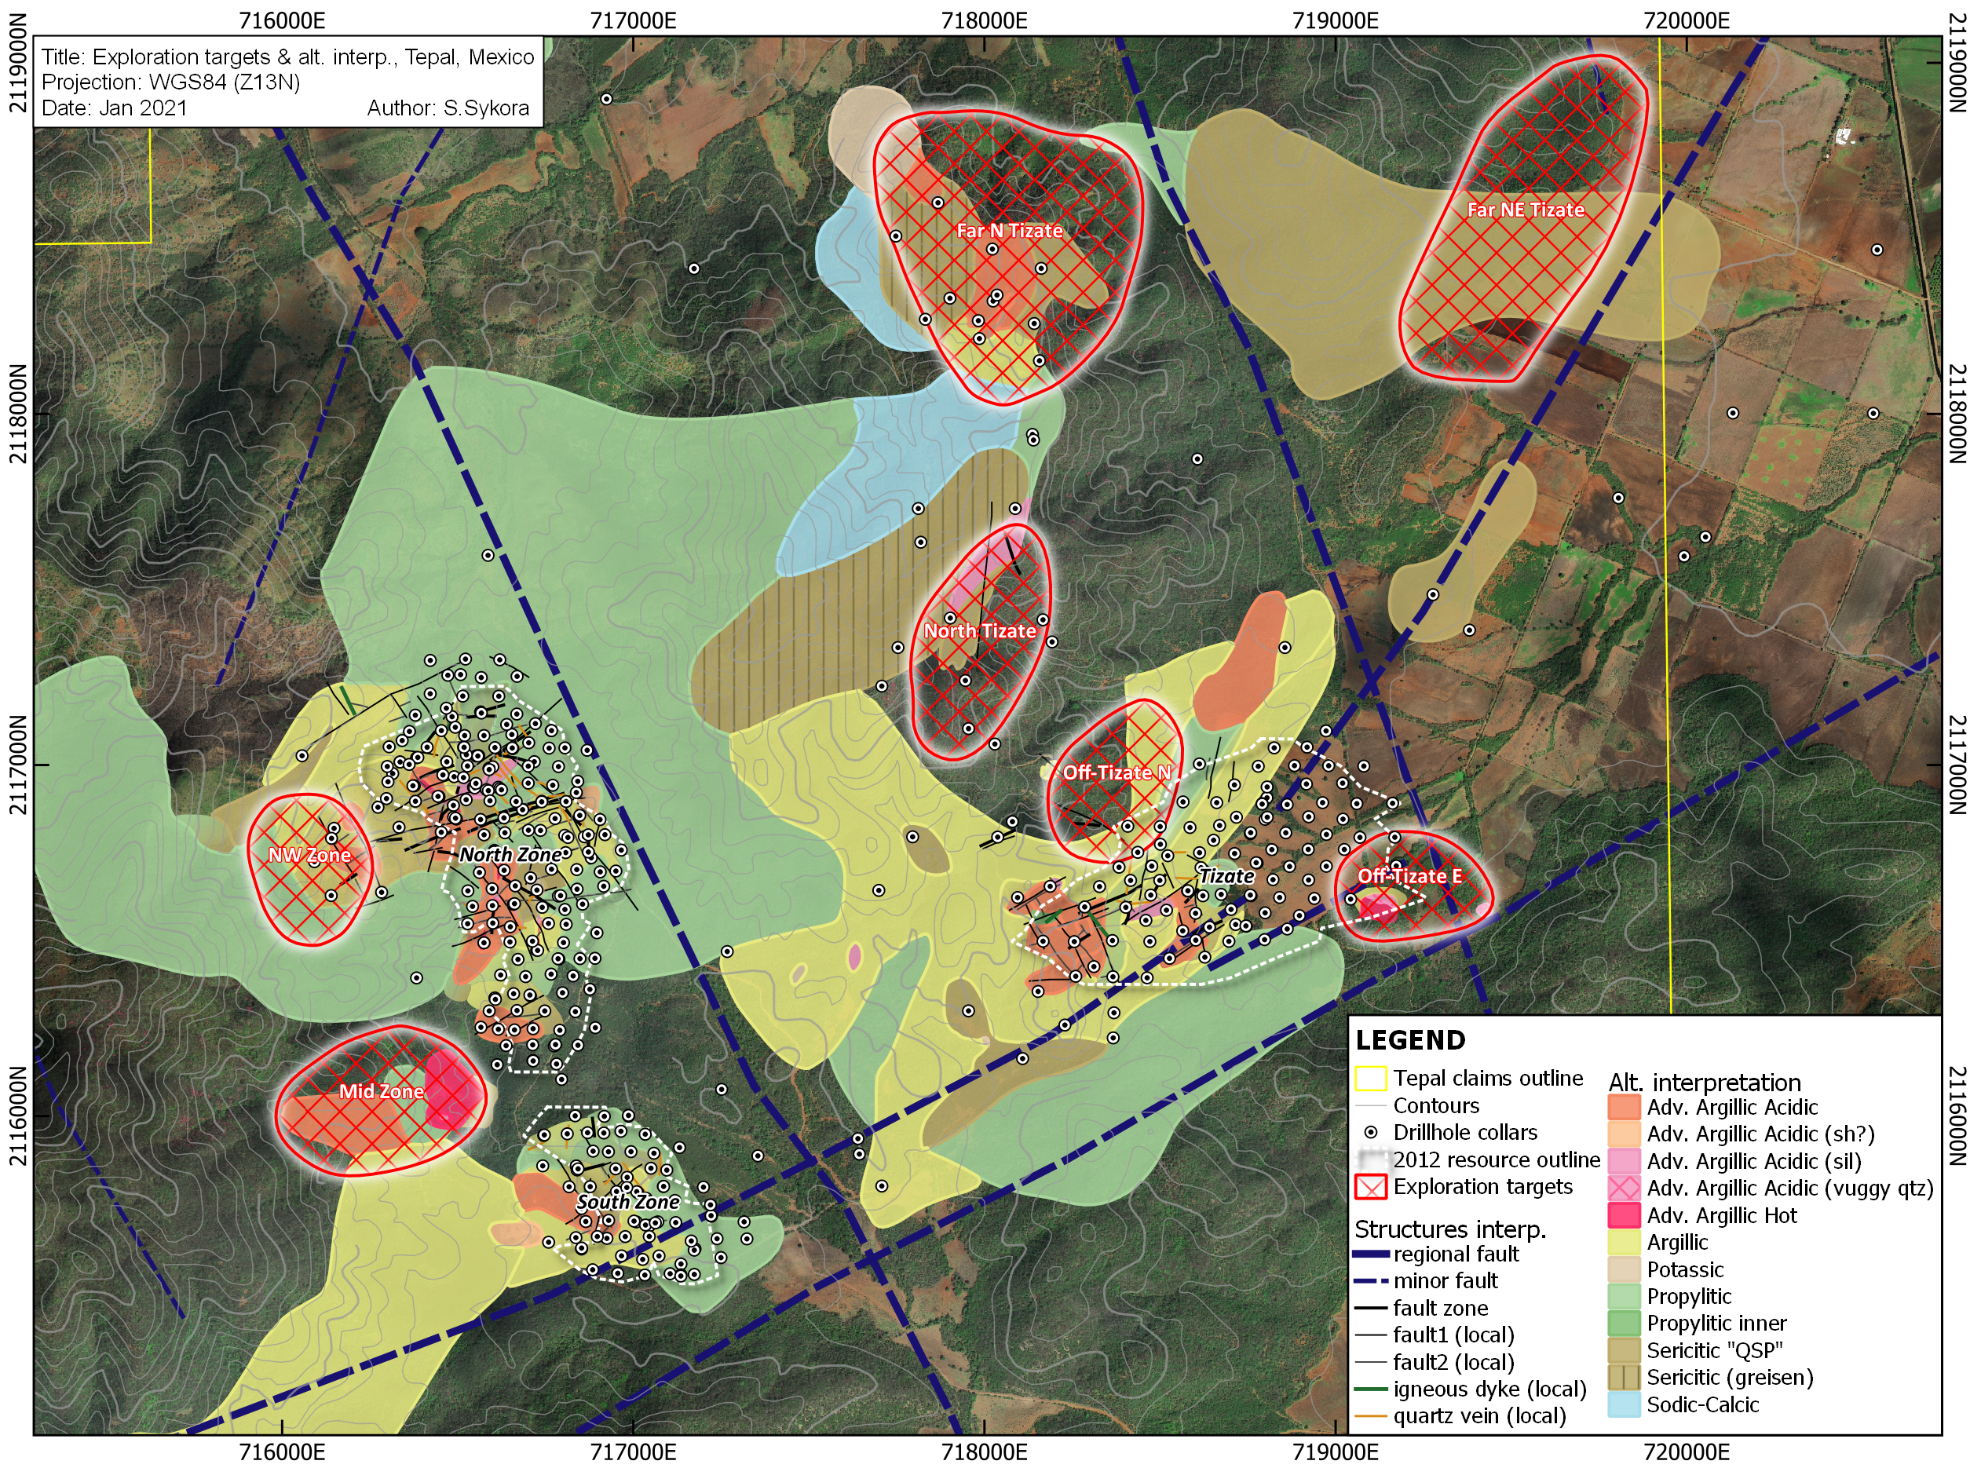
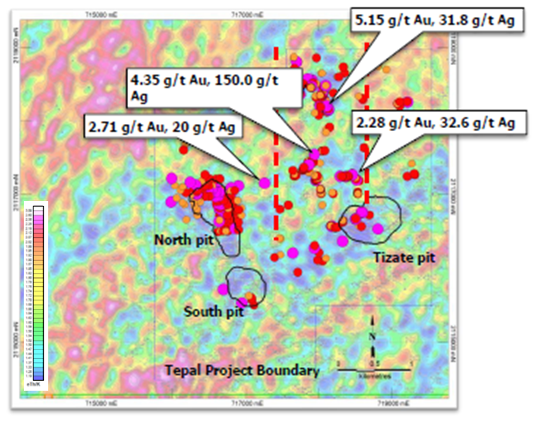
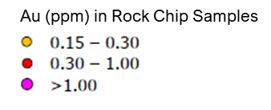
exploration upside in CENTRE BLOCK/tizate
CentRE Block
West Block
TIZ-11-018:
282.95 to 284.37m*
25.3 g/t Au, 565 g/t Ag
7 Zones identified. 12 holes planned in 5 Zones in addition to more surface exploration work.
Recent work indicates the presence of Au-Ag epithermal zones that remain largely untested.
*True width not known
19

Slide 20
Why invest in defiance?
Robust Resource Base ^{(1,2)} and Significant Exploration Potential
Proven Mine Finders: Experienced Management team with decades of exploration success leading to M&A and Mine Development
Leverage to Precious Metal Prices:
Tepal Au Price Sensitivity
Zacatecas Resource Upside
Highly Aligned with Shareholders:
Management and Key Shareholders aligned
Drill-ready exploration targets: Systematic exploration and reinterpretation of historical work has generated highly prospective targets to add ounces and increase grade.
(1) Please see Defiance news release dated January 15, 2015 and Appendix for 43-101 Inferred Mineral Resource Estimate
(2) Please see ValOro news release dated January 19, 2017 and Appendix for PEA Assumptions
20

Slide 21
Defiance Silver Corp
Suite 2900 – 550 Burrard Street
Vancouver, BC, V6C 0A3 Canada
www.defiancesilver.com
info@defiancesilver.com
+1 (604) 343-4677
TSXV:DEF OTC:DNCVF WKN: A1JQW5
Notes:
Home Slide Idea 1 – Would need to purchase higher resolution stock image.

Slide 22
Appendix
22

Slide 23
Industry veterans with proven success
Chris Wright, BA
Chairman of the Board & CEO
Founder and Director of Windermere Capital, an investment firm and manager of two private investment funds: the Navigator and Breakaway Strategic Resource Funds, both of which are significant shareholders of Defiance.
Sherry Roberge, CPA, CA
CFO & Corporate Secretary
Member of the Institute of Chartered Professional Accountants of British Columbia and holds a Bachelor of Commerce degree from Royal Roads University as well as a Master of Professional Accounting from the University of Saskatchewan.
George Cavey, P.Geo
Vice-President, Exploration & Qualified Person
Former VP Exploration of Orko Silver, part of the team who discovered 264mm oz La Preciosa deposit sold to Coeur Mining in 2013 for $380mm. 2004 recipient of the APEGBC C.J. Westermann Award. Canadian Professional Geoscientist Award, Canada’s highest honor for Professional Geoscientist.
Douglas Cavey
Vice-President, Corporate Development; Sr. Technical Advisor
Over a decade of experience working on exploration, development, and mining projects for private, junior, and mid-tier mining companies.
Jennifer Roskowski, MSc
Principal Geologist
Global exploration geologist with a decade of experience working with one of the world’s largest copper mining companies on global generative exploration and target definition.
Dunham L. Craig, P.Geo Director
Past Director of Silvercrest Mines Inc., Past President and CEO and Director of Valoro/Geologix Exploration Inc., Vice President of Exploration and Corporate Development for Wheaton River Minerals.
Paul Smith, MSc Director Founding shareholder and past Finance Director of Ocean Partners Holdings Limited, one of the world’s large traders of copper, zinc and lead concentrates.
James Bergin, BBA
Director
President and CIO of Hillhead Capital Inc. with 29 years of experience in capital markets with Credit Suisse, Barclays capital and Toronto Dominion Bank.
Ron Sowerby
Director
Director of Glentel Inc., which was purchased by Bell Inc. for $594 million. Comptroller and CFO of TCG International Inc. (Trans Canada Glass Ltd.)
23
Notes:
Take out randy, check the symbols of association (current), change DC, JR to OreQuest

Slide 24
UNEXPECTED DEVELOPMENTS | A CATALYST FOR SILVER
Global Silver Production by Country in 2018
Silver Demand by Industry
Rank | Country | MMozs
1 | Mexico | 196.6
2 | Peru | 144.9
3 | China | 114.9
4 | Russia | 43.4
5 | Chile | 42.1
6 | Bolivia | 39.9
7 | Poland | 39.6
8 | Australia | 35.4
9 | United States | 28.0
10 | Argentina | 26.5
11 | Canada | 24.8
12 | India | 23.2
13 | Kazakhstan | 19.5
14 | Sweden | 14.6
15 | Indonesia | 11.9
16 | Morocco | 11.2
17 | Turkey | 5.5
18 | Armenia | 5.0
19 | Iran | 3.6
20 | Dominican Republic | 3.4
21 | Rest of World | 21.7
 | World Total | 855.7
 | Percent of Production Offline | >47.7
Mandatory Mine Closures
Disruption or Voluntary Closures
Mine suspensions are offsetting weak industrial demand for silver, with production halted in countries that represent 47.7% of global silver production.
Silver already had an 861.7mm oz deficit and mine supply has been declining since 2015.
Over 70% of silver is mined as a by-product in polymetallic mines; a slowing economy will lower demand for base metals, putting pressure on prices and mines.
Mine resumptions and ramp-up will be gradual and are uncertain, while global scrap supply has dropped 50% since 2011.
COVID-19 has significantly shifted the supply/demand picture for silver.
As manufacturing activity ceased, industrial demand has weakened and will recover as the global economy resumes and recovers.
While industrial demand has softened, the more severe economic contraction has been in the service sector rather than manufacturing.
Source: Bloomberg, Sprott, The Silver Institute
GFMS World Silver Survey
24

Slide 25
SAN ACACIO PROJECT
43-101 COMPLIANT INFERRED MINERAL RESOURCE ESTIMATE
43-101 Inferred Mineral Resource Estimate
Vein | Tonnes > Cut-off (tonnes) | Grade>Cut-off |  |  | Contained Metal
 |  | Ag (g/t) | Au (g/t) | AgEq (g/t) | Ag (ozs) | Au (ozs) | AgEq (ozs)
VETA G | 2,150,000 | 192.43 | 0.19 | 204.66 | 13,302,000 | 10,000 | 14,147,000
VETA C | 739,000 | 153.28 | 0.08 | 158.66 | 3,642,000 | 1,900 | 3,770,000
TOTAL | 2,889,000 | 182.42 | 0.16 | 192.89 | 16,944,000 | 11,900 | 17,917,000
Source: NI-43-101 Technical Report and Resource Estimate, San Acacio Silver Deposit, Zacatecas Sate, Mexico, by Giroux and Cuttle; September 2014
The San Acacio Deposit has a 43-101 Inferred Mineral Resource Estimate available on www.sedar.com or www.defiancesilver.com. Using a silver equivalent (“AgEq”)* cut-off grade of 100 grams tonne (“g/t”). Using a gold price of $1270/ oz Au and silver price of $19.60 the silver equivalent value would be silver content plus 65 times the gold content. (Note: total contained AgEq values may not add exactly because of rounding). Metallurgical recoveries are not taken into account.
Base Metals not included in initial inferred resource.
25
Notes:
Is it possible to soften these lines? Any recommendations to make it cleaner?

Slide 26
SAN ACACIO PROJECT
“POST-RESOURCE” DRILL RESULTS SUMMARY
Hole # | From (m) | To (m) | Length (m)* | Ag (g/t) | Au (g/t) | Cu % | Pb % | Zn % | AgEq (g/t)**
SAD14-01 | 134.00 | 142.10 | 8.10 | 222.12 | 0.22 | 0.01 | 0.20 | 0.53 | 268.13
SAD14-02 | 168.50 | 171.70 | 3.20 | 419.09 | 0.82 | 0.02 | 0.14 | 0.30 | 499.43
SAD14-03 | 05.00 | 213.30 | 8.30 | 42.89 | 0.92 | 0.04 | 1.87 | 2.44 | 278.33
SAD14-04 | 147.00 | 153.10 | 6.10 | 138.35 | 0.80 | 0.19 | 1.27 | 1.90 | 340.4
SAD15-07 | 136.40 | 140.00 | 3.60 | 211.49 | 0.14 | 0.01 | 0.11 | 0.20 | 234.17
SAD15-08 | 106.05 | 113.30 | 7.25 | 631.46 | 0.43 | 0.01 | 0.09 | 0.22 | 675.58
SAD15-10 | 331.5 | 333.6 | 2.1 | 283.31 | 0.17 | 0.01 | 0.38 | 0.70 | 337.8
SAD15-12 | 226.2 | 253.65 | 27.03 | 148.21 | 0.29 | 0.02 | 0.13 | 0.67 | 202.99
SAD15-13 | 261.00 | 271.00 | 10.00 | 171.22 | 0.08 | 0.01 | 0.27 | 0.42 | 204.65
SAD15-13 | 261.00 | 271.00 | 10.00 | 171.22 | 0.08 | 0.01 | 0.27 | 0.42 | 204.65
SAD15-15 | 209.82 | 213.00 | 3.18 | 285.04 | 0.02 | 0.01 | 0.05 | 0.17 | 296.30
*Please see Defiance press release of 25 Oct 2017 for further details and 2017 intercepts.
*True Widths are approximately 70% to 80% of each intersection **Reported for comparison only, with no assumptions regarding metal recovery or smelter payments. Prices used are Au: $1210.50/ounce, Ag: $16.33/ounce, Cu; $2.80/pound, Pb; $0.83/pound and Zn $0.95/pound in US$. 1 Gram = 0.03215074657 Troy ounce
26

Slide 27
TEPAL GOLD-COPPER PROJECT
43-101 COMPLIANT MINERAL RESOURCE ESTIMATE
Tepal Total Project Resource Estimate¹ – March 2012
Mineral Resource (Mine Diluted) Included in PEA Mine Plan¹²
Resource Classification | Tonnes | Au Grade (g/t) | Cu Grade (%) | Ag Grade (g/t) | Contained Au (oz) | Contained Cu (lbs)
Measured | 34,100,000 | 0.48 | 0.25 | 0.95 | 528,000 | 185,000,000
Indicated | 153,700,000 | 0.26 | 0.19 | 1.67 | 1,276,000 | 628,000,000
Measured & Indicated | 187,800,000 | 0.30 | 0.20 | 1.54 | 1,804,000 | 813,000,000
Inferred | 35,700,000 | 0.16 | 0.15 | 1.68 | 182,000 | 120,000,000
Resource Classification | Tonnes | Au Grade (g/t) | Cu Grade (%) | Ag Grade (g/t) | Contained Au (oz) | Contained Cu (lbs)
Measured | 26,800,000 | 0.51 | 0.25 | 0.95 | 438,000 | 150,000,000
Indicated | 61,700,000 | 0.28 | 0.20 | 1.58 | 550,000 | 269,000,000
Measured & Indicated | 88,500,000 | 0.35 | 0.21 | 1.39 | 988,000 | 419,000,000
Inferred | 2,000,000 | 0.19 | 0.18 | 2.73 | 12,000 | 8,000,000
The resource states in the table conforms to CIM guidelines for reasonable potential for economic extraction and is not to be confused as reserves. Resource numbers above are rounded to the nearest 100,000 tonnes, 1,000 oz Au and 1,000,000 lbs Cu.
The mineral resource stated in the table conforms to CIM guidelines for reasonable potential for economic extraction and is not to be considered mineral reserves.
NSR cut-off for sulphide material is $8.19/tonne milled and for oxide material is $10.13/tonne milled.
Source: NI-43-101 Technical Report Preliminary Economic Assessment on the Tepal Project, Michoacan, Mexico, JDS Energy & Mining Inc; January 2017
27

Slide 28
TEPAL GOLD-COPPER PROJECT
PROJECT PROFILE
Flotation Concentrate & Tails Cyanidation Recovery Estimates
Oxide Leach Recovery Estimates
 | Flotation | Tails Cyanidation | Combined Recovery
Tepal Recovery
Copper | 88.2% |  | 88.2%
Gold | 62.4% | 16.5% | 78.9%
Silver | 27.4% | 15.5% | 40.2%
Tizate Recovery
Copper | 85.9% |  | 85.9%
Gold | 55.0% | 16.0% | 74.0%
Silver | 59.6% | 18.5% | 78.1%
Tepal Recovery
Gold | 83.2%
Silver | 63.3%
Tizate Recovery
Gold | 75.3%
Silver | 55.9%
1. Au = gold, Cu = copper, Ag = silver, Mo = molybdenum, g/t = grams per tonne, % = percent, oz. = ounces, lbs. = pounds. Resource numbers above are rounded to nearest 100,000 tonnes, 1,000 oz Au, 1,000,000 lbs Cu and 1,000 oz. AuEq ² AuEq = gold equivalent and is calculated using gold and copper only using $1000 Au, $2.75 Cu metal prices (AuEq = (lbs. Cu*$2.75/$1000) + Au oz.). All dollar values stated are $USD
2. The mineral resource stated in the table conforms to CIM guidelines for reasonable potential for economic extraction and is not to be considered mineral reserves.
Source: NI-43-101 Technical Report Preliminary Economic Assessment on the Tepal Project, Michoacan, Mexico, JDS Energy & Mining Inc; January 2017
28

Slide 29
TEPAL GOLD-COPPER PROJECT
PROJECT PROFILE
2017 PEA Assumptions
2017 PEA Highlights
Sustaining Capital Costs | $86.7
Mine Life | 9.8 years
Total Material Mined | 142.9 Mt
Strip Ratio | 0.6 : 1
Average Plant Throughput (Sulphide + Oxide) | 9.6 Mtpa
Average Au Sulphide Head Grade | 0.33 g/t
Average Cu Sulphide Head Grade | 0.21%
Average Au Oxide Head Grade | 0.45 g/t
LOM Average Au Sulphide Recovery (combined Flotation & CIL) | 77%
LOM Average Cu Sulphide Recovery | 87%
LOM Average Au Oxide Recovery | 81%
% Δ in Base Case Metals Prices |  |  | -10% | 0% | 10%
Gold Price (US$/oz) |  |  | $1,125 | $1,250 | $1,375
Copper Price (US$/lb) |  |  | $2.25 | $2.50 | $2.75
Silver Price (US$/oz) |  |  | $16.20 | $18.00 | $19.80
All-In Sustaining Costs (net of byproducts)
Gold (US$/oz) |  |  | $497 | $396 | $296
Copper (US$/oz) |  |  | $0.69 | $0.38 | $0.07
Pre-Tax
NPV(5%) (US$ millions) |  |  | $165.6 | $299.4 | $433.3
IRR (%) |  |  | 25% | 36% | 46%
Payback Period (years) |  |  | 2.2 | 1.6 | 1.3
After-Tax:
NPV(5%) (US$ millions) | $77.5 |  | $77.5 | $169.4 | $257.2
IRR (%) | 15% |  | 15% | 24% | 31%
Payback Period (years) | 3.0 |  | 3.0 | 2.3 | 1.9
Cash cost includes all mining, milling & refining, transport, mine-level G&A, and royalty costs
Source: NI-43-101 Technical Report Preliminary Economic Assessment on the Tepal Project, Michoacan, Mexico, JDS Energy & Mining Inc; January 2017
29

Slide 30
TEPAL GOLD-COPPER PROJECT
PROJECT PROFILE
2017 PEA Production by Year & Cost Profile
Gold-Equivalent Ozs
USD per Oz
Using US$1,250/oz. Au price, US$2.50/lb. Cu price and US$18.00/oz. Ag price
Cash cost includes all mining, milling & refining, transport, mine-level G&A, and royalty costs; net of byproduct credits
Source: NI-43-101 Technical Report Preliminary Economic Assessment on the Tepal Project, Michoacan, Mexico, JDS Energy & Mining Inc; January 2017
30

