Slide 1
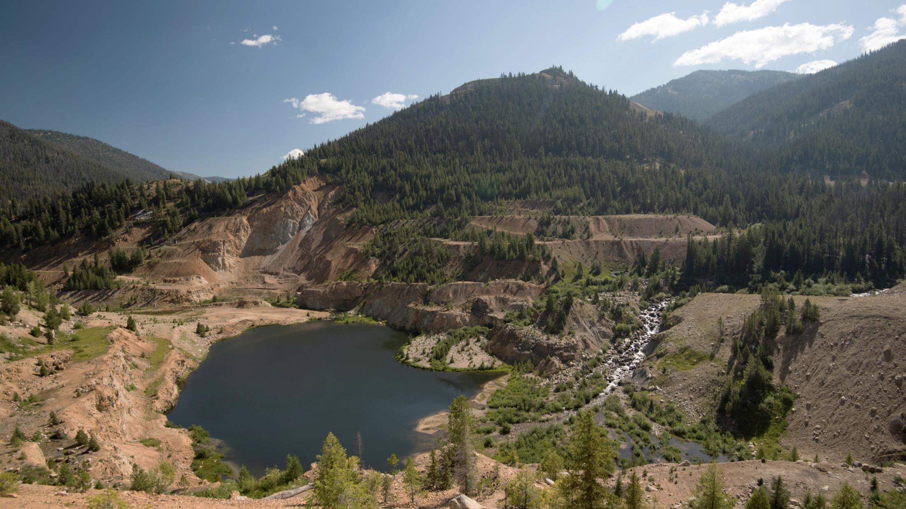

3
STIBNITE GOLD PROJECT
IDAHO, USA
MAX.TSX
MDRPF.OTCQX
NOVEMBER 2016

Slide 2
FORWARD LOOKING STATEMENTS
Statements contained in this presentation that are not historical facts are "forward-looking information" or "forward-looking statements" (collectively, "Forward-Looking Information") within the meaning of applicable Canadian securities legislation and the United States Private Securities Litigation Reform Act of 1995. Forward-Looking Information includes, but is not limited to, disclosure regarding possible events, conditions or financial performance that is based on assumptions about future economic conditions and courses of action; and the plans for completion of the Offerings, expected use of proceeds and business objectives. In certain cases, Forward-Looking Information can be identified by the use of words and phrases such as "anticipates", "expects", "understanding", "has agreed to" or variations of such words and phrases or statements that certain actions, events or results "would", "occur" or "be achieved". Although Midas Gold has attempted to identify important factors that could affect Midas Gold and may cause actual actions, events or results to differ materially from those described in Forward-Looking Information, there may be other factors that cause actions, events or results not to be as anticipated, estimated or intended, including, without limitation, the risks and uncertainties related to the Offerings not being completed in the event that the conditions precedent thereto are not satisfied; uncertainties related to raising sufficient financing in a timely manner and on acceptable terms. In making the forward-looking statements in this news release, Midas Gold has applied several material assumptions, including the assumptions that (1) the conditions precedent to completion of the Offerings will be fulfilled so as to permit the Offerings to be completed in or about April of 2016; (2) all necessary approvals and consents, including shareholder approval, in respect of the Offerings will be obtained in a timely manner and on acceptable terms; and (3) general business and economic conditions will not change in a materially adverse manner. There can be no assurance that Forward-Looking Information will prove to be accurate, as actual results and future events could differ materially from those anticipated in such statements. Accordingly, readers should not place undue reliance on Forward-Looking Information. Except as required by law, Midas Gold does not assume any obligation to release publicly any revisions to Forward-Looking Information contained in this news release to reflect events or circumstances after the date hereof or to reflect the occurrence of unanticipated events.
Forward-Looking Information involves known and unknown risks, uncertainties and other factors which may cause the actual results, performance or achievements of the Corporation to be materially different from any future results, performance or achievements expressed or implied by the Forward-Looking Information. Such risks and other factors include, among others, the industry-wide risks and project-specific risks identified in the PFS and summarized above; risks related to the availability of financing on commercially reasonable terms and the expected use of proceeds; operations and contractual obligations; changes in exploration programs based upon results of exploration; changes in estimated mineral reserves or mineral resources; future prices of metals; availability of third party contractors; availability of equipment; failure of equipment to operate as anticipated; accidents, effects of weather and other natural phenomena and other risks associated with the mineral exploration industry; environmental risks, including environmental matters under US federal and Idaho rules and regulations; impact of environmental remediation requirements and the terms of existing and potential consent decrees on the Corporation‘s planned exploration and development activities on the Stibnite Gold Project; certainty of mineral title; community relations; delays in obtaining governmental approvals or financing; fluctuations in mineral prices; the Corporation‘s dependence on one mineral project; the nature of mineral exploration and mining and the uncertain commercial viability of certain mineral deposits; the Corporation‘s lack of operating revenues; governmental regulations and the ability to obtain necessary licences and permits; risks related to mineral properties being subject to prior unregistered agreements, transfers or claims and other defects in title; currency fluctuations; changes in environmental laws and regulations and changes in the application of standards pursuant to existing laws and regulations which may increase costs of doing business and restrict operations; risks related to dependence on key personnel; and estimates used in financial statements proving to be incorrect; as well as those factors discussed in the Corporation's public disclosure record. Although the Corporation has attempted to identify important factors that could affect the Corporation and may cause actual actions, events or results to differ materially from those described in Forward-Looking Information, there may be other factors that cause actions, events or results not to be as anticipated, estimated or intended. There can be no assurance that Forward-Looking Information will prove to be accurate, as actual results and future events could differ materially from those anticipated in such statements. Accordingly, readers should not place undue reliance on Forward-Looking Information. Except as required by law, the Corporation does not assume any obligation to release publicly any revisions to Forward-Looking Information contained in this presentation to reflect events or circumstances after the date hereof or to reflect the occurrence of unanticipated events.
Cautionary Note
The presentation has been prepared by Midas Gold management and does not represent a recommendation to buy or sell these securities. Investors should always consult their investment advisors prior to making any investment decisions.
All references to “dollars” or “$” shall mean United States dollars unless otherwise specified. Exchange rates and share prices used, where appropriate, are based on the spot prices as of Feb. 19th, 2016.

Slide 3
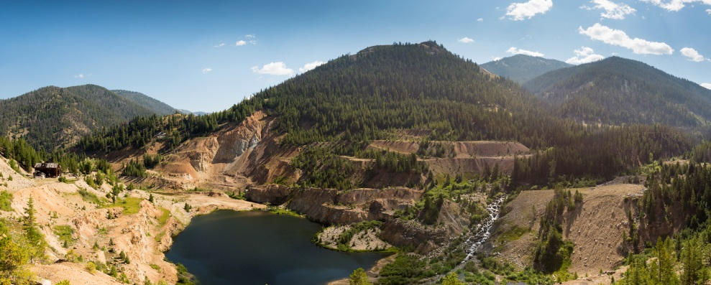
HIGHLIGHTS: MIDAS GOLD & THE STIBNITE GOLD PROJECT
WORLD CLASS GOLD PROJECT ^{(1, 2)}
SOCIAL LICENCE
Low geopolitical risk Idaho, USA – a stable mining jurisdiction
Brownfields site Restoration of extensive prior disturbance
Positive Pre-Feasibility Study US$832 million NPV & 19.3% IRR (after tax at 5% discount rate) at $1,350/oz gold
Multi-million ounce deposit 8th largest gold reserve in USA
Size 4 million oz gold produced over 12 year mine life
Superior grade 1.6g/t gold; 4th highest grade open pit deposit in USA
Scale 388,000oz gold/year for first 4 years & 337,000oz gold/year LOM
Modest capital intensity US$242/oz life of mine production
Low all-in sustaining costs $US526/oz for first 4 years (cash cost + royalties + sustaining capital)
Strong after-tax cash flow US$294 million/year (Years 1-4) & US$254 million/year (Years 1-8)
Strategic by-products Antimony + silver with production proven metallurgy
Exploration potential All deposits open to expansion and multiple exploration prospects already drilled
Community Support Strong local and state support
Financial Support Paulson, Franco-Nevada and Teck
Corporate Depth Experienced management team and strong boards with local, state & federal connections
Well Funded ~US$42.2 million cash at June 30/16
The Pre-Feasibility Study (“PFS”) is intended to be read as a whole and sections should not be read or relied upon out of context. The information in this presentation is subject to the assumptions, exclusions and qualifications contained in the PFS. See “Regulatory Information” at the end of this presentation.
See non-IFRS measures at conclusion

Slide 4
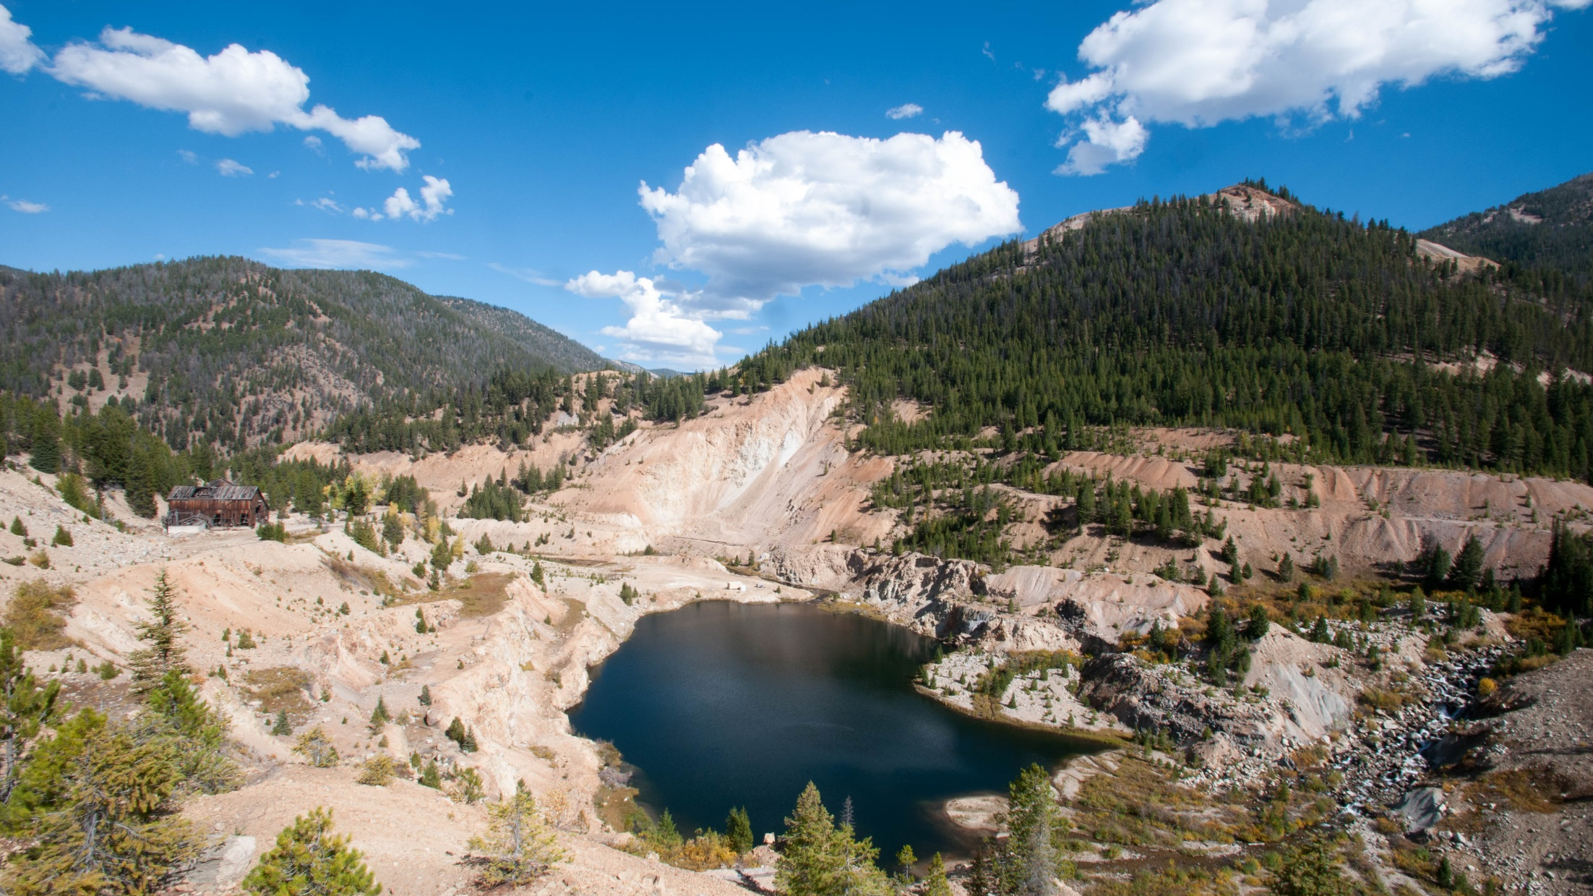
midas GOLD

Slide 5
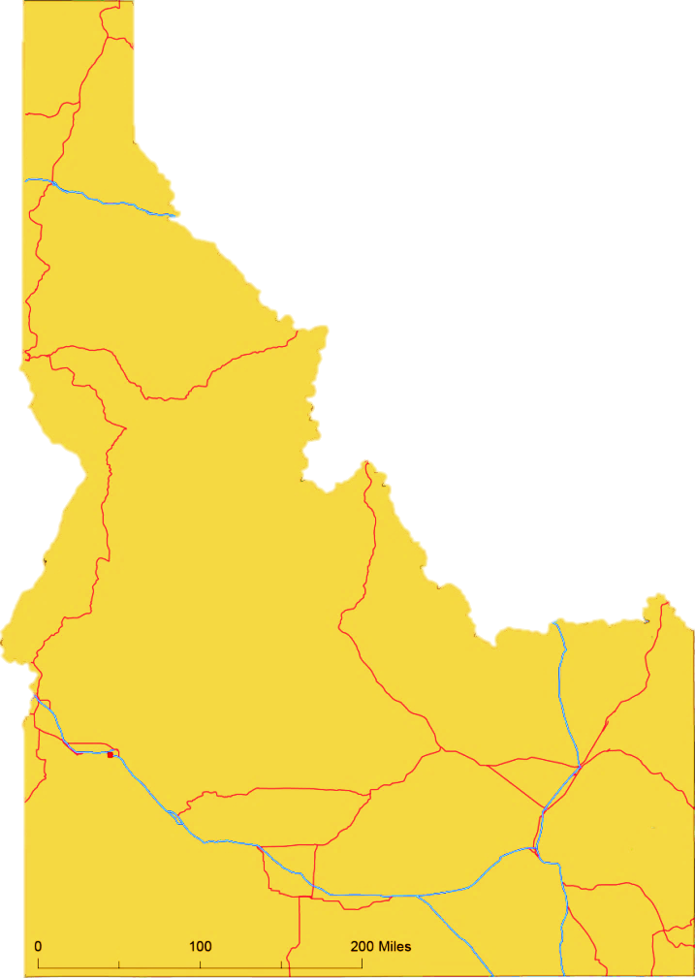
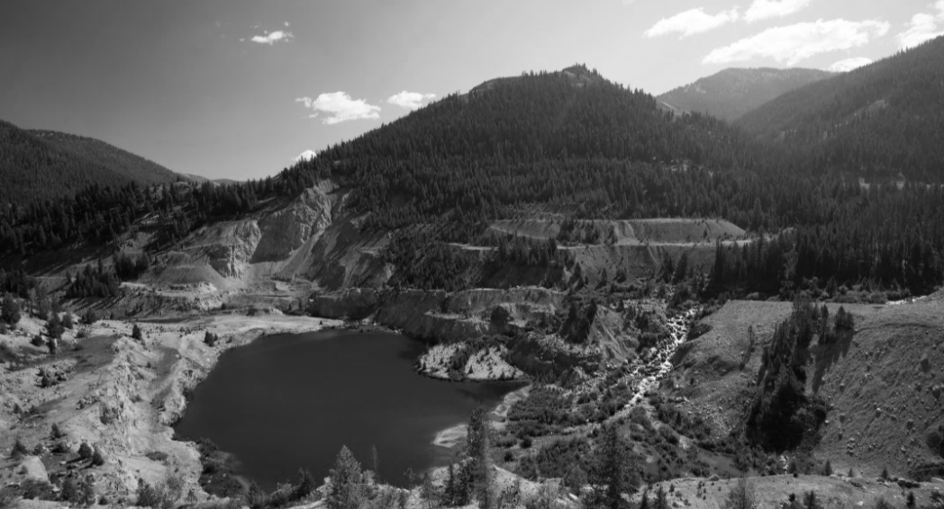
MIDAS GOLD
IPO in 2011 with sole focus on advancing the Stibnite Gold Project, Idaho, USA
~US$137m spent on the Project since 2009
    ~99,450m of drilling by Midas Gold
    ~136,400m of drilling pre-Midas Gold
    PFS completed
    3+ years of environmental baseline data collected
    175 million shares issued
    Major shareholders include:
    EuroPac
    Franklin
    Gabelli
    Franco Nevada purchased a 1.7% NSR in 2013
    Teck purchased 9.9% in 2013
    Paulson backstopped C$55 million financing in March 2016
    Experienced management team and strong boards with local connections
    M&G
    Sun Valley
    Teck Corp.
    Vista Gold

Slide 6

MIDAS GOLD
Project
  World class asset in geopolitically stable jurisdiction
Potential
  Leverage to gold price, permit progress, resource optimization and exploration success
People
  Outstanding team of professionals who have done it before
Paulson
  Strong financial supporters, led by Paulson & Co.
Past
  Restoration of a brownfields site will allow fish passage for the first time since the 1930s
Permitting
  Mine development application filed in Q3/16
Preliminary Feasibility Study
  Demonstrates a large scale, low cost, financially robust project
  Path Forward
  Permitting & feasibility study
SUCCESS

Slide 7
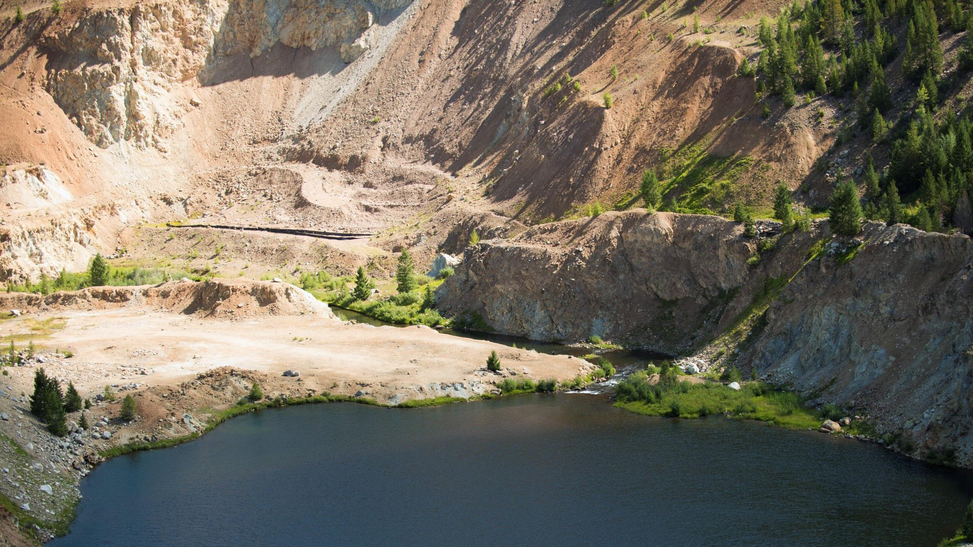
PROJECT

Slide 8
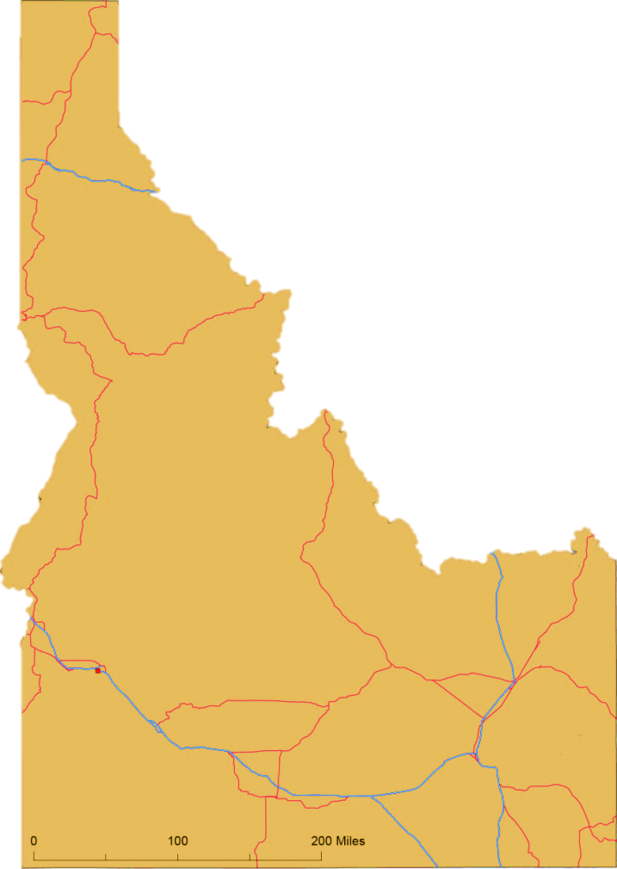
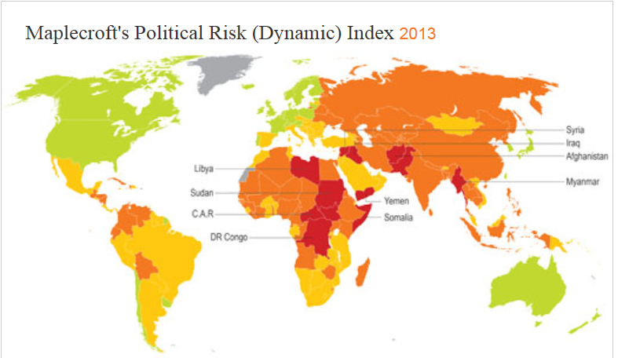
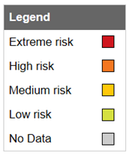
IDAHO: THE RIGHT PLACE
8
Lucky Friday Mine
Hecla Mining Company
Silver-Lead-Zinc
A mining friendly State
Well defined permitting process
Strong community support
Low geopolitical risk
#5 Ranked Mining Jurisdiction in USA ⁽¹⁾
Coeur d’Alene
Sunshine Mine
Sunshine Silver Mines Silver
Metals currently being mined
in Idaho include:
Low geopolitical risk in a high risk world
Stibnite Gold Project
Midas Gold Au-Sb
MOLYBDENUM, SILVER,
LEAD, COPPER AND GOLD
Idaho Cobalt Project
Formation Metals
Copper-Cobalt
Stibnite Gold Project
42
MO
95.94
47
AG
107.87
82
PB
207.20
29
CU
63.546
79
AU
196.97
McCall
Cascade
Thompson Creek Mine
Thompson Creek Mining
Molybdenum
Idaho is the 2nd largest Phosphate mining district in the USA
BOISE
©Maplecroft
Maplecroft identifies and monitors the key issues affecting the investment climates of 197 countries. The Atlas analyses yearly trends relating to dynamic risks, which reflect change over a short period of time, including governance, political violence, the macroeconomic environment, and included this year for the first time, resource nationalism. It also includes structural risks which reflect change over a longer timeframe, including economic diversification, resource security, infrastructure quality, the resilience of society to challenges, and the risk of complicity in human rights violations committed by regimes and business partners.
IDAHO
Phosphate District
Agrium, Monsanto, Simplot, Stonegate
(1) Fraser Institute Survey

Slide 9
STIBNITE GOLD PROJECT - PRODUCTION SCALE
Higher Return
Higher Production
Source: RBC Research Report (March 2016): ThomsonOne, Company Reports, RBC Capital Markets estimates

Slide 10
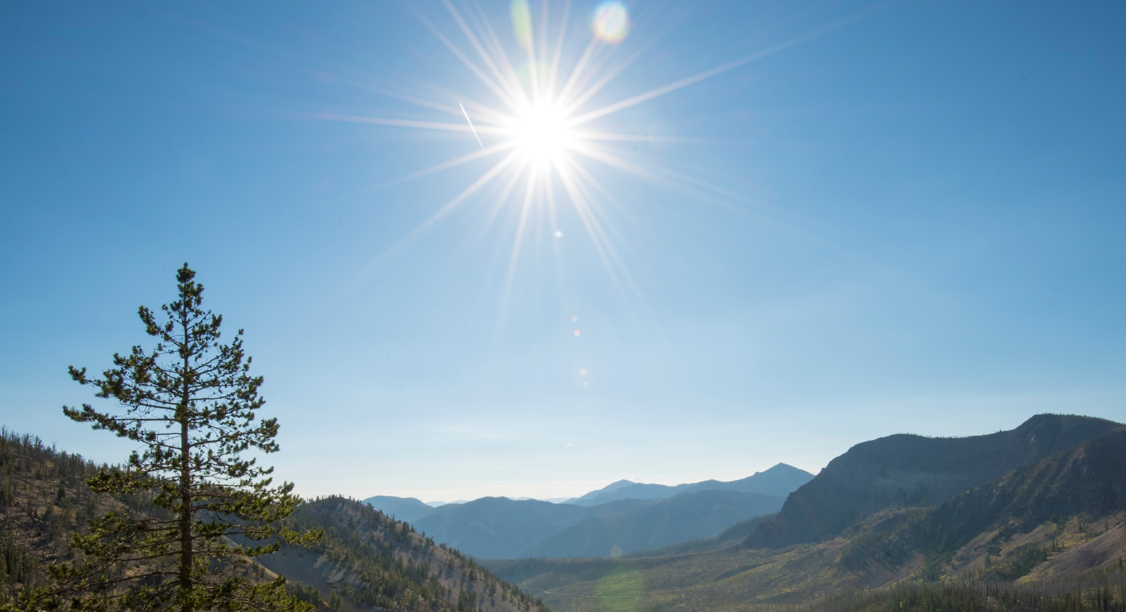
POTENTIAL

Slide 11
POTENTIAL UPSIDE – LEVERAGE TO GOLD PRICE
^{NAV Sensitivities (US$)}
 | US$1,200/oz Au⁽¹⁾ | US$1,350/oz Au⁽²⁾ | US$1,500/oz Au⁽³⁾
Project NPV5% | $513M | $832M | $1,129M
Cash on Hand | $42M | $42M | $42M
Net Asset Value | $555M | $874M | $1,171M
NAVPS⁽⁴⁾ | $1.75 | $2.75 | $3.69
⁽¹⁾ PFS Case A: $1,200/oz Au, $20/oz Ag, $4.00/lb Sb, after-tax
⁽²⁾ PFS Case B (Base Case): $1,350/oz Au, $22.50/oz Ag, $4.50/lb Sb, after-tax
⁽³⁾ PFS Case C: $1,500/oz Au, $25/oz Ag, $5.00/lb Sb, after-tax
⁽⁴⁾ Assumes debentures converted to common shares
Substantial NPV & Leverage To Gold Price
Enterprise Value
~US $125m
Source: Midas Gold December 2014 PFS

Slide 12

POTENTIAL UPSIDE – MULTIPLE EXPANSION
  Development costs lower through a down-cycle
  Construction readiness for a medium-term improvement to gold price
  Fully permitted projects traditionally attract higher valuation multiples
Price to NAV
Rainy/Romarco Comparison: Large scale deposits often get acquired after permitting, feasibility
Takeover Precedents |  | Rainy River | Romarco | Kaminak
Date Acquired |  | 31-May-13 | 30-Jul-15 | 12-May-16
Acquirer |  | New Gold | OceanaGold | Goldcorp
Takeover Value (C$M) |  | $385 | $856 | $520M
Premium (%) |  | 67% | 72% | 40%
43-101 Reserves (Moz Au) |  | 4.0 | 2.0 | 2.2
Per Oz Reserves (C$/oz) |  | $77 | $293 | $218
Project |  | Rainy River | Haile | Coffee
Stage at Takeover |  | Post BFS, Adv. Permitting | Post BFS, Permitted | Post BFS, Adv. Permitting
Project NPV5% (US$M)* |  | $656 | $329 | $438
Takeover P/NAV* |  | 0.50x | 1.22x | 0.84x
Takeover Consensus P/Target** |  | 0.65x | 0.84x | 1.12x
*BFS Study, After-Tax NPV5%, US$1,250 Au
**Analyst Consensus |  |  | Source: Haywood Securities
Post-Permit/Construction
Pre-Permit
Project Development Timeframe
* Haywood Securities compilation of Company reported economic studies after-tax NAV5%

Slide 13
PFS vs PEA – NET PRESENT VALUE
REDUCED PAYABLE METALS IS SOURCE OF LARGEST REDUCTION IN NPV
Life-of-Mine After-tax NPV_{5%} - Comparing PEA to PFS
Changes:
Decrease in payable metal:
  Inferred resources excluded in PFS
  Changes in mineral resource estimation process
Decrease in metal prices
Increases to OPEX
  Finer grinding
    Increased electricity costs & consumption, grinding media consumption
  Unit mining costs
    Lower cost Hangar Flats material eliminated
    More detailed haulage profiles
Addition of 1.7% royalty
11% of reduction
60% of reduction
PEA
NPV_{5%}
PFS
NPV_{5%}
The PFS is intended to be read as a whole and sections should not be read or relied upon out of context. The information in this presentation is subject to the assumptions, exclusions and qualifications contained in the PFS. See “Regulatory Information” at the end of this presentation.

Slide 14
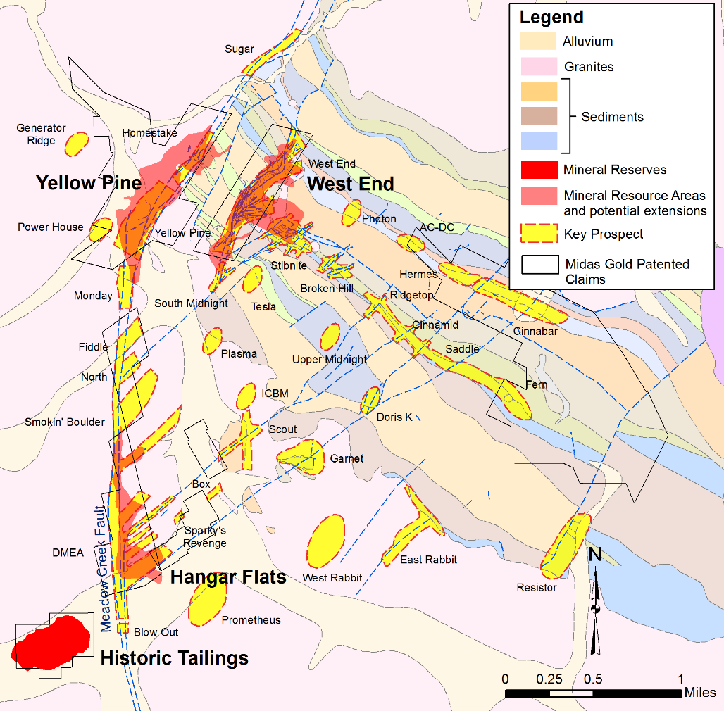
POTENTIAL UPSIDE - RESOURCES & RESERVES
Existing Deposits:
  Resource to reserve conversion
  Resource/reserve expansion immediately adjacent to pits
  In pit unclassified materials
  Grade &/or oz increases in historic data areas
Priority Prospects:
  Small tonnage, high grade
      e.g. Garnet, Scout, Upper Midnight
  Bulk tonnage
      e.g. Cinnamid-Ridgetop, Saddle-Fern, Rabbit
  Undefined airborne targets
      e.g. Mule, Salt & Pepper, Blow-out
Rarity of Global Gold Deposits >5m oz⁽¹⁾
Stibnite Gold Project
(1) Source: Mineral Economics Group, RBC Capital Markets

Slide 15
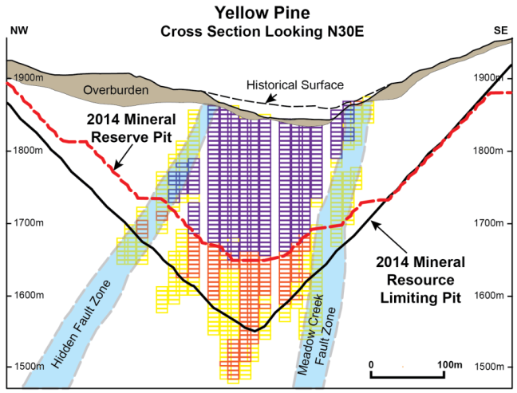
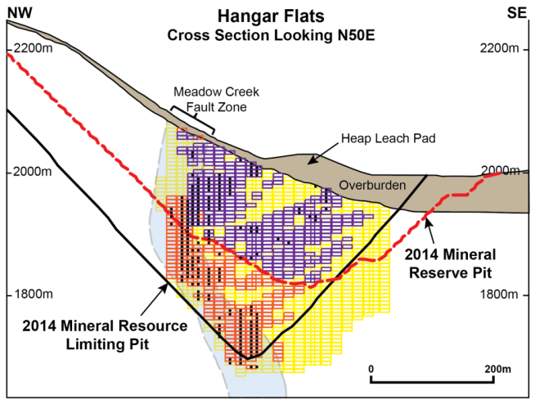
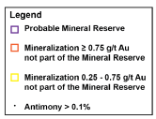
POTENTIAL UPSIDE: IN- & NEXT-TO-PIT RESERVE ADDITIONS
INSIDE THE PFS RESERVE PITS
AROUND THE PFS RESERVE PITS THROUGH RESOURCE CONVERSION
Converting some or all of 346k oz Au @ 1.1 g/t Au in inferred mineral resources* to mineral reserves, also reducing strip ratio
50-100k oz Au in partially drilled waste dumps currently treated as waste rock**
50-100k oz Au + 30-50M lbs Sb through more detailed drilling of higher grade core of Yellow Pine, where historic data restricted or excluded**
889k oz Au @ 1.7g/t Au in indicated mineral resources between reserve pit and resource pit
714k oz Au @ 1.5 g/t Au in inferred mineral resources* between reserve pit and resource pit
The PFS is intended to be read as a whole and sections should not be read or relied upon out of context. The information in this presentation is subject to the assumptions, exclusions and qualifications contained in the PFS. See “Regulatory Information” at the end of this presentation.
* See slide 51 for disclaimer regarding Inferred Mineral Resources
** See slide 51 for disclaimer regarding geologic exploration potential

Slide 16
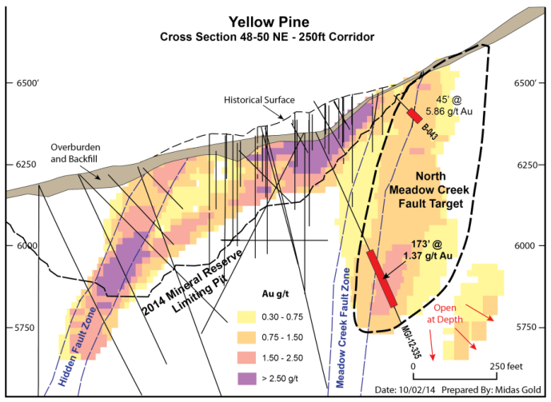
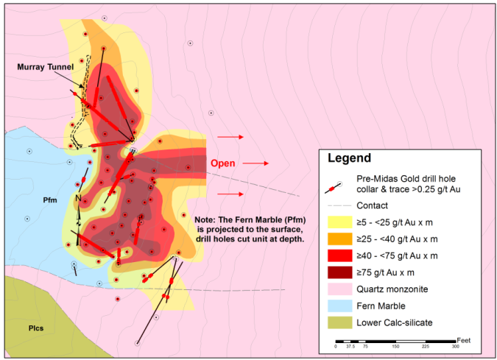
POTENTIAL UPSIDE - HIGH GRADE EXPLORATION TARGETS
EXPLORATION POTENTIAL
AROUND THE PFS PITS
HIGH GRADE UNDERGROUND PROSPECTS
NE Yellow Pine, including intercepts of:
  162ft @ 5.4g/t Au
  45ft @ 5.9g/t Au
Hangar Flats below pit, including intercepts of:
  125ft @ 3.1g/t Au, 1.45% Sb
  249ft @ 1.6g/t Au, 2.5% Sb
Hangar Flats in the old DMEA workings area,
which had intercepts of:
  84ft @ 3.6g/t Au
  157ft @ 5.1g/t Au, 0.30% Sb
  294ft @ 1.6g/t Au, 2.76% Sb
  125ft @ 6.6g/t Au, 0.51% Sb
West End, both along strike and deeper, including intercepts of:
  Deeper: 127ft @ 2.9g/t Au & 230ft @ 2.3g/t Au
  Along strike: 155ft @ 3.5g/t Au & 95ft @ 3.2g/t Au
Garnet conceptual underground target with 95 holes completed:
  1-2m ton range containing 250 – 500k oz Au at grades of 5 – 8g/t Au
Upper Midnight is a high grade prospect, including intercepts of:
  75ft @ 14.8g/t Au
  100ft @ 6.7g/t Au
  35ft @ 11.3g/t Au
  25ft @ 15.6g/t Au
The PFS is intended to be read as a whole and sections should not be read or relied upon out of context. The information in this presentation is subject to the assumptions, exclusions and qualifications contained in the PFS. See “Regulatory Information” at the end of this presentation.

Slide 17
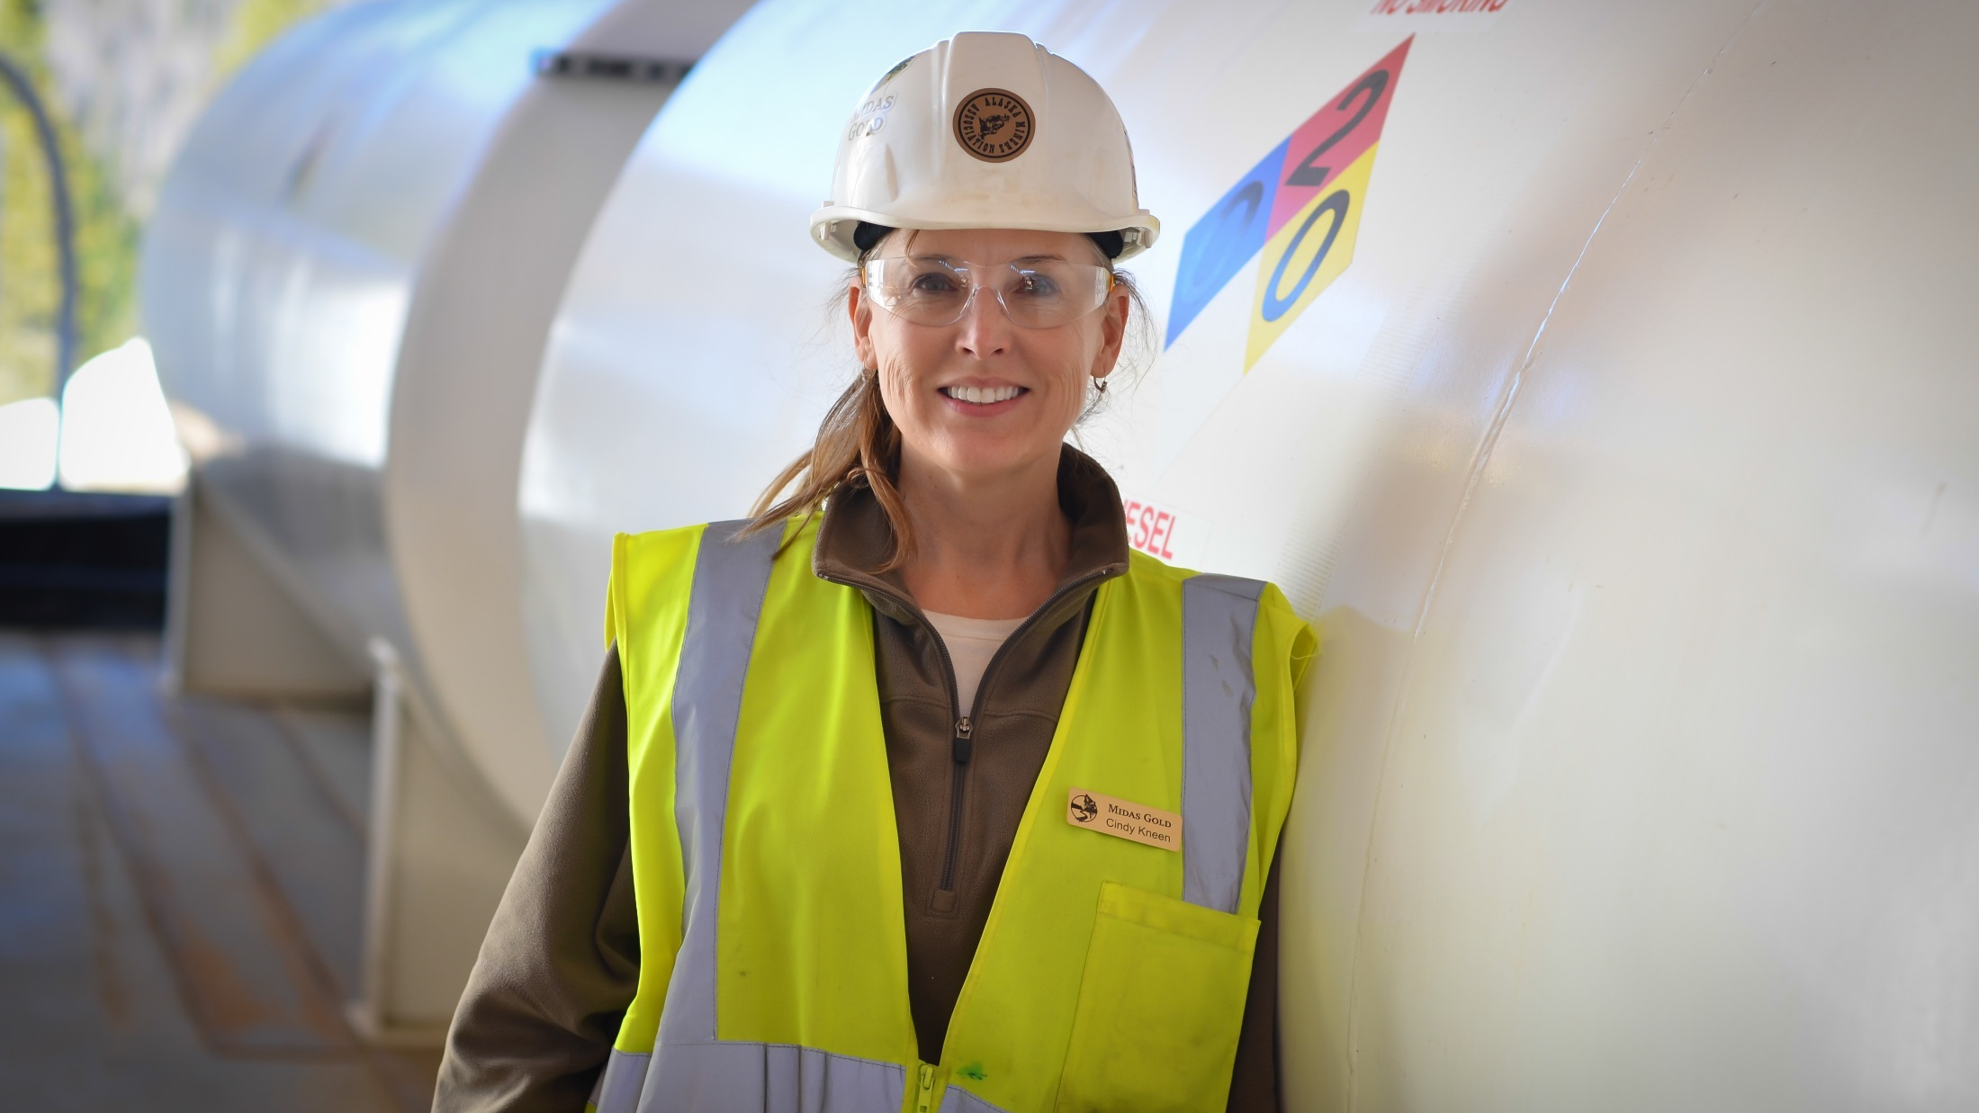
PEOPLE

Slide 18


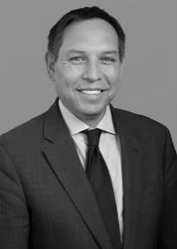










BOARDS OF DIRECTORS:
PROVEN TRACK RECORD, LOCAL INTERESTS
Midas Gold Corp. Board
Peter Nixon Chair & Director
Keith Allred Director
Michael Bogert
Director
Victor Flores
Director
Marcelo Kim
Director
Stephen Quin Director / CEO
Donald Young Director
  Ex-Goepel, director of Dundee Precious Metals, ex-Miramar
  Partner at Cicero Group, 2010 Democratic candidate for Governor of Idaho
  Attorney, Parsons, Behle & Latimer, former counselor to US Interior Secretary, former regional admin. of the US EPA Region 10 office
  Partner, Paulson & Co.
  Partner, Paulson & Co
  Ex-Capstone, Sherwood, Miramar & Northern Orion
  Ex-KPMG, Placer Dome, director of Dundee Precious Metals
Midas Gold Idaho, Inc. Board
(Idaho operating subsidiary)
Don Bailey Chair & Director
Bob Barnes
Director/COO
Ken Brunk Director
Scotty Davenport Director
Frank Eld Director
Ronn Julian Director
Laurel Sayer
Director / CEO
  Served four terms on McCall City Council, two as mayor, resident of McCall, ID
  COO Midas Gold, Ex-VP Ops Capstone, ex-Pan American, Goldcorp
  Ex-CEO Midway Gold, ex-Romarco, ex-Newmont, experienced mine builder & operator
  Founding member of Valley County Economic Development Council, business owner in Valley County, resident of McCall, ID
  Former Valley County Commissioner (two terms), resident of Rosebury, ID
  Three decades with the US Forest Service, resident of Cascade, ID
  Former E.D. of Idaho Coalition of Land Trusts, ex-director of natural resource issues & policy for Idaho congressional delegation

Slide 19









EXPERIENCED MANAGEMENT:
WE’VE DONE IT BEFORE!
Stephen Quin President & CEO
Midas Gold Corp.
Laurel Sayer President & CEO
Midas Gold Idaho
Bob Barnes Director & COO
Midas Gold Idaho
Darren Morgans
CFO
Anne Labelle
VP Legal & Sustainability
John Meyer
VP Development
Rocky Chase VP Environment & Permitting
Chris Dail Exploration Manager
Richard Moses
Field Operations Manager
Liz Monger
IR Manager
& Corp. Secretary
  Ex-COO Capstone, ex-CEO Sherwood Copper, Miramar Mining
  Former Executive Director of Idaho Coalition of Land Trusts, ex-director of natural resource issues & policy for Idaho congressional delegation
  Ex-VP Ops Capstone, ex-Pan American, Goldcorp
  Ex-Terrane, Placer Dome, MIM and PWC
  Ex-Capstone, Sherwood, Miramar
  Ex-Kinross, Aurelian, Barrick, Syncrude
  Ex-Barrick, Hecla, Stibnite district experience
  Ex-Cominco, Asarco, Kennecott, Piedmont,
  USFS
  Ex-Livengood, Pebble, Donlin Creek, Bakyrchik
  Ex-Rainy River and Rubicon Minerals

Slide 20
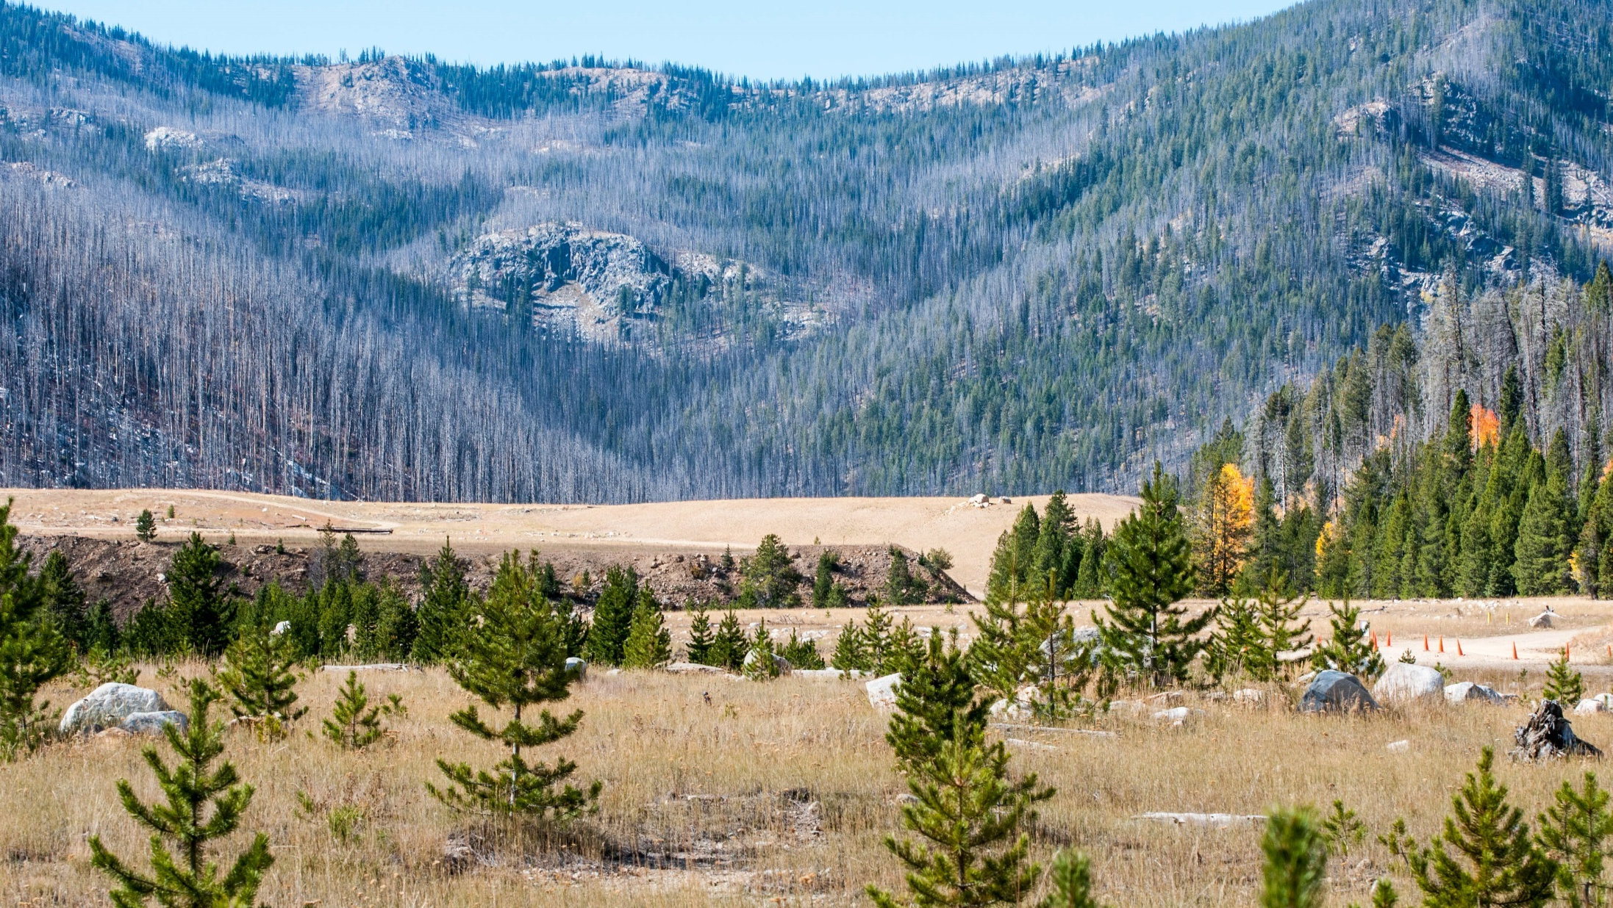
PAULSON

Slide 21

PAULSON - STRATEGIC INVESTMENT IN MIDAS GOLD
C$55.2 million investment backstopped by Paulson – March 2016
  Current shareholders participated for C$20.7 million
  Paulson took up balance (C$34.5 million)
0.05% coupon, senior unsecured convertible debenture
7-year term, redeemable after 4 years
Funds the permitting process and feasibility for the Stibnite Gold Project
Funding certainty for 3+ year period
Adds cornerstone committed gold investor with strong balance sheet
“We are excited to be investing in one of North America’s largest, highest quality gold development projects. With funding certainty, the team at Midas Gold will be able to continue to advance the Stibnite Gold Project. Following shareholder approval, we look forward to working with Midas Gold to see this project through the regulatory process, and into site restoration and development.”
-Victor Flores, Partner, Paulson & Co.

Slide 22
USE OF PROCEEDS - PERMITTING & FEASIBILITY
Illustrative Timeline
Multi-year Investment
(all percentages are approximate)
Regulatory
CSR
Development
Q1
Finalize PoO
~20%
Baseline data collection
Land title
~20%
Permitting
Regulatory
~30%
Technical studies
Feasibility
~10%
Legal
Sustainability
~20%
Exploration
Corporate
Working capital
Q2
2016
Project optimization, drilling, site characterization
Q3
Q4
Q1
Q2
Permitting, Joint Review, EIS
2017
Q3
C$55m
Q4
Feasibility Study
Q1
Q2
2018
Q3
Continued Cost Reductions:
Q4
Q1
Ongoing community & government relations
Q2
2019
Q3
Q4

Slide 23
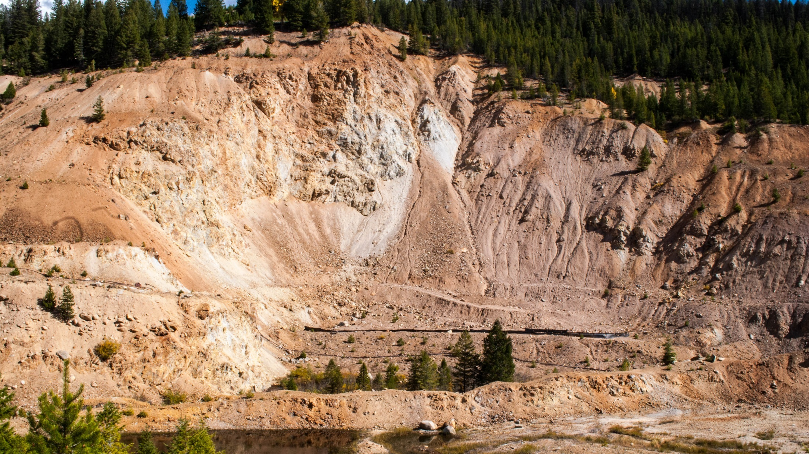
Past

Slide 24
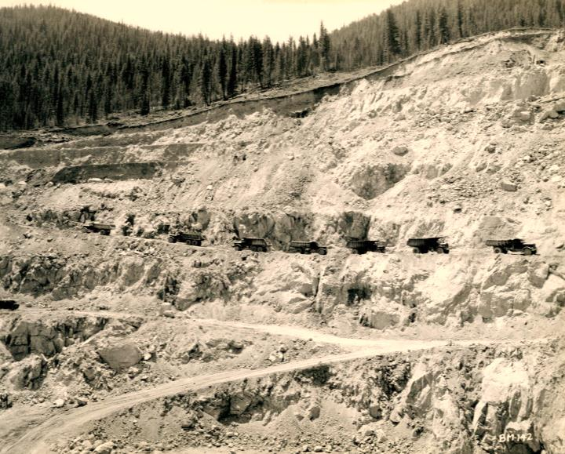
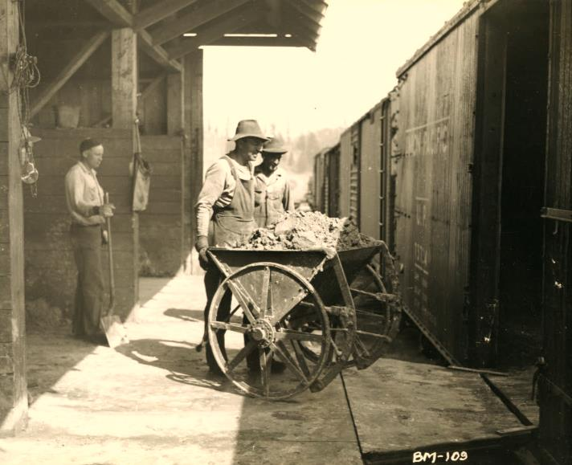
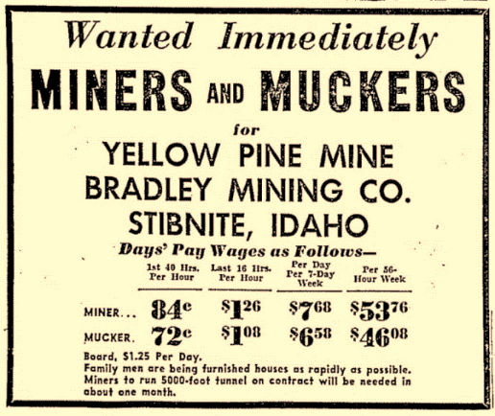
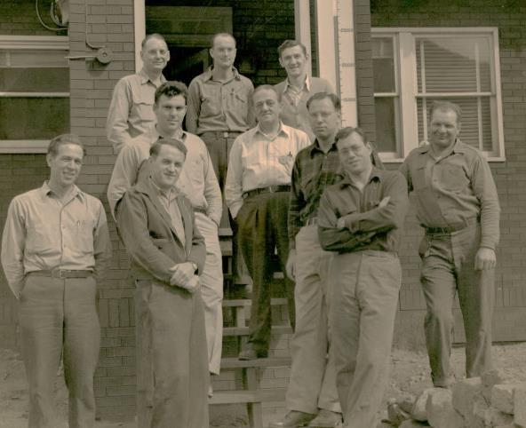
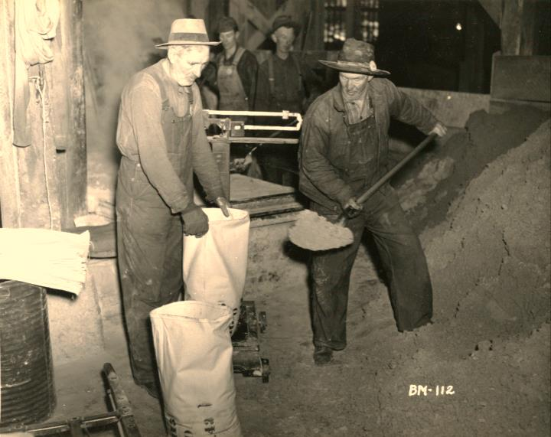
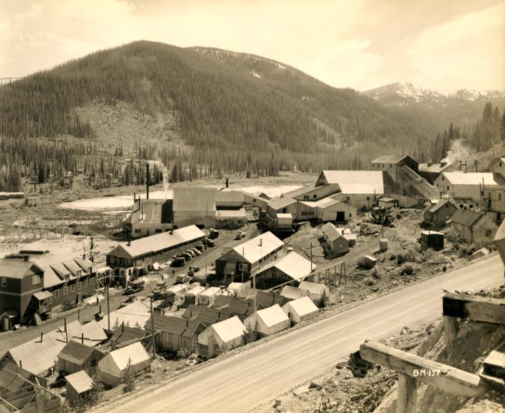
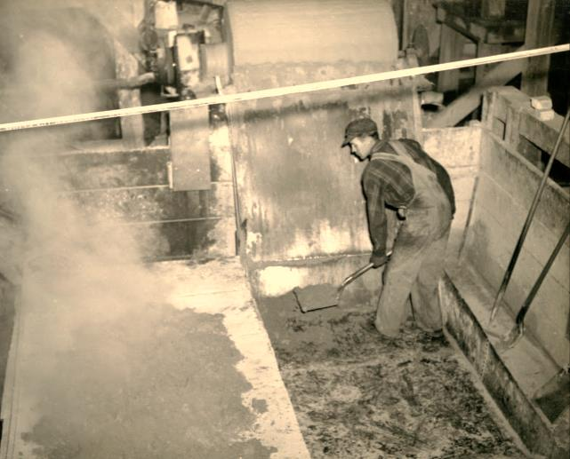
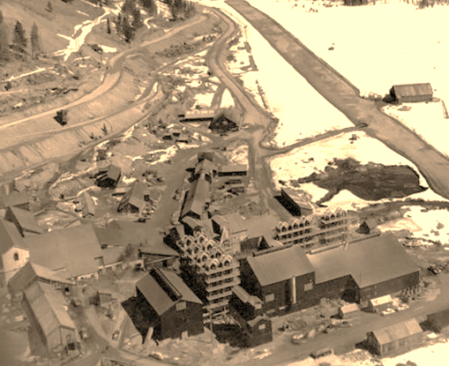
STIBNITE, IDAHO: A RICH HISTORY OF MINING

Slide 25
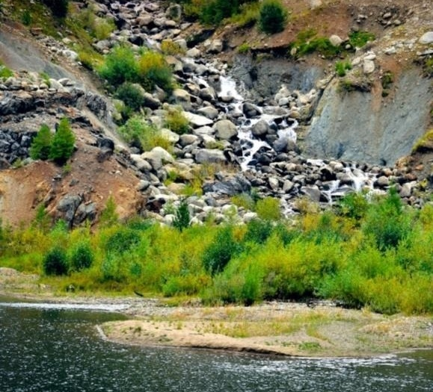
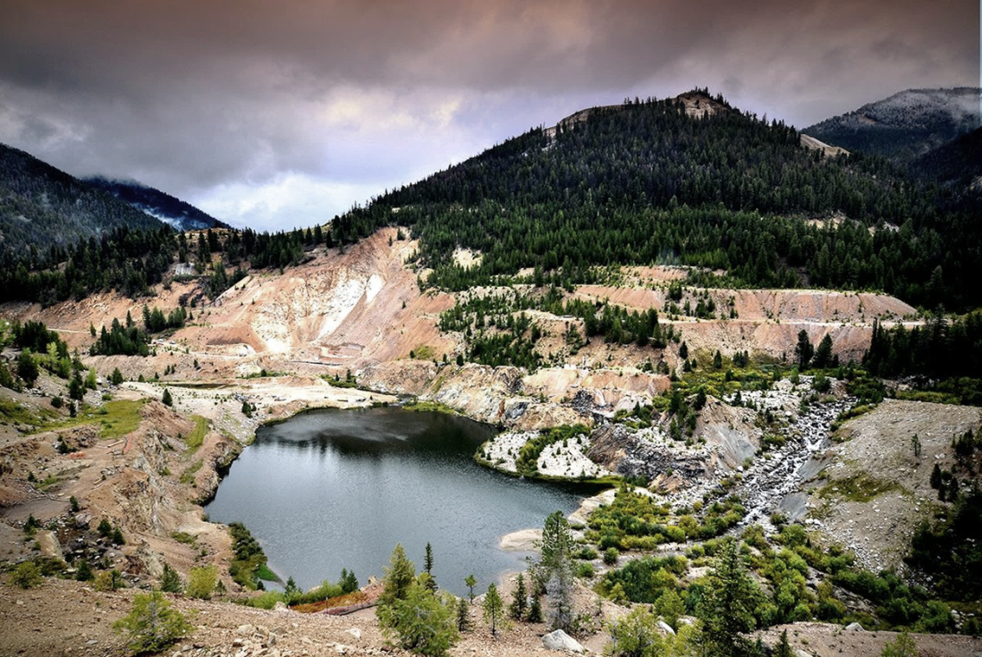
STIBNITE’S LEGACY
BROWNFIELDS SITE & RESTORATION OPPORTUNITY
Example:
Fish Passage blocked since 1938
Midas Gold would:
Restore fish passage

Slide 26
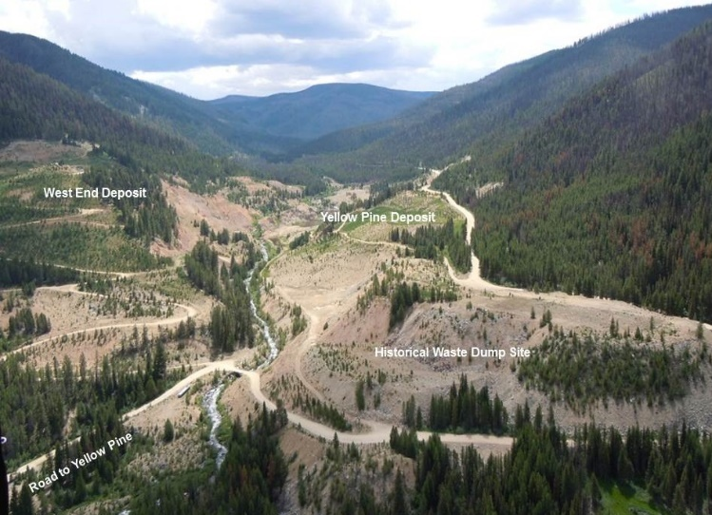
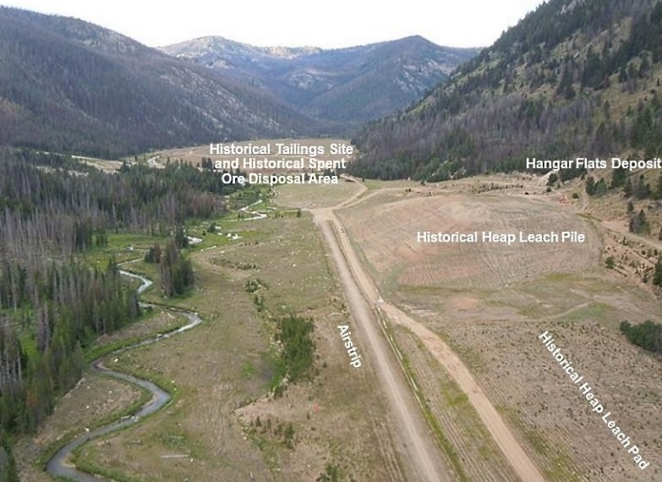
STIBNITE: RESTORING THE SITE
An economically feasible, socially & environmentally sound project…
  >$1 billion to be invested in Idaho
  ~1,000 well-paid jobs
  20-year project, including construction, operations and reclamation
…that will finance restoration at an existing brownfields site...
  Re-establish fish passage in the upper watershed
  Rehabilitate stream channels and create wetlands
  Remove and reprocess existing tailings
  Reuse existing spent ore & waste rock for new construction
  Rehabilitate historical impacts
The PFS is intended to be read as a whole and sections should not be read or relied upon out of context. The information in this presentation is subject to the assumptions, exclusions and qualifications contained in the PFS. See “Regulatory Information” at the end of this presentation.

Slide 27
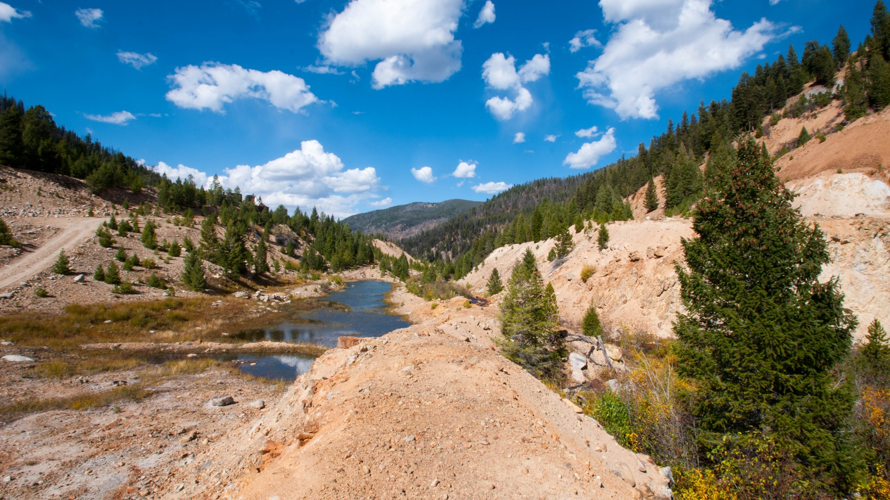
PERMITTING

Slide 28


THE PERMITTING PROCESS – MINE PLAN REVIEW
The US Forest Service generally follows a five-step process for reviewing mine plans:
Reviewing the completeness of the proposed plan
NEPA analysis of potential impacts to the environment, human health, cultural and historical resources
Approval of Mine Plan
Establish a Reclamation Bond
Authorizing Mine Operations

Slide 29
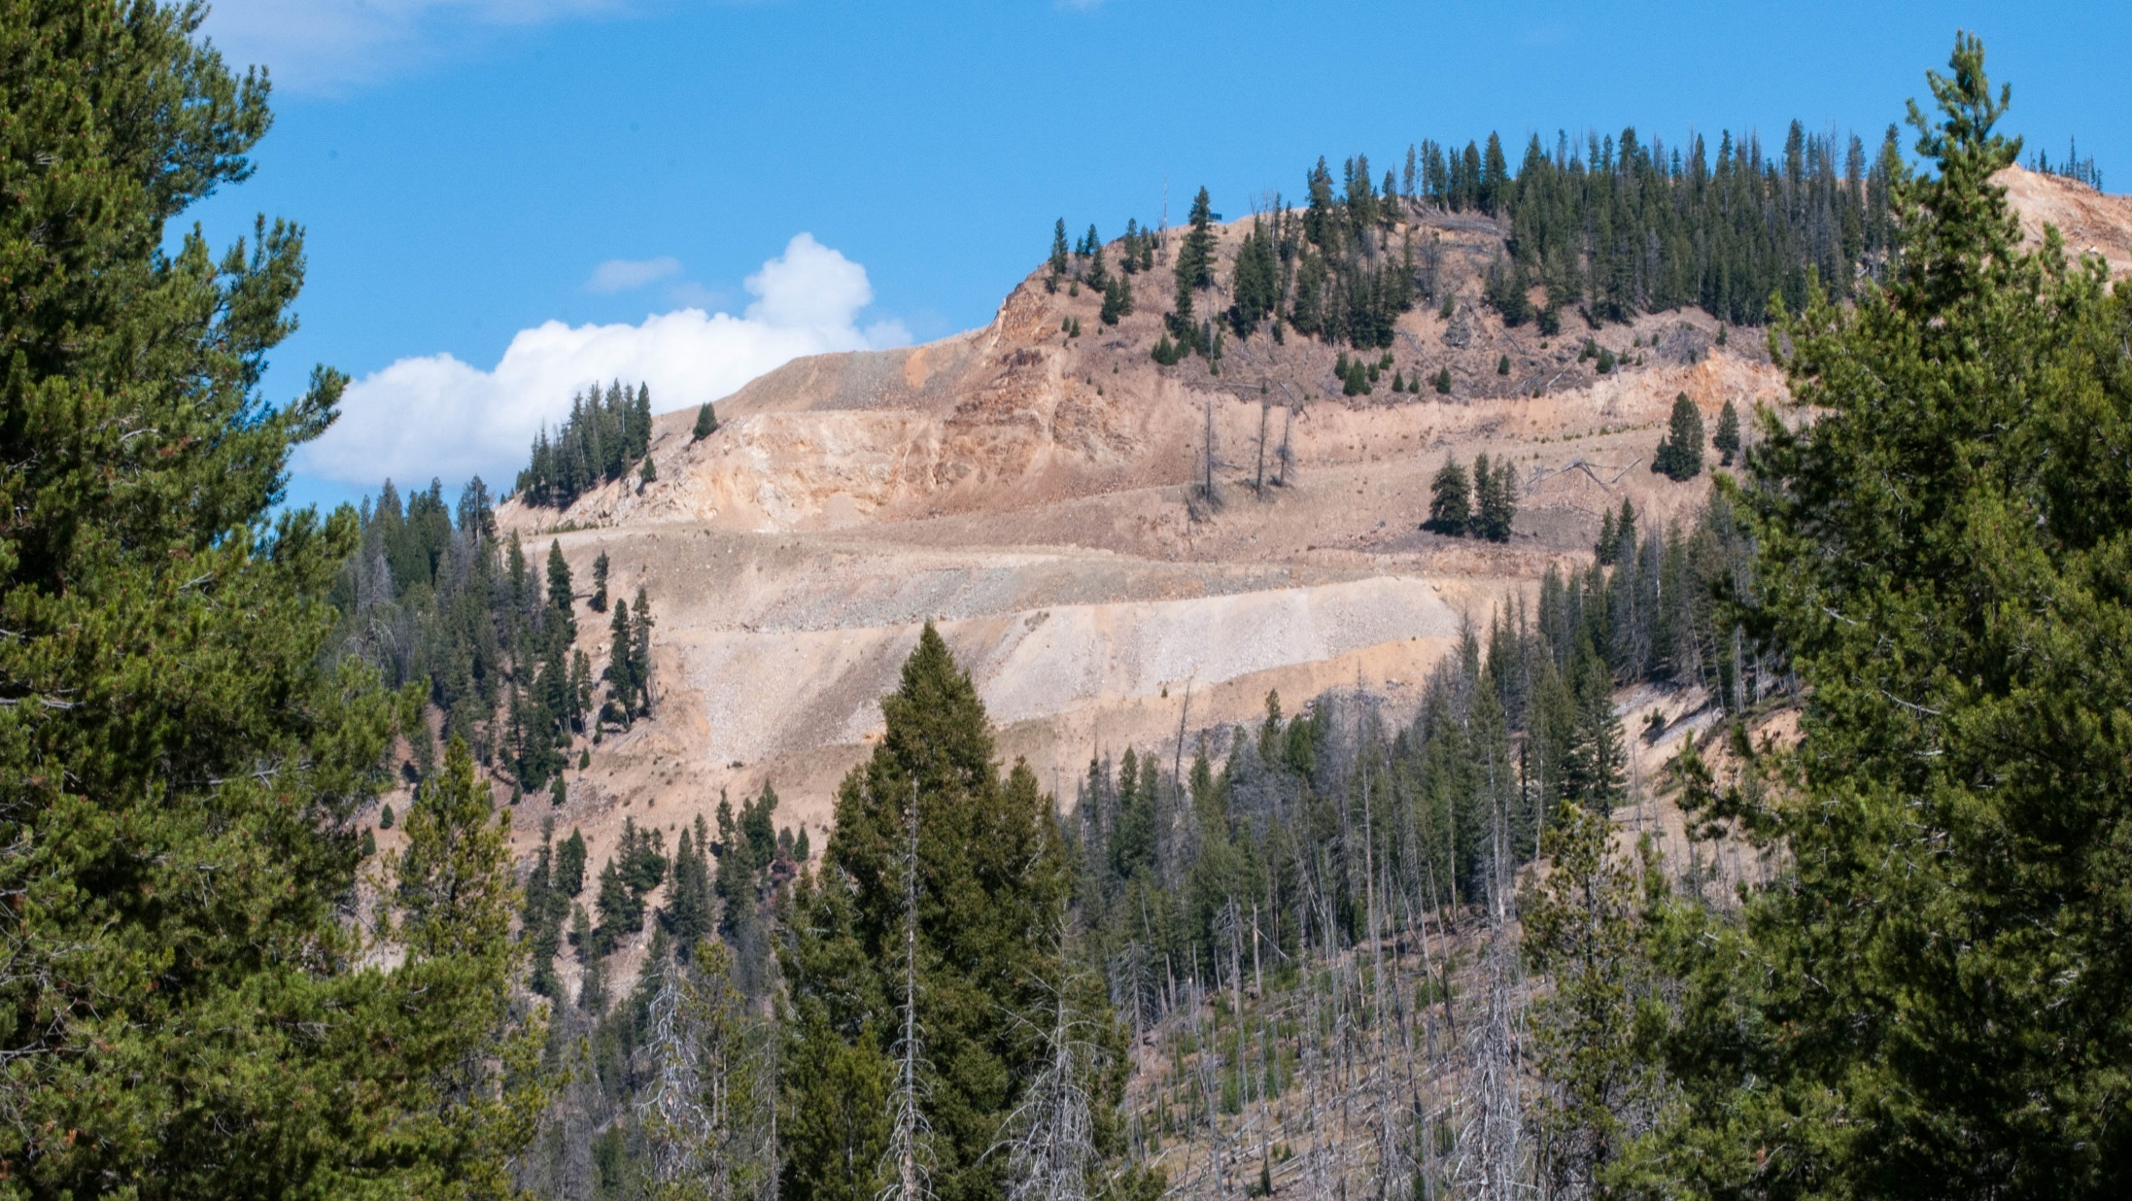
PRE-FEASIBILITY STUDY

Slide 30
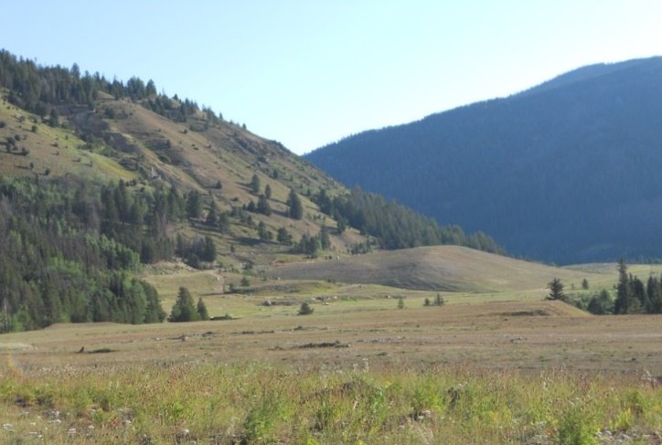
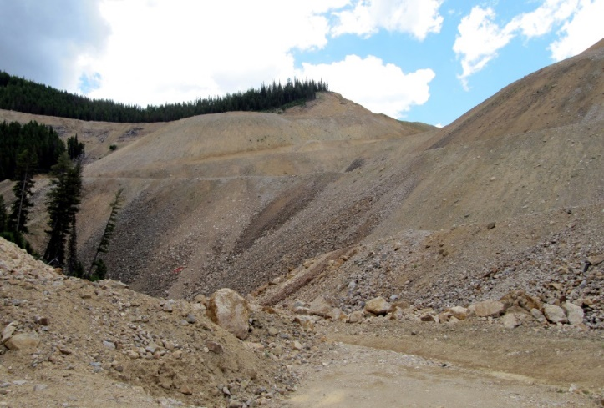
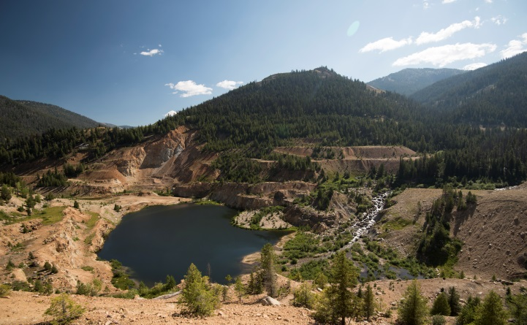
WORLD CLASS MINERAL RESOURCES AND RESERVES*
(September 10, 2014 / December 15, 2014; “M” = millions)
Totals for all deposits: PROBABLE RESERVES 4.6 Moz
included in INDICATED 5.5Moz and INFERRED 1.1 Moz RESOURCE
Yellow Pine
Hangar Flats
West End
Probable
Reserves:
2.5 Moz
1.97 g/t Au
Probable Reserves:
1.3 Moz
1.22 g/t Au
Probable Reserves:
0.7 Moz
1.53 g/t Au
Plus reserves of 102,000 oz at a grade of 1.17 g/t gold in historic tailings
* See table and disclaimers at back of the presentation and Company news release dated September 10, 2014 and December 15, 2014 for full details on the resource and reserve estimates.

Slide 31
POSITIVE PRELIMINARY FEASIBILITY STUDY (PFS) *
^{December 2014 (at $1,350 gold)}
IRR
NPV_{5%} (US$)
= $242/oz produced
22.0%
19.3%
$1,093M
$832M
pre-tax
pre-tax
Cash Costs
after-tax
after-tax
AISC
$506
AISC
$616
In this presentation, “M” = million, “k” = thousands, all amounts in US$, “LOM “ = Life-of-mine
* The PFS is intended to be read as a whole and sections should not be read or relied upon out of context. The information in this presentation is subject to the assumptions, exclusions and qualifications contained in the PFS. See “Regulatory Information” at the end of this presentation.

Slide 32
ONE OF THE LARGEST, BEST GRADE GOLD PROJECTS IN THE USA
Largest US Gold Mines
2012 Production
000s oz Gold
Largest US Gold Mine Reserves
000s oz Gold
Barrick Cortez
4th largest years 1-4
6th largest LOM
8th largest
* Stibnite Gold PFS, December 2014
Largest US Gold Resources (Measured + Indicated)
000s oz Gold
Highest Grade US Open Pit Gold Mines g/t
4th highest grade
13th largest
Source: USGS data for 2012 excluding mines/projects that are primarily copper or silver
* Based on the Stibnite Gold 2014 Pre-Feasibility Study

Slide 33
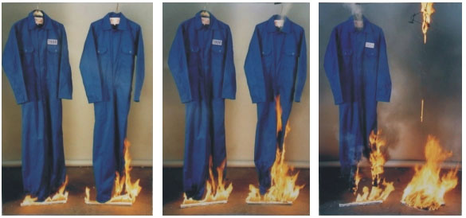
STRATEGIC BY-PRODUCTS
POTENTIAL BY-PRODUCT CREDITS FROM ANTIMONY & POSSIBLY TUNGSTEN
Supply Risk - China dominates world antimony & tungsten supply
No domestic U.S. antimony or tungsten mine production
U.S. is reliant on China for majority of its antimony & tungsten
Chinese supply is falling
Export restrictions from China since 2009
Potential for new U.S. legislation aimed at
developing U.S. production of critical minerals
Antimony Uses (USGS)
World Antimony Production 2014 (USGS)
Effectiveness of antimony flame retardant (left coverall)

Slide 34

PATH FORWARD

Slide 35

PATH FORWARD
  Regulatory process underway
  PFS completed
  Post-PFS optimization completed
  Environmental baseline data collected to support an EIS
  Project extensively discussed with local communities and stakeholders
  Plan of Restoration and Operations for mine development filed
  Management team in place
  Feasibility work underway
  Metallurgical optimization test work
  Resource optimization drilling
  Financing provides multi-year certainty
  Can complete the process
  Support of a well-funded strategic investor

Slide 36
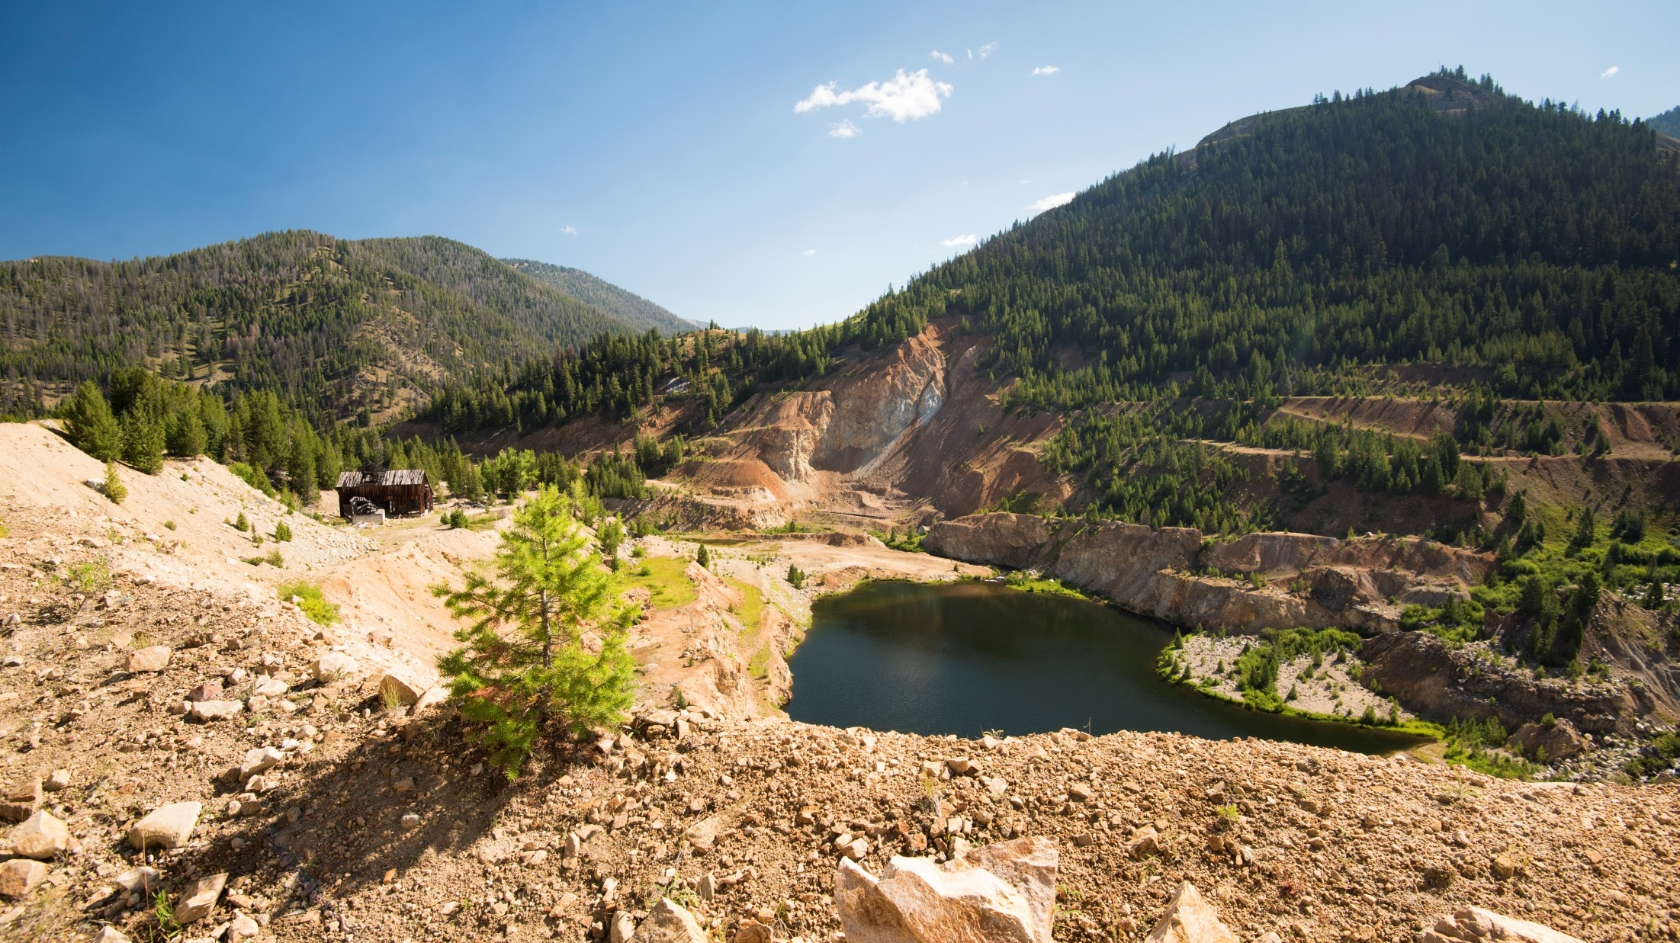
regulatory INFORMATION

Slide 37
COMPLIANCE WITH NI43-101
The technical information in this presentation (the “Technical Information”) has been approved by Stephen P. Quin, P. Geo., President & CEO of Midas Gold Corp. (together with its subsidiaries, “Midas Gold”) and a Qualified Person. Midas Gold’s exploration activities at Stibnite Gold were carried out under the supervision of Christopher Dail, C.P.G., Qualified Person and Exploration Manager and Richard Moses, C.P.G., Qualified Person and Site Operations Manager. For readers to fully understand the information in this presentation, they should read the Pre-Feasibility Study Report (available on SEDAR or at www.midasgoldcorp.com) in its entirety (the “Technical Report”), including all qualifications, assumptions and exclusions that relate to the information set out in this presentation that qualifies the Technical Information. The Technical Report is intended to be read as a whole, and sections or summaries should not be read or relied upon out of context. The technical information in the Technical Report is subject to the assumptions and qualifications contained therein.
Mineral resources that are not mineral reserves do not have demonstrated economic viability. Mineral resource estimates do not account for mineability, selectivity, mining loss and dilution. These mineral resource estimates include inferred mineral resources that are considered too speculative geologically to have economic considerations applied to them that would enable them to be categorized as mineral reserves. There is also no certainty that these Inferred mineral resources will be converted to the Measured and Indicated categories through further drilling, or into mineral reserves, once economic considerations are applied.
Section 2.3 of NI 43-101 states that: Despite paragraph (1) (a), an issuer may disclose in writing the potential quantity and grade, expressed as ranges, of a target for further exploration if the disclosure
(a) states with equal prominence that the potential quantity and grade is conceptual in nature, that there has been insufficient exploration to define a mineral resource and that it is uncertain if further exploration will result in the target being delineated as a mineral resource; and
(b) states the basis on which the disclosed potential quantity and grade has been determined.
The mineral resources and mineral reserves at the Stibnite Gold Project are contained within areas that have seen historic disturbance resulting from prior mining activities. In order for Midas Gold to advance its interests at Stibnite, the Project will be subject to a number of federal, State and local laws and regulations and will require permits to conduct its activities. However, Midas Gold is not aware of any environmental, permitting, legal or other reasons that would prevent it from advancing the project.
The PFS was compiled by M3 Engineering & Technology Corp. (“M3”) which was engaged by Midas Gold Corp.’s wholly owned subsidiary, Midas Gold, Inc. (“MGI”), to evaluate potential options for the possible redevelopment of the Stibnite Gold Project based on information available up to the date of the PFS. Givens Pursley LLP (land tenure), Kirkham Geosystems Ltd. (mineral resources), Blue Coast Metallurgy Ltd. (metallurgy), Pieterse Consulting, Inc. (autoclave), Independent Mining Consultants Inc. (mine plan and mineral reserves), Allen R. Anderson Metallurgical Engineer Inc. (recovery methods), HDR Engineering Inc. (access road), SPF Water Engineering, LLC (water rights) and Tierra Group International Ltd. (tailings, water management infrastructure and closure) also contributed to the PFS. Additional details of responsibilities are provided in the technical report filed on SEDAR in December 2014. The PFS supersedes and replaces the technical report entitled ‘Preliminary Economic Assessment Technical Report for the Golden Meadows Project, Idaho’ prepared by SRK Consulting (Canada) Inc. and dated September 21, 2012 (PEA) and that PEA should no longer be relied upon.
NON-IFRS REPORTING MEASURES
"Cash Costs", “All-in Sustaining Costs” and “Total costs” are not Performance Measures reported in accordance with International Financial Reporting Standards (“IFRS”). These performance measures are included because these statistics are key performance measures that management uses to monitor performance. Management uses these statistics to assess how the Project ranks against its peer projects and to assess the overall effectiveness and efficiency of the contemplated mining operations. These performance measures do not have a meaning within IFRS and, therefore, amounts presented may not be comparable to similar data presented by other mining companies. These performance measures should not be considered in isolation as a substitute for measures of performance in accordance with IFRS.

Slide 38


FOR MORE INFORMATION:
Tel: 778.724.4700
Fax: 604.558.4700
E-mail: info@midasgoldcorp.com
Suite 890 – 999 West Hastings Street
Vancouver, BC CANADA V6C 2W2
www.midasgoldcorp.com

