Slide 1
EXPLORATION INSIGHTS – JOE MAZUMDAR
Don’t get fooled again
Screening opportunities in the junior mining sector
Precious Metal Summit, November 2016 - Zurich and London
www.explorationinsights.com

Slide 2
EXPLORATION INSIGHTS – Joe Mazumdar
Question: What do Shakespeare’s plays have in common with investments in junior mining?

Slide 3
EXPLORATION INSIGHTS – Joe Mazumdar
Answer: A lot of tragedy
Most of the protagonists in Shakespeare’s plays had tragic or fatal flaws.
Not unlike projects being promoted by some junior mining companies, that are plagued by risks which cannot be mitigated.

Slide 4
EXPLORATION INSIGHTS – Joe Mazumdar
Tragic outcomes are not limited to junior miners
The technical/execution issues or fatal flaws that lead to tragic failures in a junior mining company can also occur in major producers.
However, their diversified portfolio can save them from a fatal consequence at the corporate level.

Slide 5
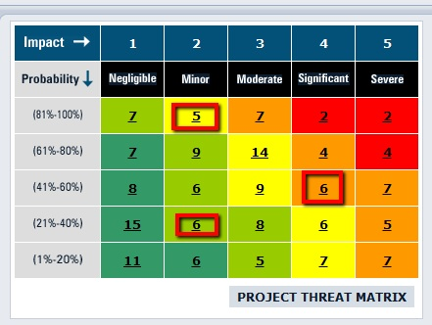
EXPLORATION INSIGHTS – Joe Mazumdar
Fatal Flaws - The Red Zone

Slide 6
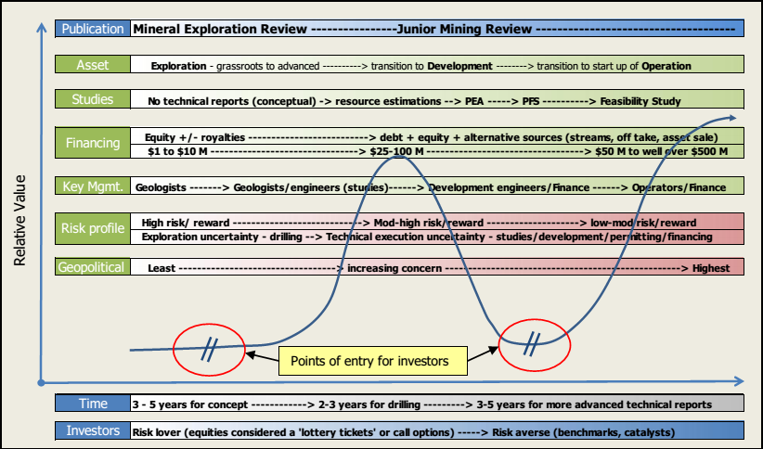
EXPLORATION INSIGHTS – Joe Mazumdar
Risk vs. Reward
You need to know where you want to be on this chart
The evolution of a junior mining play
Unknown unknowns
Known unknowns
Source: Canaccord Genuity

Slide 7
EXPLORATION INSIGHTS – Joe Mazumdar
Fatal Flaws - Sources of information
What don’t they say?
Easy to find material or not?
Good presentation or too polished?
Truly independent technical reports should provide an overview of risks and opportunities.
One-on-ones provides opportunity to evaluate mgmt.
Site visits - meet expectations?

Slide 8
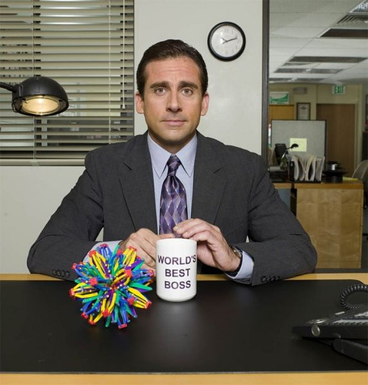
EXPLORATION INSIGHTS – Joe Mazumdar
Management Risk - In management we trust
Strategic vision
Background
Relevant experience
Board expertise
Previous success
Technical or capital markets
Stage of project, jurisdiction
G&A expenditures
Insider ownership
Change of ownership clauses
Notes:
The investors debate between supporting jockeys (management) or horses (asset) has been prevalent in the junior mining sector for decades. When it comes to a potential M&A transaction, given the amount of write-downs from the cycle, suitors are asking for more project de-risking prior to any potential transaction. A management team, which includes the executive and board members, must have the capacity to handle the de-risking.
Unfortunately, given the high probability of failure, any investor will need to look for both a solid management team and a top-tier project. An effective management team should have excellent technical skills backed by a previous history of success, relevant experience (deposit type, jurisdiction), and capital market knowledge.
A competent technical team with no capital market experience may execute a poor financing plan or sell the project too cheaply. A capital market-heavy management team may get involved in a marginal project with no hope of ever being built or acquired. Also, a management team with minimal insider ownership that considers the company a lifestyle choice is a sign the company is best avoided.
The financial acumen and relevant experience of a management team and board can be derived from public data. However, some professionals look good on paper but are, in fact, unreliable, making speaking with management at conferences or by phone remarkably useful.

Slide 9
EXPLORATION INSIGHTS – Joe Mazumdar
Technical Risk - Getting the geology right is critical
Between 2009 and 2015 Rubicon raised ~C$680 million
2013 resource at the Phoenix Gold project in Red Lake, Ontario, hosted 3.3 Moz @ 8.5-9.2 g/t Au.
In early 2016 it reported a 85-90% drop in resources (SRK).
More geologically complex with less continuity.
Weak visual indicators and a strong nugget factor.
Funded to development with equity, stream and some debt.

Slide 10
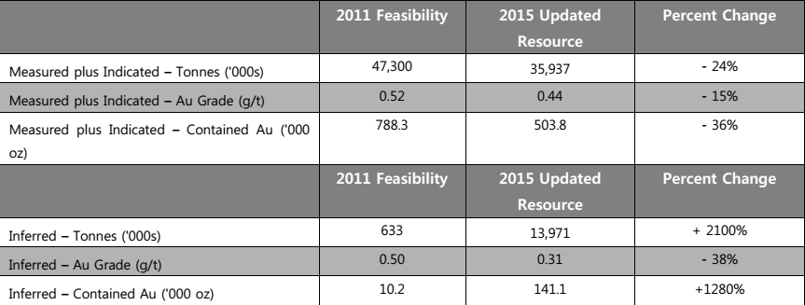
EXPLORATION INSIGHTS – Joe Mazumdar
Technical Risk - Getting the geology right is critical
The improved understanding of the geologic controls
Blast hole samples
Gold mineralization was less continuous along the trend than previously interpreted from resource drilling.
Funded to production through debt and equity.
Notes:
The improved understanding of the geologic controls on mineralization at the Pan gold project in Nevada dropped the grade and tonnes.
The variation between the production model and the 2011 FS was discovered through blast hole samples which suggested that the mineralization was less continuous along the trend than previously interpreted from resource drilling.
Funded to production through debt and equity.

Slide 11
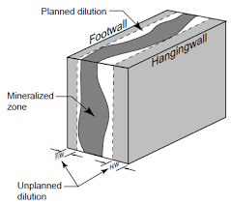
EXPLORATION INSIGHTS – Joe Mazumdar
Technical Risk - Mining dilution
Soure: McGill University

Slide 12
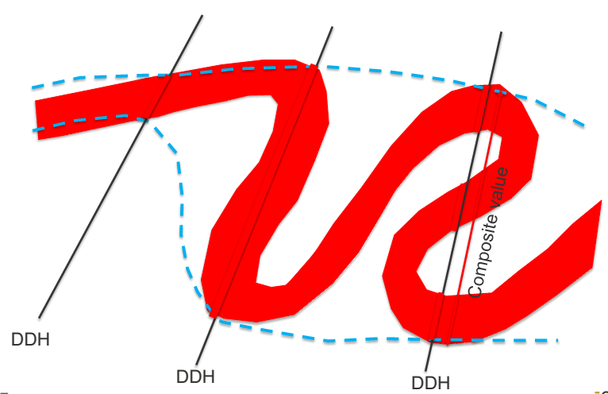
EXPLORATION INSIGHTS – Joe Mazumdar
Technical Risk - Mining dilution - Éléonore

Slide 13
EXPLORATION INSIGHTS – Joe Mazumdar
Technical Risk - Metallurgy
Allied Nevada’s Hycroft low grade (0.4 g/t Au), open pit, gold-silver deposit in Nevada
Refractory, requiring pre-oxidation of ore prior to leaching the precious metals
Autoclave was expensive and not the best solution
Lab-scale test-work of alternative methods that did not make the deposit economic
Vista Gold’s Mount Todd low-grade (0.84 g/t Au), open pit gold deposit in Australia
Very hard deposit (Bond work index of over 26 kWh/t)

Slide 14
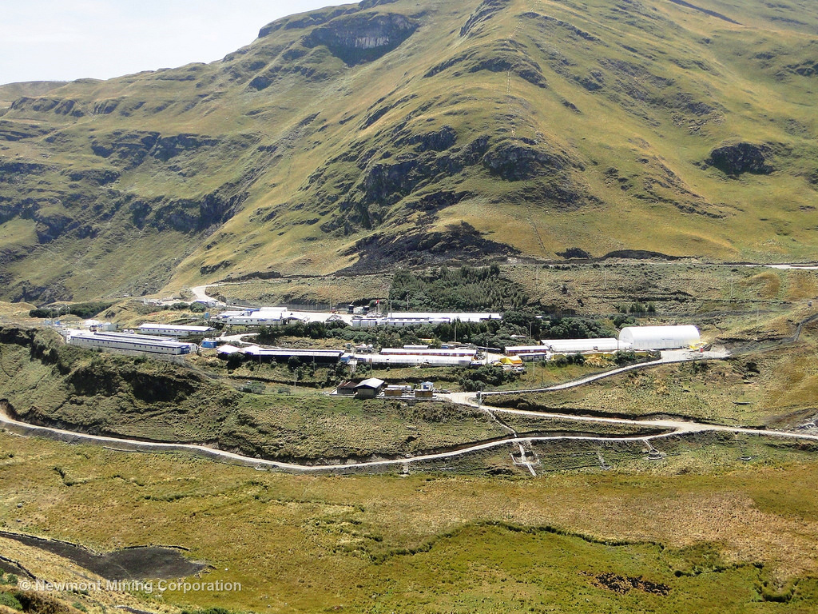
EXPLORATION INSIGHTS – Joe Mazumdar
Execution Risk - Conga removed from reserves
12.6 Moz of gold in reserves (100% basis).
Newmont removed its share (6.5 Moz) from reserves in 2015.
Notes:
6.5 Moz removed from reserves (51.35%)
12.6 Moz (100%)

Slide 15
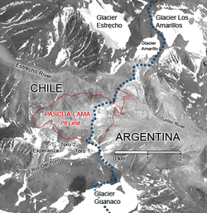
EXPLORATION INSIGHTS – Joe Mazumdar
Execution Risk - Pascua Lama hanging on to hope
15.3 Moz of gold in reserves (end of 2015)
Notes:
By the end of 2013, when Pascua Lama was temporarily suspended, Barrick Gold had recorded an impairment charge of US$6 billion and was projected to spend an additional US$300 million just to put it on care and maintenance.

Slide 16
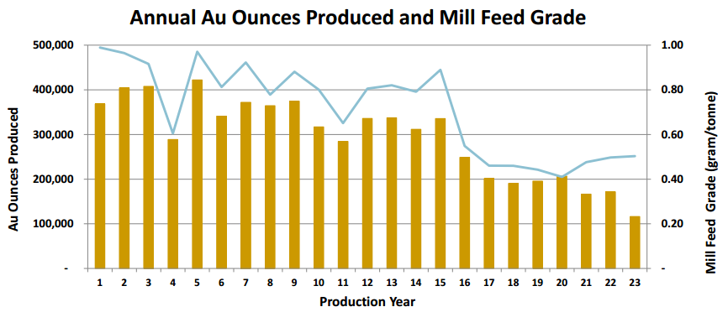
EXPLORATION INSIGHTS – Joe Mazumdar
Financing Risk – Funds to build marginal ounces
International Tower Hill’s (ITH.T)
Revised PFS for Livengood low grade (0.71 g/t Au), long life (>20 years), large (>50 kt/d, 290 koz/y) gold project
Revised (down 34%) upfront capex is US$1.84 B
After tax IRR is 0.5% and AISC is US$1,263.
ITH’s market capitalization is ~C$110 M

Slide 17
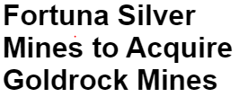
EXPLORATION INSIGHTS – Joe Mazumdar
All's Well That Ends Well
Not all Shakespeare’s plays ended in tragedy

Slide 18
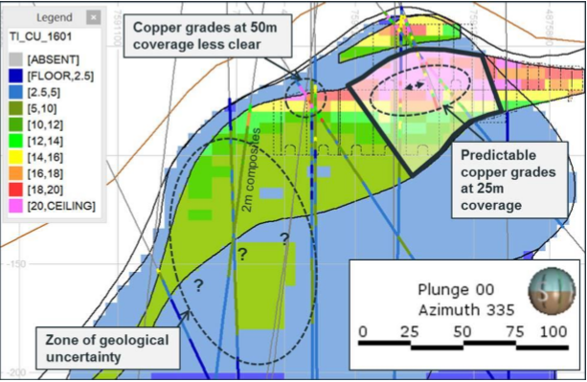
EXPLORATION INSIGHTS – Joe Mazumdar
Upper Zone of Cukaru Peki – Timok Project, Serbia
UZ hosts 1.7 Mt @ 13.5% Cu + 10.4 g/t Au (Ind.) with 35 Mt @ 2.9% Cu + 1.7 g/t Au (Inf.).
Reservoir Minerals was acquired by Nevsun (NSU.T)
EI booked a gain of 770% for a 2012 position

Slide 19
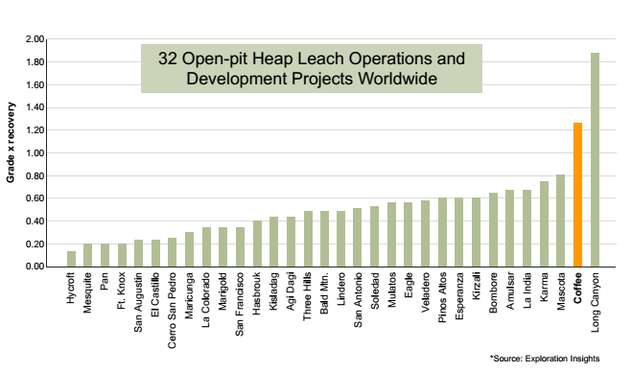
EXPLORATION INSIGHTS – Joe Mazumdar
High grade open pit, heap leachable gold – Coffee project, Yukon
Potential low cost producer with a 2-year payback of capital at US$1,150/oz gold price
Favorable jurisdiction with district scale upside.
EI booked a >250% return for EI portfolio

Slide 20
EXPLORATION INSIGHTS – Joe Mazumdar
Conclusions and Summary
Risks are part of the package for a junior mining company
High risk-to-potential reward ratio
Unknown unknowns versus known unknowns
Management need to develop a viable strategy to mitigate the risks (technical, execution, geopolitical, financing)
Some of the protagonists of Shakespeare’s tragedies had a fatal flaw that sealed their fates
In the case of a mining project, an extreme risk or fatal flaw has a high potential impact and an elevated probability of occurring (red zone on a risk heat chart)
A fatal flaw will likely end the project’s chances of advancing
An investor’s ability to recognize fatal flaws ahead of the crowd is the critical element to profiting in the high risk junior mining sector
Focus on reality and avoid highly promoted stories that verge on the ‘too good to be true’

Slide 21
EXPLORATION INSIGHTS – Joe Mazumdar
Exploration Insights
At Exploration Insight, we attempt to differentiate ourselves by providing independent, unbiased opinions - which may be incorrect as we are subject to the limitations of being human.
Our opinions (Brent Cook and Joe Mazumdar) are based on decades of international experience, not only with companies on a technical/field and corporate basis, but also with sell-side and buy-side firms.
In the end, our due diligence forms the foundation of our buying and/or selling (and avoiding), so we have “skin in the game”.
What a subscriber does with this information is really up to them.
Questions?
“Turning Rocks Into Money”

